Slide 1
Back Calculation of Rock Mass Modulus using Finite Element Code (COMSOL)
EGEE 520
Spring Semester, 09
Speaker: Amirreza Ghasemi

Slide 2
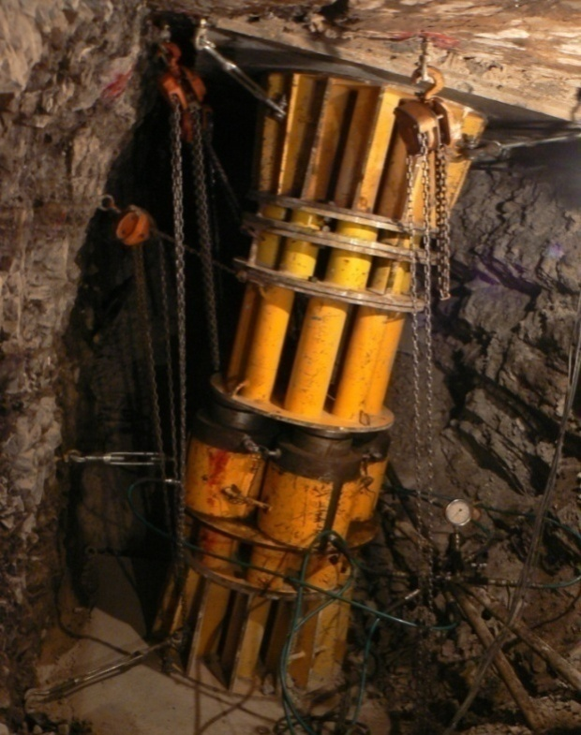
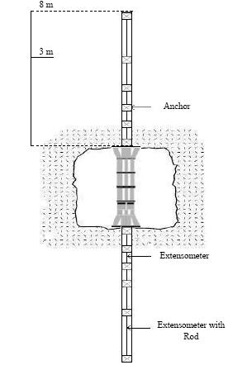
Rigid Plate Load Test
There are two main methods to calculate rock mass modulus:
ASTM Standard
UNAL Method

Slide 3
Governing Equations
VW_{I} = VW_{E}
VW_{E}= Boundary forces (f) × Boundary Displacements (virtual) (u)
VW_{I} = Body strain resulting from virtual displacement (ɛ) × Stress change due to boundary conditions (σ)
f = K u
K= ∫_{v} a^{T}.D.a.dv

Slide 4
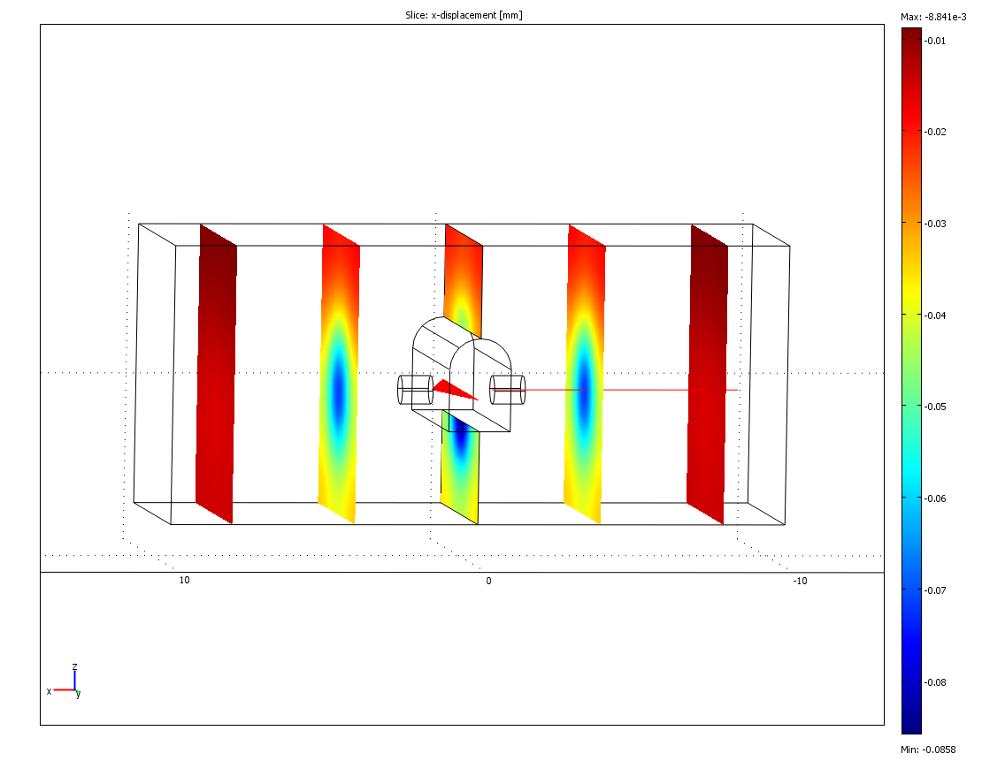
Solution

Slide 5
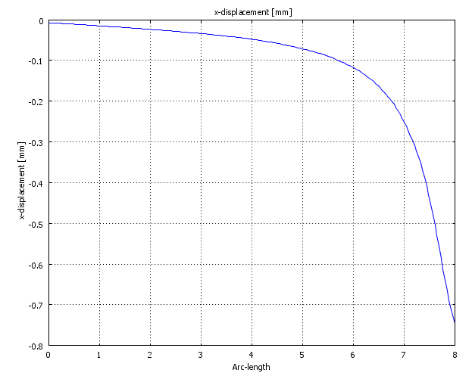
Validatioan
20 GPa | 0.796 mm
? | 0.9022 mm
?= 0.796/0.9022 * 20 = 17.6

Slide 6
Rock Mass Modulus Results
 | ASTM | UNAL | COMSOL
Min. | 1 | 0.5 | 0.6
Max. | 46 | 39 | 39.0
Mean | 12.6 | 12.4 | 12.6
Median | 10 | 8 | 9.0
Mode | 7 | 3 | 6.0
STD. | 9.1 | 10.2 | 9.9
Skewness | 1.1 | 0.9 | 0.9
Count | 69 | 69 | 69

Slide 7
Parametric Study
 | ν= 0.2 | ν= 0.25 | ν= 0.3 (Base Case) | ν= 0.35
Min. | 0.6 | 0.6 | 0.6 | 0.5
Max. | 42.1 | 40.9 | 39.0 | 37.7
Mean | 13.5 | 13.1 | 12.6 | 12.1
Median | 9.4 | 9.2 | 9.0 | 8.4
Mode | 8 | 5 | 6.0 | 6
STD. | 10.5 | 10.3 | 9.9 | 9.4
Skewness | 0.9 | 0.9 | 0.9 | 0.9
Count | 69 | 69 | 69 | 69

Slide 8
Conclusion
Results from ASTM, Unal, and COMSOL show very good consistency between different methods.
Sensitivity analysis shows that Rock mass modulus is not very sensitive to change in Poisson's ratio.

