Slide 1
Tarmat Layer Geo-mechanical Behavior under Producing Oilfield
EGEE 520
April 28, 2009
Mohammed AlAbbad

Slide 2
Introduction
Tarmat layers posses their importance since they usually exist at the bottom of oil column reservoirs and hence act as a barrier from the underneath water supporting layer.
In oil fields Several attempts were done to either frac this layer, drill several wells to make communication or at least drillings injectors just few foots above this layer.
Hence, studying the geomechanical behavior of this layer is important to investigate the degree of the deformation in that layer.

Slide 3
Governing Equations
Fluid flow Equation: single phase & incompressible
Applying Darcy’s Law
The mechanical governing equation:
Total stress tensor
Solid velocity wrt fixed system
infinitesimal strain
infinitesimal strain rate
Average Rock porosity

Slide 4
Model Formulation
Chemical Engineering Module → Momentum balance → Darcy law
Structural Mechanic Module → plain strain
HR reservoir
Tarmat
3D to 2D
Aquifer

Slide 5
COMSOL Solution
Pressure distribution captured
Effect of pressure differential on the rock displacement

Slide 6
COMSOL Solution
Change of middle layer permeability due to strain effect

Slide 7
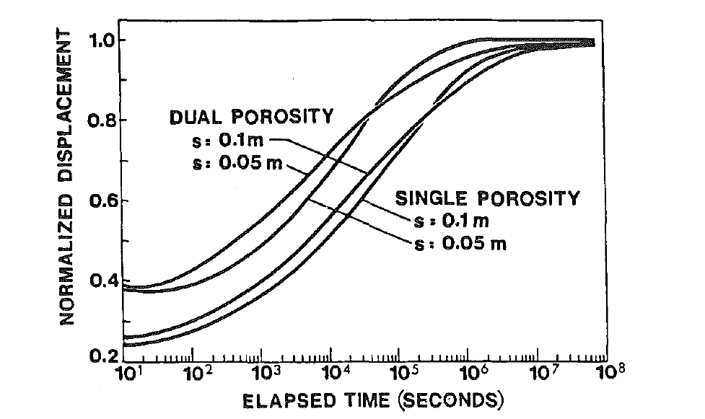
Model Validation
(a) Surface displacement response at centerline (from Elsworth) at various times.
(b) COMSOL displacement distribution with changing the pressure difference.
Elsworth, Journal of Geotechnical Engineering-ASCE, 1992, 118, (1), 107-124.

Slide 8
Parametric Study
Displacement at center layer vs. pressure at bottom layer for different Modulus.

Slide 9
Conclusions
The model developed for this study qualitatively described the behavior of the rock displacement due to fluid flow/mechanical interactions as expected
Most of the physical parameters used in this study, although realistic, were chosen arbitrary.
It is important to use specific rock parameter in order to access the stability of the model.

