Slide 1
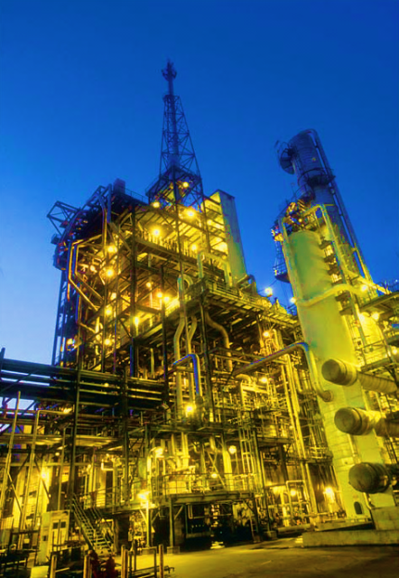
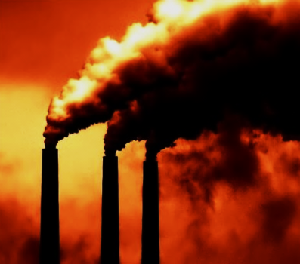
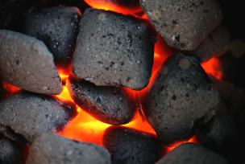
Coal Conversion and Utilization for Reducing C CO₂ Emission
Chenxi Sun
Ruthut Lapudomlert
Sukanya Thepwatee

Slide 2
Problem statement
This project will examine oxy-co-gasification method and Ion Transport Membrane for an Integrated Gasification Combined Cycle (IGCC) power plant incorporates the highest potential technology for carbon capture.
Objective
Enhance power generation and reduce CO₂ emissions from an IGCC power plant using co- gasification of coal and biomass. Reduce production cost by introducing new gas separation technology (Ion Transport Membrane). Reduce pollutant emissions using CO₂and H₂S co-capture.

Slide 3
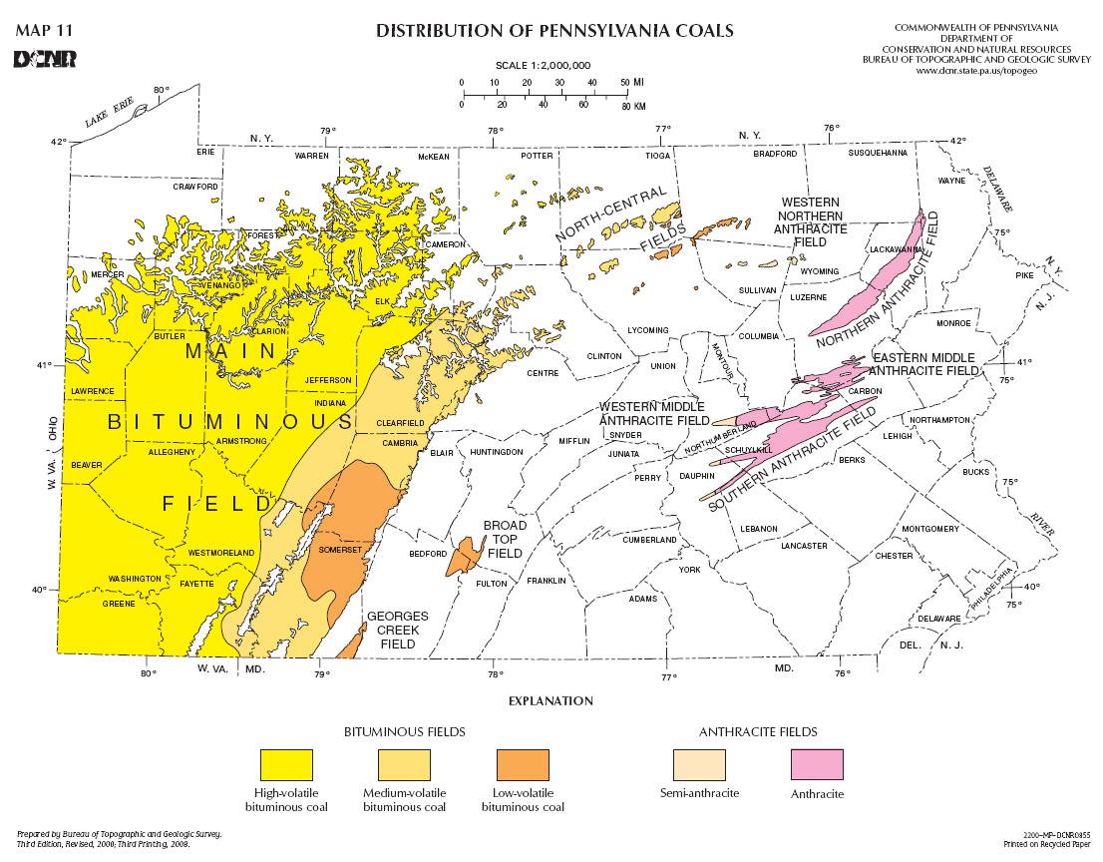
Plant location
Location: Pittsburgh
Plant size:
122 Mwe.
Coal usage:
Bituminous
764 TPD
98% (64 million ton/y)
2% (1.6 million ton/y)

Slide 4
Why IGCC?
proven lowest NOx, SOx, particulate matter and hazardous air pollutants
Less water consumption and waste
Low cost electricity for economic growth
Market barrier
Currently higher capital and operating costs relative to supercritical boilers
(2400- 3000+ $/kW)
Standard designs and guarantee packages not yet fully developed
“Official US government figures give more optimistic estimates of $1,491/kW for a conventional clean coal facility”
Ref.: Coal and oil, John Tabak, 2009. pg. 66, 2).Clean Air Task Force
http://www.eia.doe.gov/oiaf/aeo/assumption/pdf/electricity.pdf#page=3

Slide 5
Coal-biomass IGCC power plant
circulating fluidized-bed gasifier
H₂S and CO₂
Co- capture
H₂-rich fuel
H₂
Water-gas shift reactor
H₂
Transportation fuels
Coal
Gases
H₂S + CO₂
Fuel cell
Biomass
H₂
Electric power
Combustion turbine
CO₂
Air
Combined cycle
Non-permeated gas
Solids
O₂
I
TM
Electric power
Air
Exhaust
Water
Steam
Heat recovery
Steam generator
Exhaust
Marketable
solid byproducts
Steam turbine
Electric power

Slide 6
Analysis for coal & biomass
 | Coal (Pitt 8#) | Wood (Pine Tree)
Proximate Analysis (wt%)
Fixed Carbon | 0.524 | 0.16652
Volatile Matter | 0.352 | 0.70196
Moisture | 0.024 | 0.08
Ash | 0.1 | 0.05152
Ultimate analysis (wt%) |  | 1
Carbon | 0.833 | 0.528
Oxygen | 0.083 | 0.392
Hydrogen | 0.057 | 0.057
Nitrogen | 0.014 | 0.022
Sulphur | 0.013 | 0.0009
Ash | 0 | 0.056
Lower Heating vlaue (KJ/Kg)
LHV | 30410 | 16365

Slide 7
Feedstock and gasifier
Biomass co-gasification
Competitive price compare to coal.
Biomass can increase the gasification efficiency as well as reduce the CO2 emission.
Circulating fluidized-bed gasifier
Can accept a variety of feeds, in different shapes and densities.
Investment fit for small or mid-sized power plants.
O₂/CO₂ as oxidant gas
increase coal conversion ratio.
Increase gasification efficiency.
Decrease the consumption for Oxygen(6ton/MW per day).
circulating fluidized-bed gasifier
Water-gas shift reactor
Coal
Gases
Biomass
CO₂
Solids
O₂
ITM
Steam
Marketable
solid byproducts

Slide 8
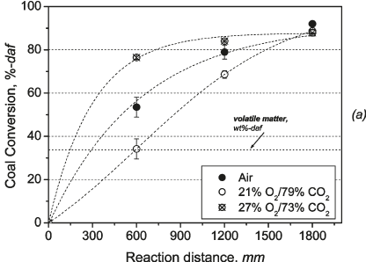
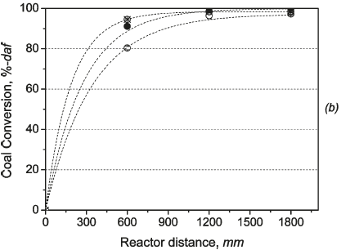
Gasification with O₂/CO₂
Gasification with O₂/CO₂ can get better coal conversion rate than air only. But this result is not compared with Oxygen gasification.
Coal conversion rate as a function of reaction distance for the temperature of 800℃ (a) and 1000℃ (b)

Slide 9
Water-gas shift reaction
Water-gas shift reaction:
CO + H2O ←→ CO2 + H2, ΔH = −41.1kJmol⁻¹
In this reaction, higher CO conversions are favored at lower temperatures.
Fe/Cr oxide catalysts are applied at a reactor inlet temperature of 300–360◦C and a total pressure between 10 and 60 bar.
About 97% of CO is converted to CO₂ by this reaction. After pre-combustion CO₂ capture, mainly H₂ is left for combustion and steam is the final product.

Slide 10
Gasifier modeling
Volatilization is the decomposition of coal/biomass into volatiles and char:
CH_{hf}O_{of}N_{nf}S_{sf}(H₂O)_{w}Z→CH_{h}O_{o}N_{n}S_{s}Z+V+wH₂O
Char particles react with gas:
Combustion
Char+aO₂→bCO+cCO₂+dH₂O+eH₂S+fN₂
Boudouard reaction
Char+CO₂→2CO+(o/2)H₂O+(h/2-s-o)H₂+sH₂S+(n/2)N₂
Steam gasification
Char+(1+o)H₂O→CO+(1-o+h/2-s)H₂+sH₂S+(n/2)N₂
Methane reforming
Char+(2+o+s-h/2)H₂→CH₄+oH₂O+sH₂S+(n/2)N₂

Slide 11
Oxy-co-gasification modeling
Equivalence ratio for gasification, oxygen needed for per 100kg feedstock, gasification efficiency and temperature.
 | Coal | 10%Biomass (wt%) | 20%Biomass (wt%)
Combustion
LHV (KJ/Kg) | 30410 | 29005 | 27601
Oxygen (mole/100kg) | 6.4208 | 5.9983 | 5.5942
Gasification
Oxygen (mole/Kg) | 24.737 | 22.3 | 19.971
Equivalence Ratio | 2.5956 | 2.6898 | 2.8011
Gasification Efficiency | 0.6968 | 0.6968 | 0.6982
Temperature (ºC) | 1100.27 | 885.12 | 652.72
Need For Feedstock for a 122MWe Power Plant (Energy efficiency 40%)
Coal/Biomass (TPD) | 874 | 818/91 | 764/191

Slide 12
10%Biomass
CO2 concentration 0%-50%
20%Biomass

Slide 13
10%Biomass 10%CO2
Effect of different steam/coal ratio
10%Biomass 20%CO2

Slide 14
20%Biomass 10%CO2
Effect of different steam/coal ratio
20%Biomass 20%CO2

Slide 15
Gasifier Pressure 1-30bar
20%Biomass 10%CO2
20%Biomass 20%CO2

Slide 16
20%Biomass 10%CO2
Gasifier Temperature 750-1300 ℃
20%Biomass 20%CO2

Slide 17
Gas Separation- ITM (Ion Transport Membrane) Technology

Slide 18
Goals for Oxygen supply
Supply large amount of Oxygen
High purity to gasifier unit
Low production cost (gas separation)
http://www.fossil.energy.gov/programs/powersystems/gasification/howgasificationworks.html

Slide 19
Gas Separation
Gas Separation
Cryogenic distillation
Air Separation Unit
Non- Cryogenic distillation
Ion transport Membrane
Molecular sieve adsorbents
Polymeric
Membrane
Renewable and Sustainable Energy Reviews 15 (2011) 1284-1293

Slide 20
Non-Cryogenic
 | Ion transport Membrane | Molecular sieve adsorbents | Polymeric Membrane
Production range | Large , up to 3000 Tons per day | Less than 150 Tons per day (small plant) | Less than 20 Tons per day
Purity (vol.%) | 99+ - 100% | 93-95% | approx. 40%
Status | developing | semi-mature | Semi-mature
Others | operate at high temperature i.e. 800-900 ºc | bed volume control capital cost | poor chemical resistance, limited temperature
Fuel Processing Technology 70(2001) 115-134
Membrane Technology No. 110, Mixed conducting ceramic membranes for gas separation and reaction

Slide 21
Candidates: ASU VS ITM
ASU
Maturity, produce tonnage of O2, high purity
Consume large fraction of the plant internal energy ie.15% of IGCC capital cost
Few possibilities to provide step-change cost reduction
ITM
25-30% reduction in capital requirements over conventional cryogenic oxygen plants e.g. cooling cost.
30% reduction in operation cost for oxygen
35-60% reduction in power consumption
Can be integrated with high-temperature processes to produce electrical power and/or steam from air
Compact design

Slide 22
How ITM works?
Solid state diffusion of
Oxygen anion through
Mixed conductors
O2 from air feed adsorbs onto the surface, where it dissociates and ionizes by electron transfer from membrane
O²⁻ fill vacancies in the lattice structure, diffuse through the membrane under O2 chemical- potential gradient (applied by maintaining difference in O2 partial pressure on opposite sides)
O²⁻ release electrons, recombine, and desorbs from surface as O2 molecule
O2 flux α (1/L)ln(Phigh/Plow)
>> Thin film
Cryogenics& Ceramic Membrane, 4th European Gasification Conference
Notes:
Electronic countercurrent accompanies O2 anion transport- no need external circiut

Slide 23
Integrated: ITM + IGCC
Thermal activated: heating air feed from gas turbine
Hot air from combustion turbine (800-900 ˚C) is fed to ITM → high purity O₂ → Gasifier.
Non-permeated gas from ITM is heated before being transported into the turbine unit.
Note: Supplemented air compressor adds sufficient air to replace the O₂ removed by this process cycle.
Solid State Ionics 134 (2000) 21-33

Slide 24
ITM Design- Membrane type
Mixed conducting ceramic membrane
Doped compound
Different in electronic and ionic conductivity
Classified based on the following oxide
1. Sr(Co,Fe)O3−δ (SCFO)
High Oxygen ionic conductivity and oxygen permeability
2. La(Co,Fe)O3−δ(LCFO)
high oxygen ionic conductivity and but low oxygen permeability
3. LaGaO3(LGO)
low electronic conductivity
Ceramic Membranes for Separation and Reaction, Kang Li, Chapter 6
Journal of the European Ceramic Society 29 (2009) 2815- 2822

Slide 25
ITM Structure
SrCo0.9Sc0.1O3-δ
Disk- shaped membrane | Hollow-fiber ceramic membrane
Easy to fabricate | More complicate technique e.g. sintering
Provide limited area of O2 permeation | Large membrane area per unit volume
High electrochemical transport resistance | Less membrane resistance to oxygen transfer
NETL, The Energy Lab
AIChE Journal, July 2002 Vol. 48,No.7
Jiangsu Jiuwu Hitech CO.,LTD
CEPAratiom, partners in filtration

Slide 26
Performance Analysis
Effect of flow patterns
At same temperature, co-current flow exhibits higher oxygen productivity compared to countercurrent flow pattern when the vacuum pressure is less than 0.05 atm.
AIChE Journal, July 2002 Vol. 48,No.7

Slide 27
ITM-Design
Flow Pattern : Co-Current flow
Material balance
Overall: N_{f} = N_{O2}+ N_{R}
Oxygen: 0.21N_{f} = N_{O2}[p’_{o2}/P]+ N_{R}
Ceramic Membranes for Separation and Reaction, Kang Li, Chapter 6
AIChE Journal, July 2002 Vol. 48,No.7

Slide 28
ITM-Design
Oxygen flux
Where
Ceramic Membranes for Separation and Reaction, Kang Li, Chapter 6
AIChE Journal, July 2002 Vol. 48,No.7

Slide 29
ITM- Design Parameters
Design Parameters
Temperature (˚C) | T= 900 (exhibit high stability)
Thickness (mm) | h = 0.62 (thin, high flux)
Outer radius (mm) | Rout =2.35
Inner radius (mm) | Rin = 1.73
Length (cm) | L = 30
Air feed flow rate (mol/s) | F = 200 mL/min
Pressure at shell side | Ps = 1 atm
Pressure at lumen side | Pl = 0.01 atm
Diffusivity of oxygen vacancy (cm^2/s) | Dv = 1.58x10^-2 exp(-8852.5/T)
Forward reaction rate constant (cm/atm^0.5*s) | kf = 5.9x10^6 exp(-27291/T)
Reverse reaction rate constant (mol/cm^2*s) | Kr = 2.07x10^4 exp(-29023/T)
Oxygen flux (ml/cm^2*min) | Jo2 = 4.41
f
Journal of the European Ceramic Society 29 (2009) 2815-2822
AIChE Journal, July 2002 Vol. 48,No. 7

Slide 30
ITM- Design
Plant size (Mwe) | 122
Feed stock (TPD) | 800-900
Oxygen (TPD) | 700
JO2 = 3.28x10^-6 mol/cm^2*s (D=1.429 g/L, MW =32)
Calculate oxygen amount per day
O2 = 90685.44 g/ m^2 per day
Total membrane area to produce 700 TPD O2
(700x1000000)/90685.44 = 7718.9 m^2
Ceramic membrane cost is $1000/m^2
Total membrane cost = $7,718,900
Number of fiber tube ( 0.00427 m^2/unit)
N = 7718.9/0.00427 = 1807704.92
http://www.usbr.gov/pmts/water/media/pdfs/report040.pdf

Slide 31
ITM – Economic Consideration
Using Linear extrapolation from reported data set we get:
ITM Cost per kW
Cost = 15437800/(122x1000) = 127 $/kW
Cost | O₂ 700 TPD | USD
Air compression | 17% | 2,624,426
Separation part | 50% | 7,718,900
Product compression | 33% | 5,094,474
Total ITM cost | 100% | 15,437,800
Air separation unit integration for alternative fuel projects

Slide 32
ITM VS ASU in IGCC Power Plant
Factors | ASU | ITM-O2 | % Change
Illinios#6 Coal (TPD) | 3180 | 3176 | 0.125
Oxygen (TPD) | 2565 (95%) | 2420 (99+%) | 5.6
Power production (MW) | 409 | 420 | 2.7
Power plant capital investment ($/kW) | 1567 | 1453 | 7.3
Gas separation capital investment ($million) | 60.2 | 41.6 | 31
Gas separation capital investment ($/kw) | 147.2 | 99.1 | 32
Thermal efficiency | 45.2 | 46.5 | 2.9
Solid State Ionics 134 (2000) 21-33

Slide 33
ITM Economics and Concerns
Development project by Air Products/ U.S. Department of Energy/ Ceramatec Inc.
Phase1:
- Construction of oxygen technology development unit for process concept validation test
- re-confirm expected commercial economics to address market requirements.
Phase2:
Demonstrate scale-up to commercial scale.
Expected : 1000 TPD to be available to the market near the end of the decade.
YEARS | O2 Production (TPD)
2006-2008 | 5-50
2008-2009 | 100
2009-201x | 1000
Concerns:
Size of ITM unit to supply sufficient O2 to the system.
e.g. 458 Mw Power Plant size need 3200 TPD of O2
- Compression cost for pressurized air.

Slide 34
CO₂ capture

Slide 35
CO₂ capture
Coal plant performance targets include:
90% CO₂ capture
<10% increase in IGCC COE with CCS
Post-combustion
Oxyfuel-combustion
Pre-combustion
Chemical
absorption
Physical
absorption
Co-capture
(H₂S/CO₂)
and
Separated
capture
MEA
Selexol
&
Ionic liquid

Slide 36
Post-combustion
Steam
turbines
Power
N₂
Boiler
200 ˚C,15 psi
Air
Fuel
CO₂
capture
CO₂
Flue gas
N₂ (70%)
CO₂ (3-15%)
Capture the CO₂ from the exhaust gas
Monoethanolamine (MEA): a wildly used capture technology
Allow retrofit at existing facilities

Slide 37
Oxyfuel-combustion
Fuel
Air
separation
O₂
Boiler
CO₂+H₂O
Condensation
Air
CO₂
N₂
H₂O
Use O₂ instead of air for fuel combustion
Flue gas is mainly H₂O and CO₂, which is readily captured
Produce high CO₂ content (> 80 vol%) flue gas
Power consumption of air separation unit is high, which impact on the overall efficiency of the power plant

Slide 38
Pre-combustion
N₂
CO₂
Air
Air
separation
O₂
400 ˚C,
950 psi
Gasifier
/shift
Syn gas
H_{2,} CO₂ (40%)
CO₂
capture
H₂
Combustion
turbine
Power
Fuel
Air
Steam
cycle
Heat
Fuel is reacted w/ either O₂ or steam
Water-gas-shift reactor is used to convert CO to CO₂ which is readily captures
Physical absorption: Selexol
Relevant for IGCC
Proven industrial-scale technology

Slide 39
MIT estimates of additional costs of selected carbon capture technology (percent increase in electric generating costs on levelized basis).
 | New construction | Retrofit*
Post-combustion (MEA) | 60-70% | 220-250%
Pre-combustion (IGCC) | 22-25% | Not applicable
Oxy-fuel combustion | 46% | 170-206%
* Assumes capital costs have been fully amortized.
CRS report for congress, 2008
Notes:
http://www.fas.org/sgp/crs/misc/RL34621.pdf

Slide 40
CO₂ capture
Coal plant performance targets include:
90% CO₂ capture
<10% increase in IGCC COE with CCS
Post-combustion
Chemical
absorption
Physical
absorption
co-capture
(H₂S/CO₂)
or
Separated
capture
Oxyfuel-combustion
Pre-combustion
MEA
Selexol
&
Ionic liquid

Slide 41
Chemical absorption: monoethanolamine (MEA)
MEA
heat
MEA-carbamate
Pros
Applicable to low-CO₂ partial pressures.
Recovery rates of up to 98% and product purity >99 vol% can be achieved.
Cons
Process consumes considerable energy.
Solvent degradation and equipment corrosion occur in the presence of O₂.
Concentrations of SO_{x} and NO_{x} in the gas stream combine with the MEA to form nonregenerable, heat-stable salts.

Slide 42
Physical absorption: Selexol (glycol)
A mixture of dimethyl ethers polyethylene glycol with the formulation of CH₃(CH₂CH₂O)_{n}CH₃, where n is between 3 and 9
Selexol has a higher capacity to absorb gases than amines
Solvent is allowed to be regenerated by pressure reduction
Selexol can remove H₂S and organic sulfur compounds
Low utility consumption
Comparison of physical solvent
vs. chemical solvent
Physical
solvents
Chemical
solvents

Slide 43
Physical absorption: Ionic liquid (IL)
A promising future membrane: - Non-volatility
- Thermal stability
- Tunable chemistry
Post-combustion | MEA | IL
CO₂ capacity ( metric tons/yr) | 47,100 | 46,900
CO₂ recovery (%) | 91.4 | 91.3
CO₂ purity (%) | 95.3 | 98.7
Equipment cost ($1,000) | 1,623 | 1,192
Total investment ($1,000) | 18,133 | 16,200
Cost for CO₂ capture ($/metric ton CO₂) | 147 | 63 * Not optimized yet (Next goal is 33)
ILs : need more research
Bara, J. E.; Camper, D. E.; Gin, D. L.; Noble, R. D., Accounts of Chemical Research 2009, 43 (1), 152-159.

Slide 44
CO₂ capture
Coal plant performance targets include:
90% CO₂ capture
<10% increase in IGCC COE with CCS
Post-combustion
Chemical
absorption
Physical
absorption
co-capture
(H₂S/CO₂)
or
Separated
capture
Oxyfuel-combustion
Pre-combustion
MEA
Selexol
&
Ionic liquid

Slide 45
Economic: Co-capture, Selexol
 | (1) IGCC No Capture | (2) IGCC Separated H₂S, CO₂ captures | (3) IGCC Co-capture
CO₂ emission (g/kWh) | 744 ( 24% to PC) | 193 ( 74% to (1)) | 193 ( 74% to (1))
Capital investment (US$/kW) | 2176 | 2916 ( 34% to (1)) | 2308 ( 6% to (1))
Net capital cost |  |  | (1)+20 million$
CO₂ mitigation cost (US$/ton CO₂ avoided) |  | 25.45 | 6.35
COE (US¢/kWh) | 5.09 | 6.67 ( 31% to (1)) | 5.48 ( 7.7% to (1))
Note: National Energy Technology Laboratory (NETL) shows that CO₂ capture and compression using Selexol raises the cost of electricity from a newly built IGCC power plant by 30 percent, from an average of 7.8 ¢/kWh to 10.2 ¢/kWh.

Slide 46
IGCC power plant parameters
Gasifier temperature | 1000 ℃ | Plant size | 122MWe
Gasifier pressure | 20 bar | Life cycle | 30 years
Coal feed per day | 764 ton | Capacity factor | 80%
Biomass feed per day | 191 ton | Energy efficiency | 40% (LHV)
Oxygen per day | 611ton | Coal conversion ratio | 99.8%
Gas turbine | GE MS6101FA | Steam/coal ratio | 0.2
Gas turbine output | 82.1 MWe
Steam turbine output | 55.1 MWe
Internal consumption | 15.2 MWe
Net system output | 122 MWe

Slide 47
Economics analysis
Capital cost | $/kWe | Variable cost
Feedstock handling | 36 | Coal (Pitts 8#) | 42/ton
Feedstock drying | 45 | Biomass (wood) | 30/ton
Gasifier (CFBG) | 150 | Transportation | 12/ton
HRSG | 63 | WGS catalyst | 2.4/ton
Gas Turbine | 217 | O&M cost | 120Mill/kWe-yr
Steam Turbine | 230
ITM | 128 | Price for electricity | $40/MWh
CO₂ capture | 142 | -Capital cost | $6.6/MWh
Construction | 382 | -O&M cost | $13.7/MWh
Total | 1393 | -Fuel cost | $19.6/MWh

Slide 48
THANK YOU for your attention

