Slide 1
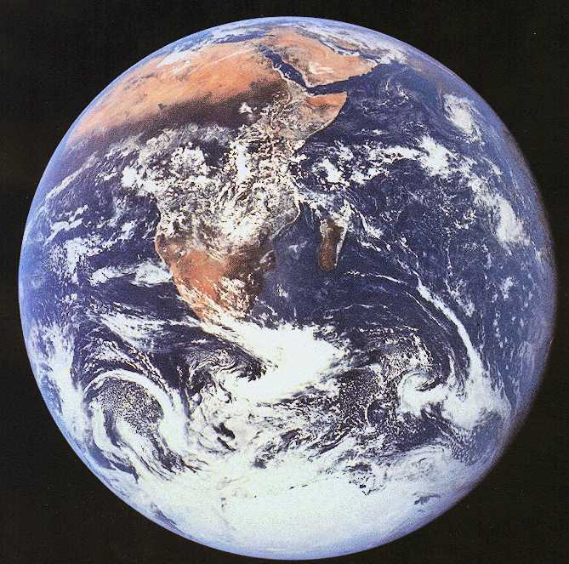
Earth 202
Chapter 1
Introduction
To Global
Change

Slide 2
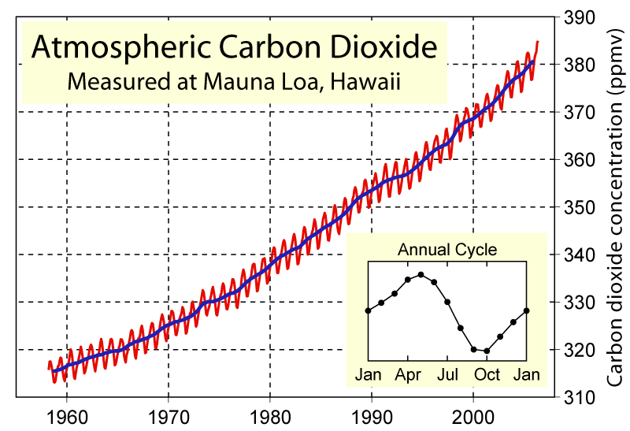
Keeling curve (Mauna Loa)
387.8 ppmv
(July, 2008)
315 ppmv
(1958)
Source: http://scrippsco2.ucsd.edu/
(Graph from Wikipedia)

Slide 3
More up to date, but not as pretty
398.8 ppmv
(July, 2014 –
annual trend
removed)
Rate of change:
84 ppm/56 yr
= 1.5 ppm/yr
http://scrippsco2.ucsd.edu/graphics_gallery/mauna_loa_record.html

Slide 4
CO₂: the last few years
The red curve shows the actual data
The black curve is a smoothed fit
Rate of change:
10 ppm/4.5 yr = 2.2 ppm/yr
What causes the “wiggle” in the actual data?
http://www.esrl.noaa.gov/gmd/ccgg/trends/

Slide 5
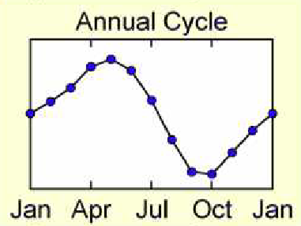
Keeling curve interpretation
5-6 ppm seasonal cycle
“Breathing” of northern hemisphere forests
CO₂ + H₂O ↔ CH₂O + O₂
Hawaii is at 19ºN, so
CO₂ is low in the fall (following summertime photosynthesis)
CO₂ is high in the spring (following wintertime respiration)
Graph from Wikipedia

Slide 6
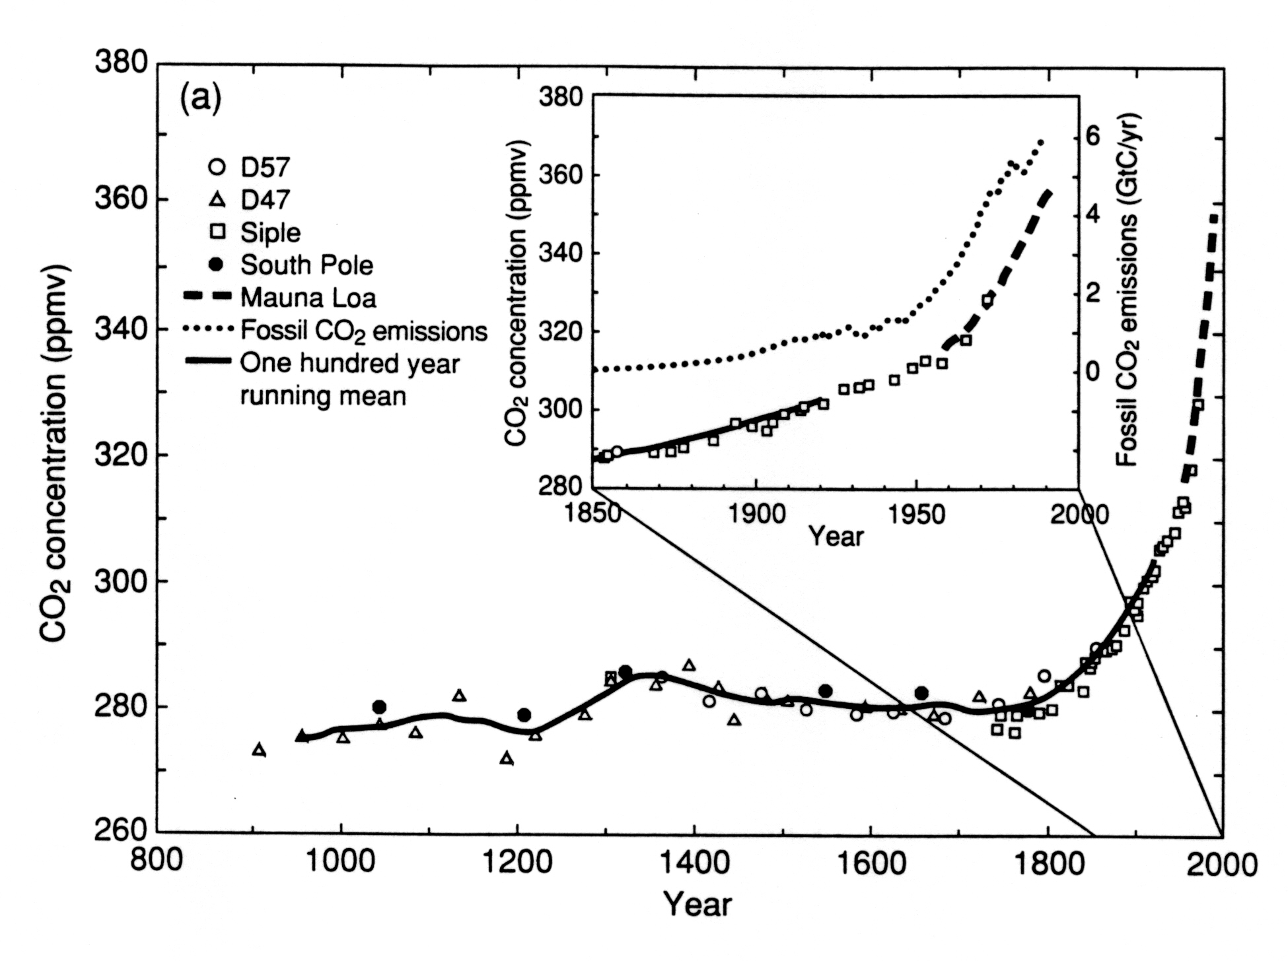
Ice core CO₂/Keeling curve
Fossil fuel CO₂
Atmospheric
measurements
Ice core data
Source: Climate Change 1994 (IPCC)
See also The Earth System, ed. 2, Fig. 1-3

Slide 7
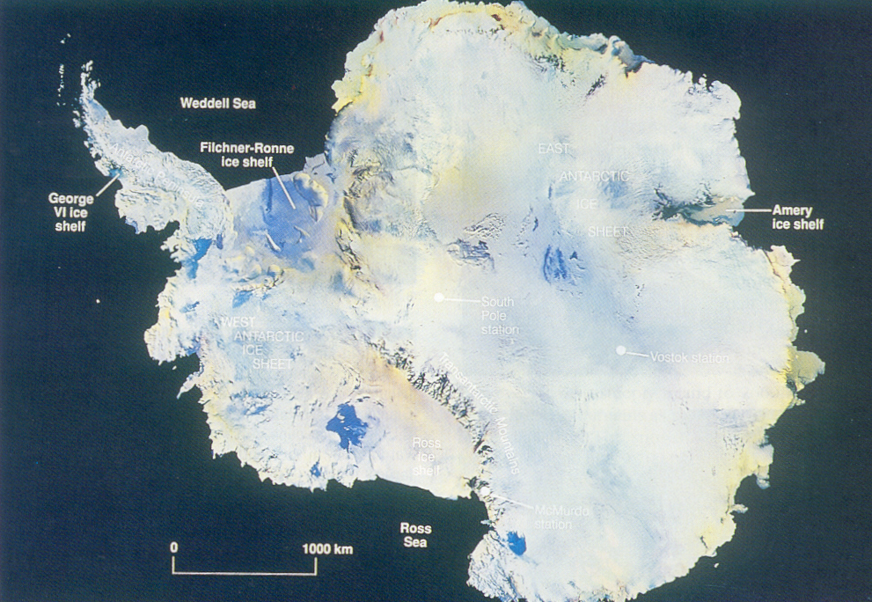
Antarctic research stations
EAST
ANTARCTICA
* Halley
Bay
* Siple
station
* South
Pole
* Vostok
WEST
ANTARCTICA
From Skinner and Porter, The Blue Planet (1995)

Slide 8
We know where the CO₂ is coming from…

Slide 9
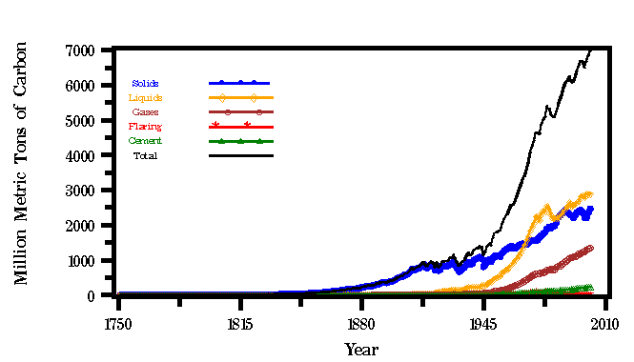
Global CO₂ emissions
Coal
Oil
Natural gas
Source: Carbon Dioxide Information Analysis Center (CDIAC)
See also The Earth System, ed. 2, Fig. 16-2

Slide 10
CO₂ mass units
Mass measured in metric tons of carbon (not including the O₂)
1 metric ton = ??? lbs

Slide 11
CO₂ mass units
Mass measured in metric tons of carbon (not including the O₂)
1 metric ton = 1000 kg = 2200 lbs
1 Mt = 1 megaton = 10⁶ tons
1 Gt = 1 gigaton = 10⁹ tons

Slide 12
Global CO₂ emissions
This graph is not as pretty but is slightly more up-to-date
Total fossil fuel CO₂ emissions ≅ 9.5 Gt(C)/yr in 2010
1 PgC (picogram carbon) = 10¹⁵ g(C) = 1Gt(C)
Source: 2013 IPCC report (Tech Summary):

Slide 13
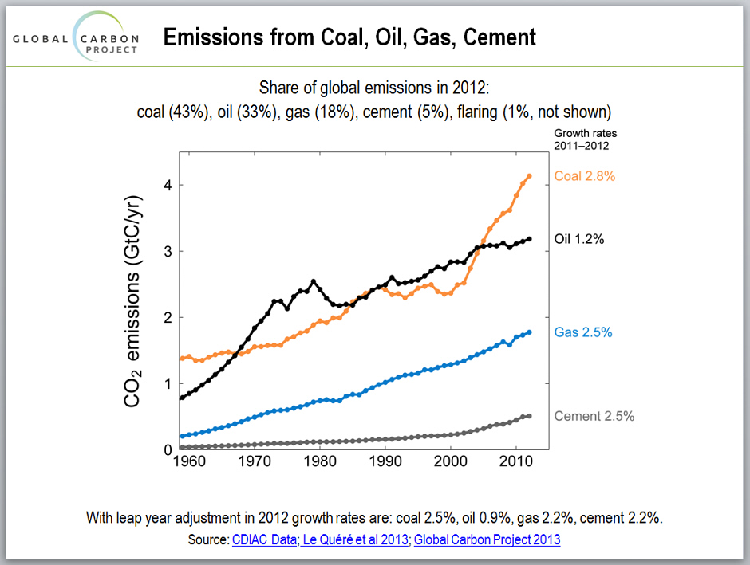
Which fossil fuels are being burned?
Coal
Oil
Natural gas
Source: Carbon Dioxide Information Analysis Center (CDIAC)

Slide 14
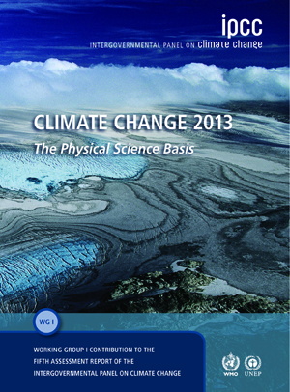
Intergovernmental Panel on Climate Change (IPCC)
The IPCC is a group of ~2000 climate scientists from around the world
They issue reports on climate change every 6-7 years
The 2013 report is the 5th such assessment
We update our textbook following each such report
http://www.ipcc.ch/report/ar5/wg1/

Slide 15
Question: What country emits the most CO₂ from burning
fossil fuels?
Answer: China (29% of total emissions as of 2012)
(U.S. is 15%)
Second question: What country has the highest per capita
emissions?
Answer: The U.S. (about twice that of China)

Slide 16
Other greenhouse gases are increasing in concentration, as well

Slide 17
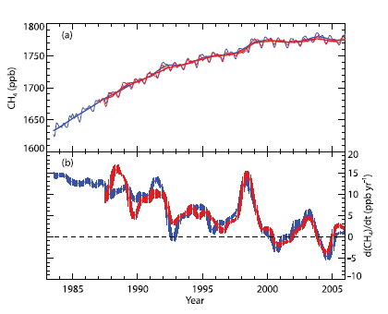
Methane (CH₄) measurements
Concentration
Rate of change
Methane increased steadily up until about the year 2000
It now appears to be leveling off!
-- Does this make sense?
IPCC 2007, Chapter 2, Fig. 2.4

Slide 18
More up to date, but not as pretty
These data from the
ALE/GAGE network
(Trinidad Head, CA,
station) show that CH₄
has started increasing
again in the last few
years!
What is going on?
(Admission: I don’t
know for sure!)
Previous graph
ends here
http://cdiac.ornl.gov/ndps/alegage.html

Slide 19
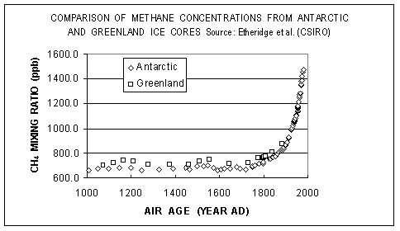
Methane from ice cores
The Earth System, ed. 2, Fig. 16-4
Methane concentrations have more than doubled since
the preindustrial era

Slide 20
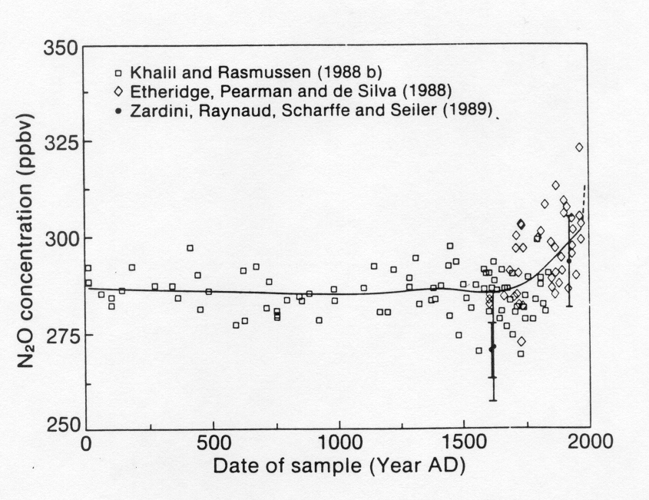
Nitrous oxide (N₂O) measurements
Atmospheric measurements
Ice core data
IPCC 2007, Chapter 2, Fig. 2.5
The Earth System, ed. 2, Fig. 16-4

Slide 21
Let’s turn now to global surface temperatures. This is where things start to become controversial.

Slide 22
Recent surface temperatures
Influenced by
sulfate aerosols?
Source: IPCC 2007 report, Ch. 3, p. 241
See also The Earth System, ed. 2, Fig. 1-4

Slide 23
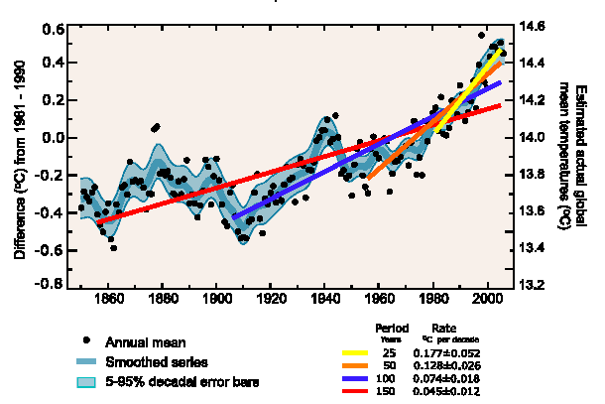
Surface temperature trends
Source: 2007 IPCC report (http://www.ipcc.ch/)
There is also statistical evidence that the rate of surface temperature
increase is also increasing

Slide 24
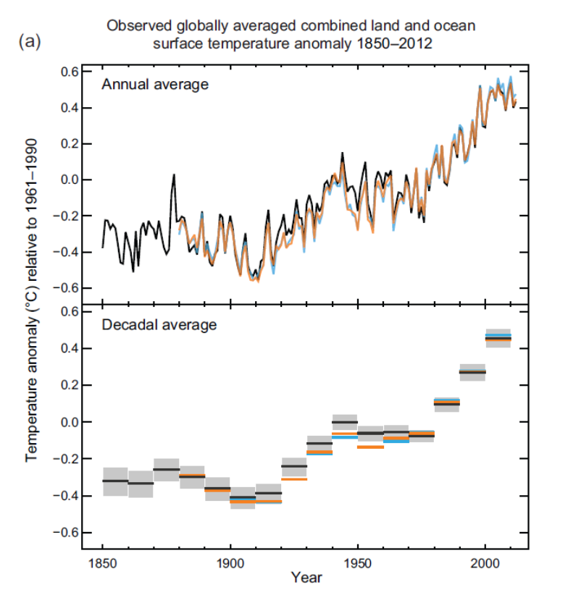
2013 update
The new 2013 IPCC report shows that the global warming trend is real and continuing
However, the rate of surface warming has been slower over the last few years, and much has been made of this by climate skeptics
2013 IPCC Report: Summary for Policymakers,
Fig. SPM.1a

Slide 25
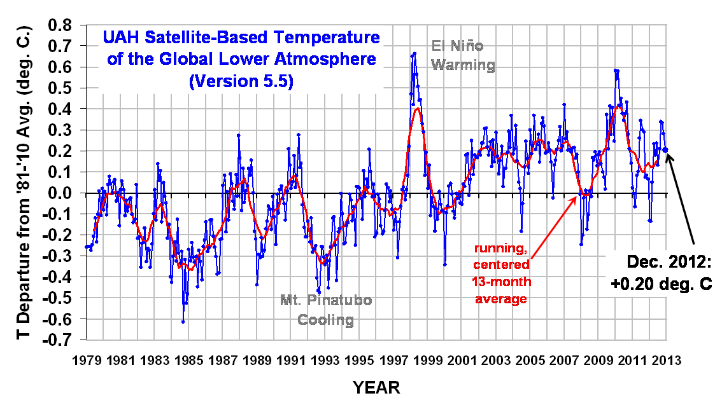
Mean surface temperatures: the last 14 years
Q: What do skeptics say?
A: They point out that if you start counting in 1998, there has been little or no net warming since that time
Is this significant?
http://www.drroyspencer.com/2013/01/
uah-v5-5-global-temperature-update-for-
december-2012-0-20-deg-c

Slide 26
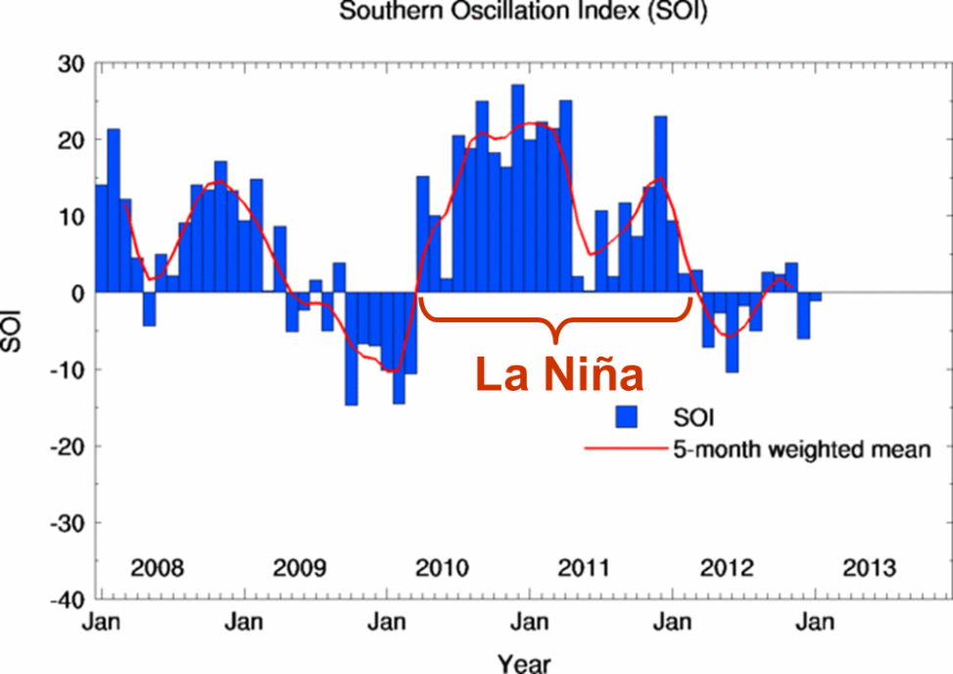
LLa Niña effect
Part of the reason why temperatures haven’t risen recently may have to do with the El Niño/La Niña cycle
1998 was a strong El Niño
Since then, we’ve been in a prolonged La Niña
Upward mixing of cold deep ocean water is inhibited during El Niño; hence, such years are abnormally warm
http://www.bom.gov.au/climate/current/
soi2.shtml

Slide 27
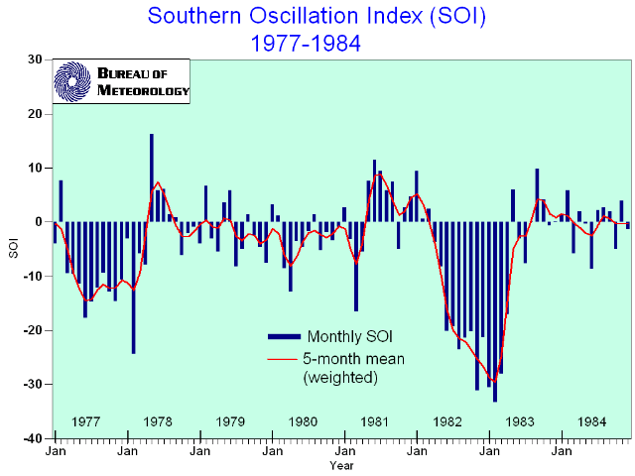
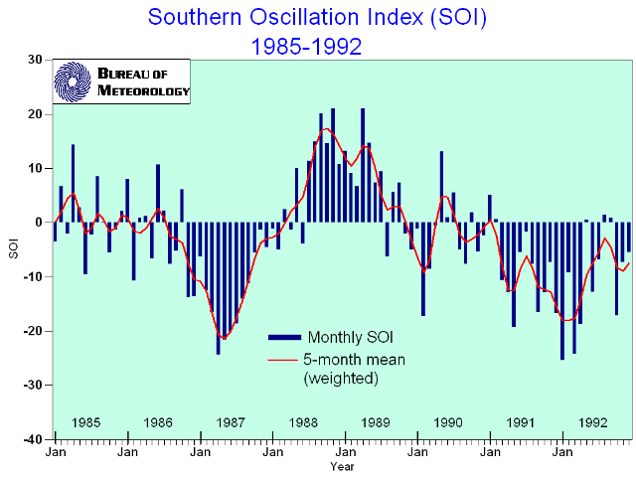
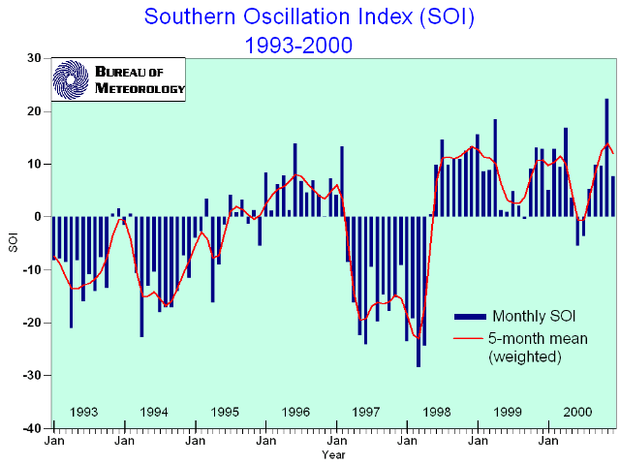
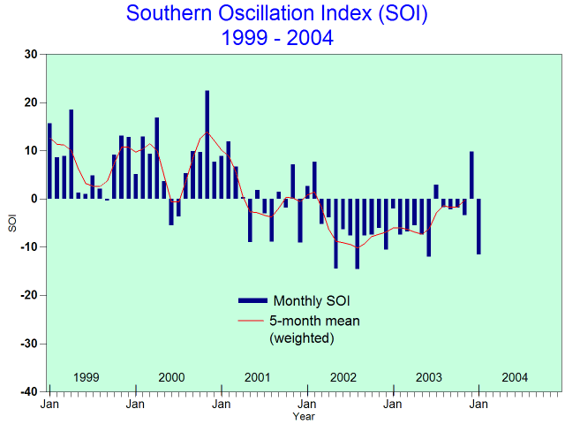
El Niño

Slide 28
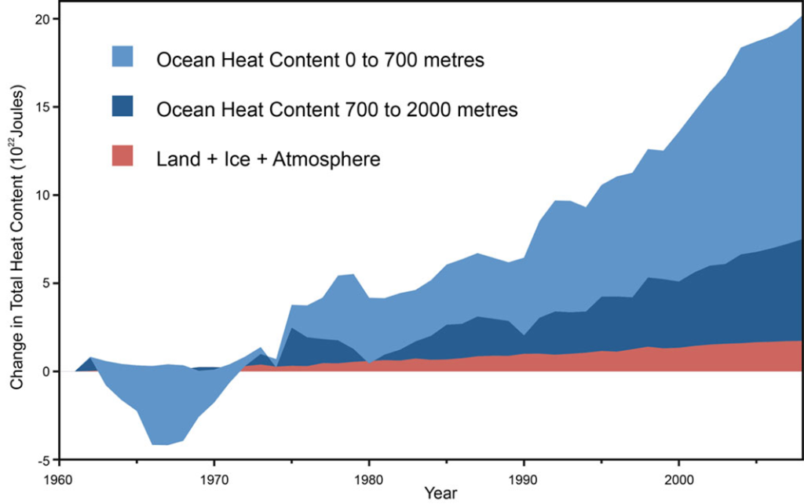

Total heat accumulation in sea, land, and air
During the extended La Niña of the past few years, most of the excess heat has been transferred to the mid- to deep ocean, instead of warming the surface ocean
This has been confirmed by direct measurements of ocean temperatures down to 2000 m depth

Slide 29
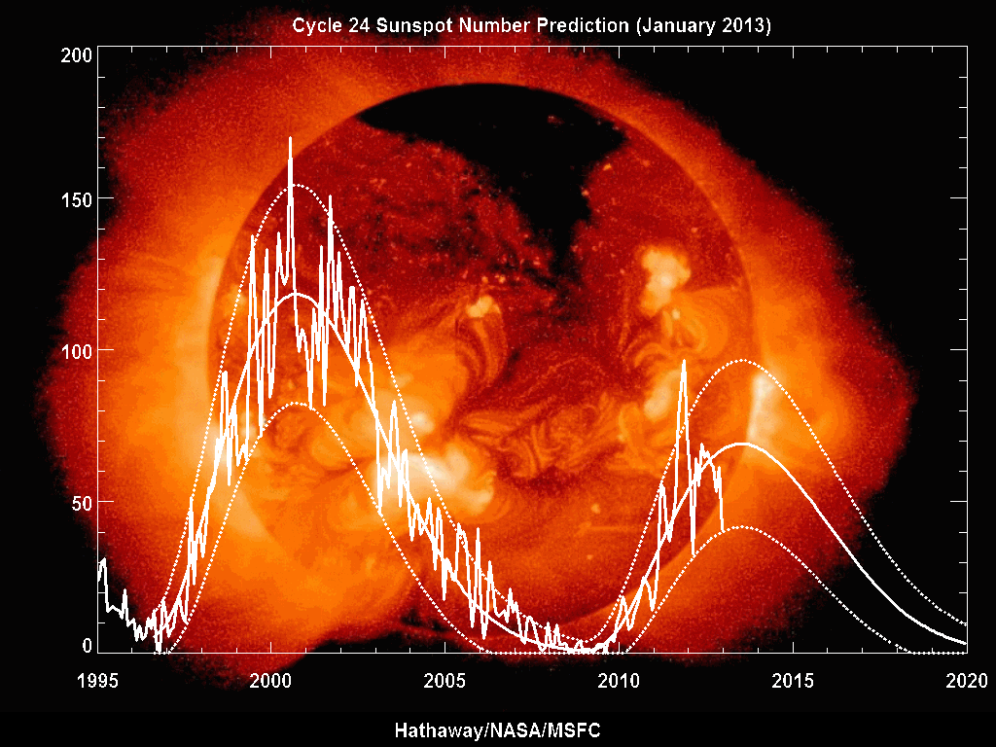
Sunspot cycle
Another thing keeping surface temperatures down over the past few years may be the sunspot cycle
Solar irradiance is slightly (~0.1%) higher at solar max than at solar min
We’re just emerging from solar minimum conditions, so this cycle may also cause the Earth to warm as we return to solar maximum
http://solarscience.msfc.nasa.gov/predict.shtml

Slide 30
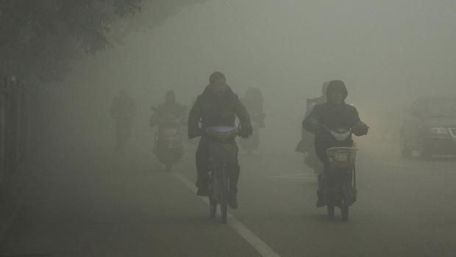
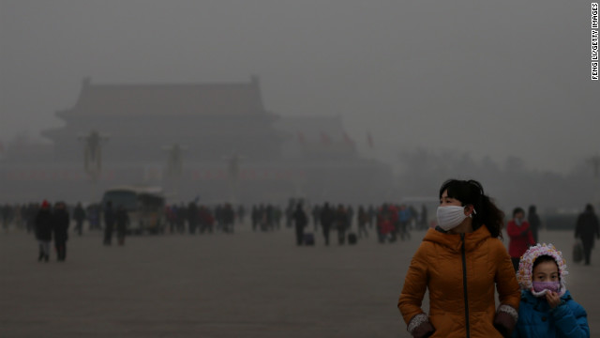
Aerosol cooling from East Asia?
Finally, China has been industrializing rapidly, and so aerosols produced by coal burning and other activities may also be cooling the climate, as happened with the U.S. and Europe between 1940 and 1970
We would know more about this if NASA’s Glory satellite hadn’t ended up in the Pacific Ocean
Photos showing air quality in Beijing

Slide 31
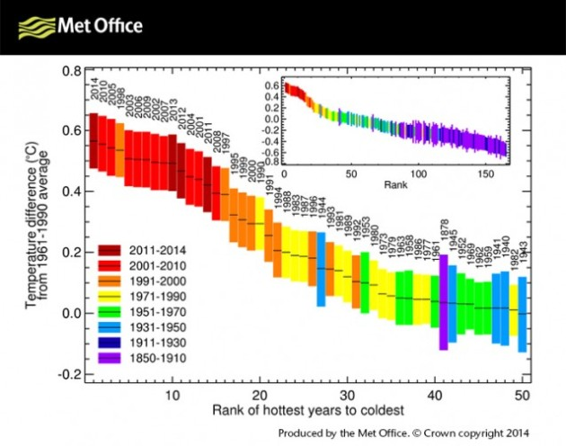
Was 2014 the warmest year yet??
http://blogs.mprnews.org/updraft/2015/01/noaa-and-nasa-about-to-call-2014
-as-warmest-year/

Slide 32
The smoking gun for climate change:
Arctic sea ice

Slide 33
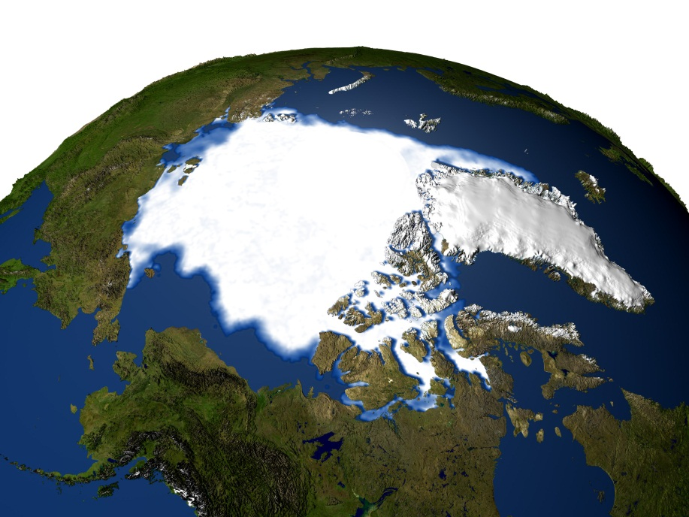
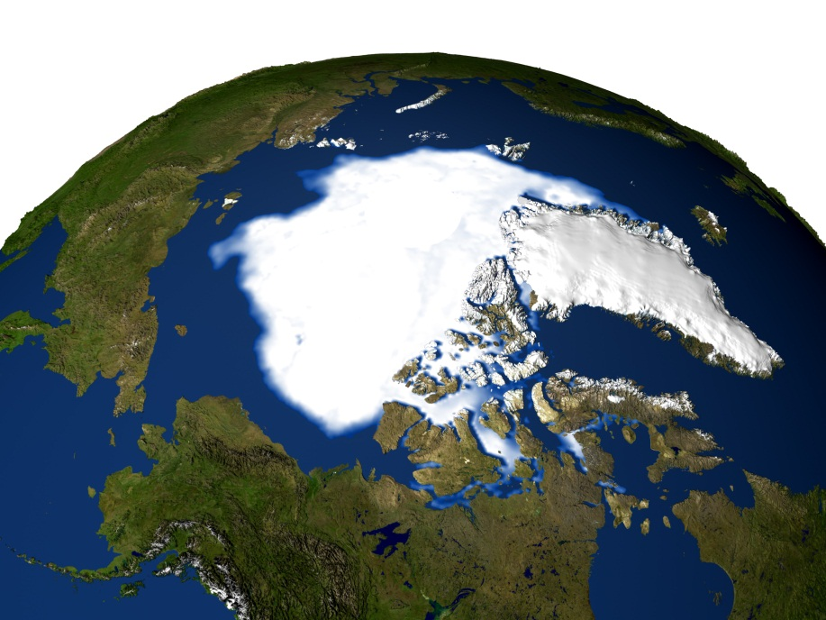
Changes in Arctic sea ice
Sea ice minimum--1979
Sea ice minimum--2005
Arctic sea ice has diminished in extent during recent summers
The fabled Northwest Passage, long sought by explorers, is now
open briefly in the early Fall
http://earthobservatory.nasa.gov/Newsroom/NewImages/

Slide 34
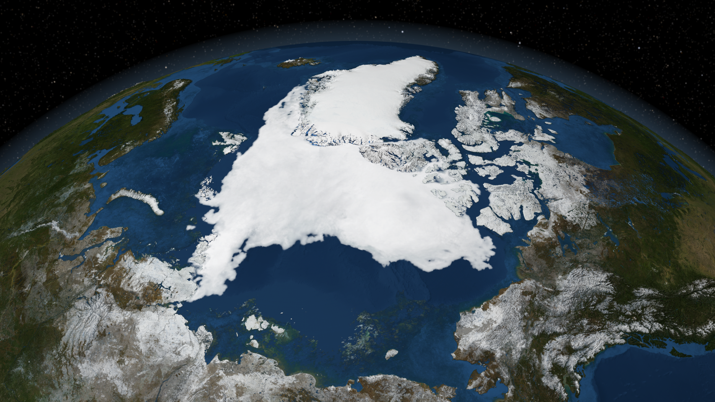
2007 Arctic sea ice minimum
http://www.nasa.gov/images/content/190554main_AMSR_E_09_14_2007_r1.1536.tif
The 2007 Arctic sea ice pack was the smallest yet…

Slide 35
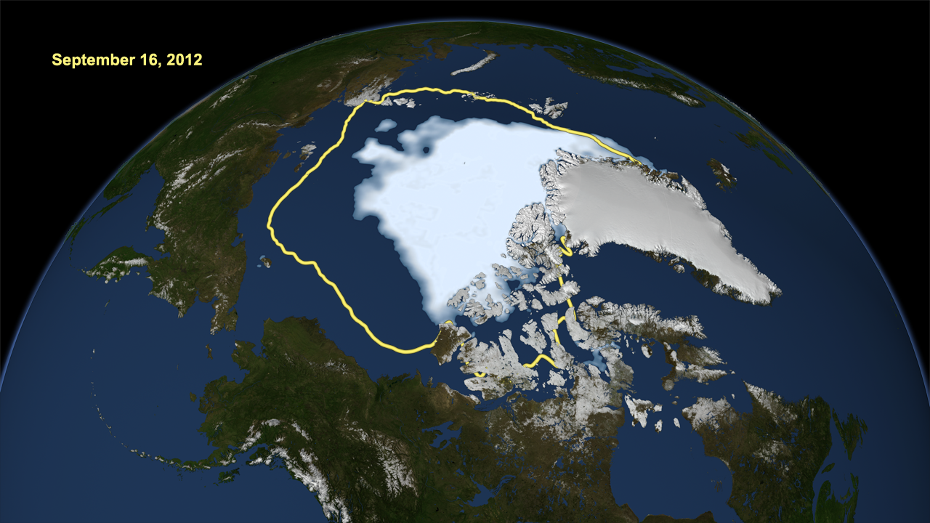
2012 Arctic sea ice minimum
http://earthsky.org/earth/2012-arctic-sea-ice-extent-lowest-ever-recorded
The 2012 Arctic sea ice minimum smashed the old (2007) record for the lowest
recorded sea ice extent
Yellow curve shows the 1979-2010 average

Slide 36
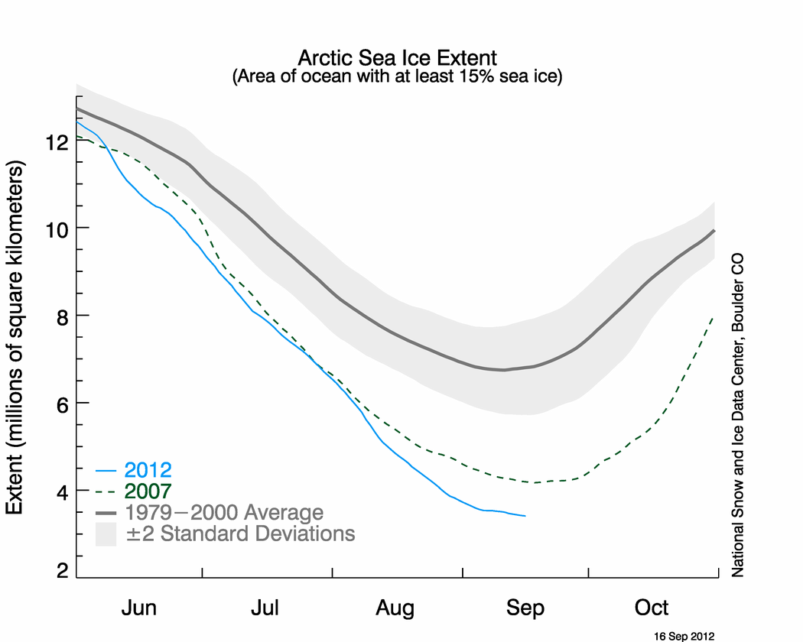
Time-dependent sea ice area
http://earthsky.org/earth/2012-arctic-sea-ice-extent-lowest-ever-recorded

Slide 37
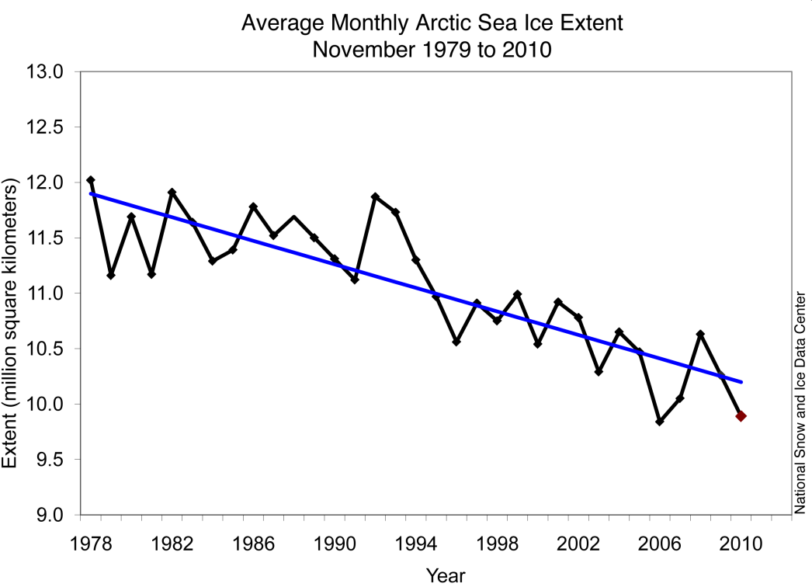
Average monthly Arctic sea ice extent during November
Rate of decline is 4.7% per decade over the last 30 years
November 2010 had the second-lowest ice extent for the month since the beginning of satellite records
The Arctic Ocean could be completely ice-free during late summer by ~2030
http://nsidc.org/arcticseaicenews/

Slide 38
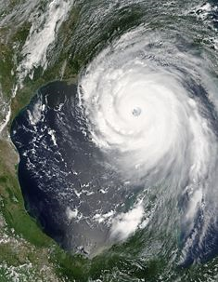
We’re also very interested in hurricanes
Katrina was at various times a category 4 or 5
Are hurricanes getting stronger and/or more frequent?
http://en.wikipedia.org/wiki/Hurricane_Katrina
Hurricane Katrina near peak strength
(Aug. 28, 2005)

Slide 39
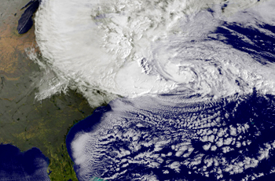
Hurricane Sandy
Hurricane Sandy (late October, 2012), although only a Category 1 when it hit the coast, was the biggest Atlantic hurricane in history (diameter ≅ 1100 miles)
Confluence of three events: 1) hurricane, 2) winter storm, 3) high tide
The maximum storm surge was 4.3 m (14 ft)!
Damage was more than $60 billion (Katrina was estimated at ~$80 billion)
http://topics.bloomberg.com/hurricane-sandy/

Slide 40
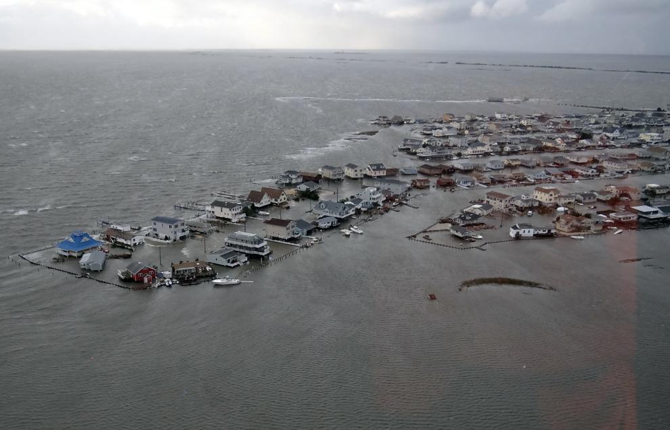
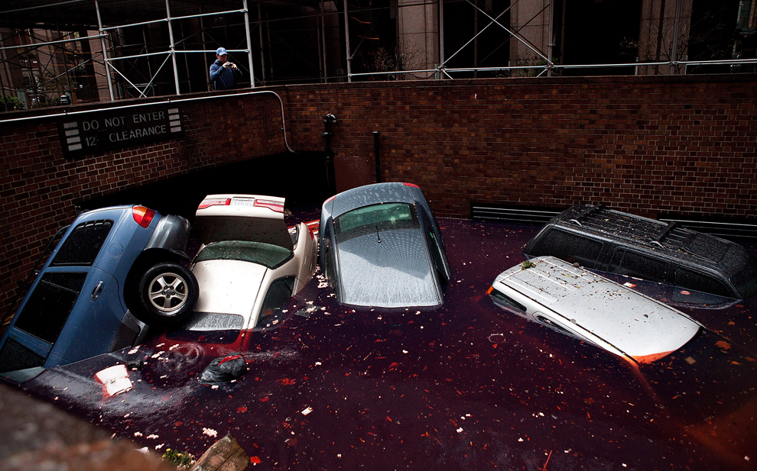
Hurricane Sandy flood damage
Flooded homes in Tuckerton, N.J., on
Oct. 30 after Hurricane Sandy made
landfall on the southern New Jersey
coastline on Oct. 29.
Cars floating in a flooded subterranean
basement following Hurricane Sandy on
Oct. 30 in the Financial District of New
York City.
http://www.boston.com/bigpicture/2012/10/hurricane_sandy_the_superstorm.html

Slide 41
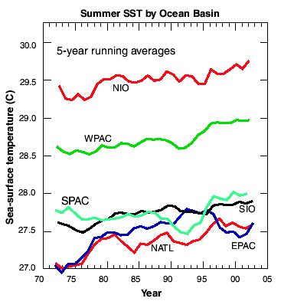
Summer sea
surface
temperature
vs. time
NIO—Northern Indian Ocean
WPAC—Western Pacific
SPAC—Southern Pacific
SIO—Southern Indian Ocean
EPAC—Eastern Pacific
NATL—North Atlantic
Webster et al., Science (2005), Fig. 1

Slide 42
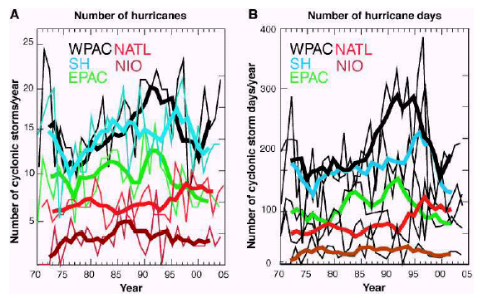
Hurricane frequency vs. time
Webster et al., Science (2005), Fig. 3
No obvious long-term trend

Slide 43
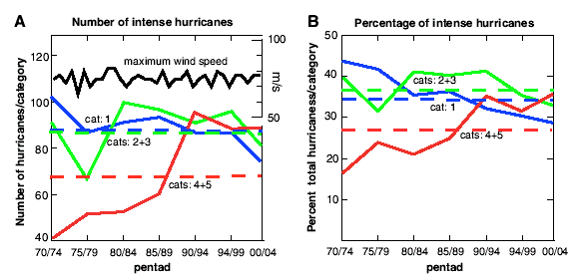
Hurricane intensity vs. time (global)
Webster et al., Science (2005), Fig. 4
But there may be trends in hurricane intensity

Slide 44
Webster et al.’s conclusions (still controversial):
No obvious trend in hurricane frequency vs. time
but
Number of Category 4 and 5 storms has doubled over the past 35 years
Questions:
Might there be a long-term change in the size (areal extent) of hurricanes over time?
How will storm surge heights change with time?
This is obviously related to future changes in sea level

