Slide 1
Chapter 2
Introduction to Systems
/Daisyworld

Slide 2
What is a System?
Definition: A system is a group of different components that interact with each other
Example: The climate system includes the atmosphere, oceans, polar caps, clouds, vegetation…and lots of other things

Slide 3
How do we study systems?
Identify the components
Determine the nature of the
interactions between components

Slide 4
Systems Notation
= system component
= positive coupling
= negative coupling

Slide 5
Positive Coupling
Atmospheric
CO₂
Greenhouse
effect
An increase in atmospheric CO₂ causes
a corresponding increase in the greenhouse
effect, and thus in Earth’s surface temperature
Conversely, a decrease in atmospheric CO₂
causes a decrease in the greenhouse effect

Slide 6
Negative Coupling
Earth’s albedo
(reflectivity)
Earth’s
surface
temperature
An increase in Earth’s albedo causes a
corresponding decrease in the Earth’s surface
temperature by reflecting more sunlight back to
space
Or, a decrease in albedo causes an increase in
surface temperature

Slide 7
The interesting thing to do is to put
couplings together in feedback loops
Your text gives several examples,
including a harmonious/non-harmonius
family and the Carter family’s mixed-up
electric blankets
I will skip those and move on to Daisy-
world. But first, consider stable and
unstable equilibria

Slide 8
An Unstable Equilibrium State

Slide 9
An Unstable Equilibrium State
Perturbation

Slide 10
When pushed by a perturbation, an unstable equilibrium state shifts to a new, stable state.

Slide 11
A Stable Equilibrium State

Slide 12
A Stable Equilibrium State
Perturbation

Slide 13
When pushed by a perturbation, a stable equilibrium state, returns to (or near) the original state.

Slide 14
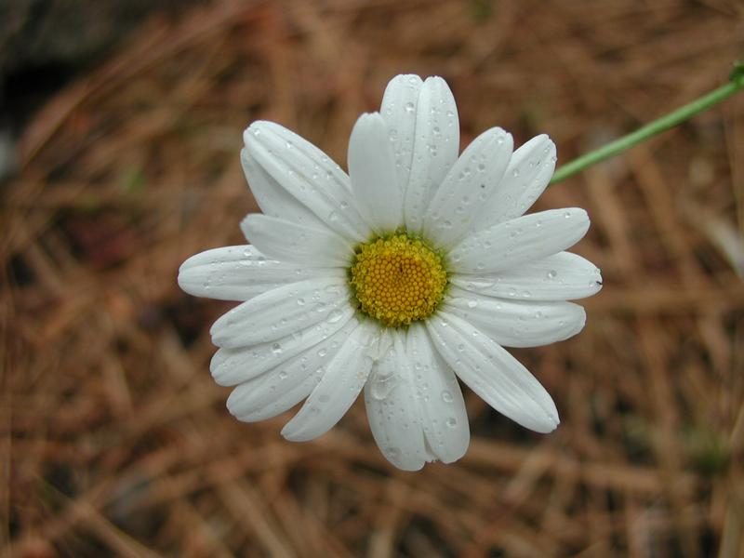
Daisy World

Slide 15
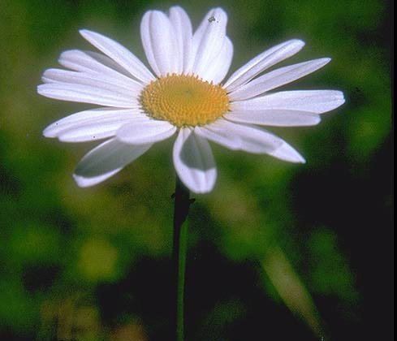
A simplified climate system:
Daisy World
Average Temperature = 30 ºC
No clouds, no ocean
Soil = light gray (absorbs some light)
Life = white daisies (reflects all light)
Sun = like Earth’s
Daisy growth = changes with temperature

Slide 16
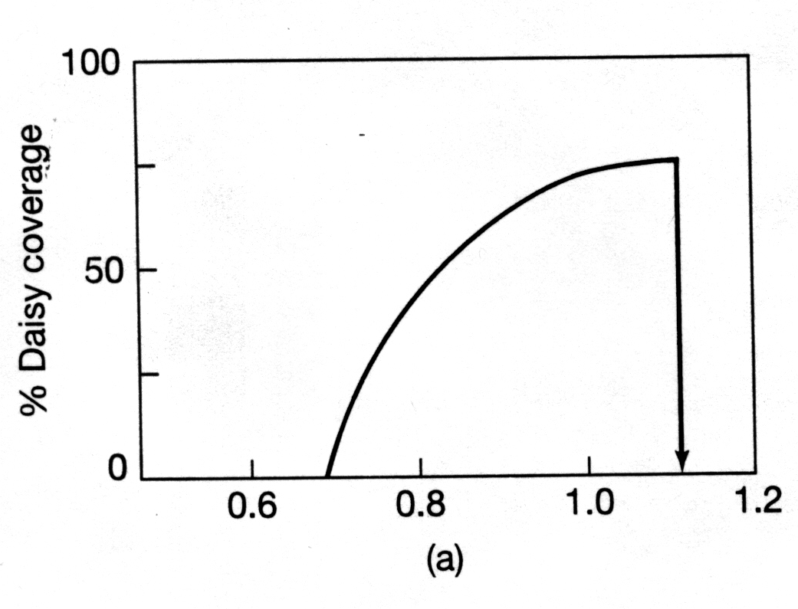
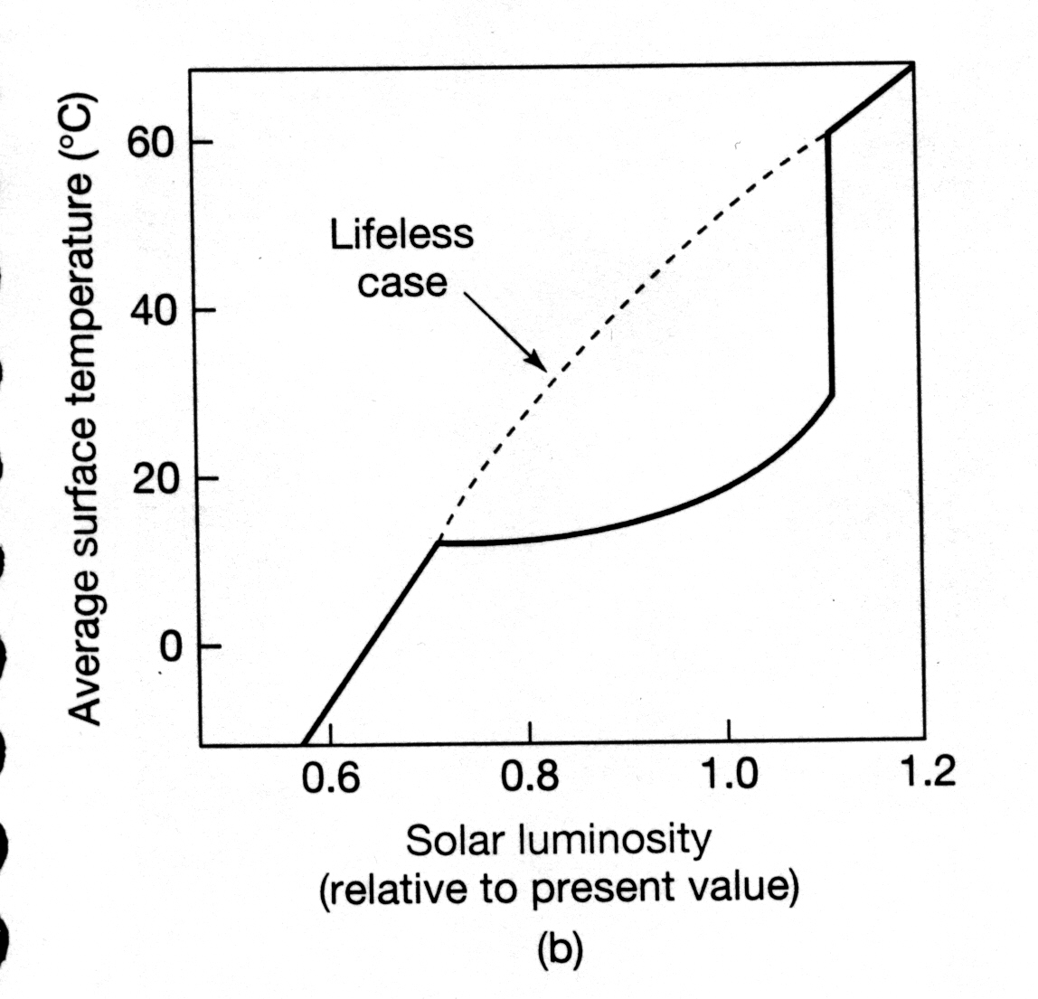
White Daisy Response to Increasing Solar Luminosity
Relative solar luminosity
The Earth System, Ch. 2

Slide 17
The rest of Chapter 2 will be done on the blackboard…

