Slide 1
Chapter 8—Part 1
Fluxes and reservoirs/
The organic carbon cycle

Slide 2
The Carbon Cycle
1. Flow of energy and matter
2. Organic and inorganic carbon
3. The organic carbon cycle

Slide 3
So far, we have considered systems in a very general way
Today: systems and the flow of matter
= Reservoir
= Flux of material

Slide 4
A Bathtub
an example of a reservoir
Input
Output

Slide 5
A Bathtub
an example of a reservoir
(the amount of water is the size of the reservoir)
Input
(flow of water into the tub)
Output
(flow of water out of the tub)

Slide 6
When the flow of water into the tub equals the flow out of the tub, the water level does not change.
Steady state conditions:
input = output

Slide 7
Residence Time
The average length of time matter spends in a reservoir
Residence time = reservoir size / input
= reservoir size / output

Slide 8
A Bathtub
tub = 100 liters
input = 5 liters/minute

Slide 9
A Bathtub
tub = 100 liters
input = 5 liters/minute
Residence time = 100 liters
5 liters/minute

Slide 10
A Bathtub
tub = 100 liters
input = 5 liters/minute
Residence time = 100 liters
5 liters/minute
= 20 minutes

Slide 11
Organic and Inorganic Carbon
C is cycled between reduced and oxidized forms by natural processes
Organic carbon Inorganic carbon
(reduced) (oxidized)
‘CH₂O’ CO₂ carbon dioxide
H₂CO₃ carbonic acid
Example: HCO₃⁻ bicarbonate ion
Glucose -- C₆H₁₂O₆ CO₃⁼ carbonate ion

Slide 12
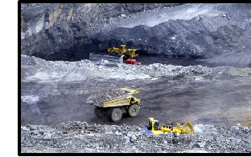
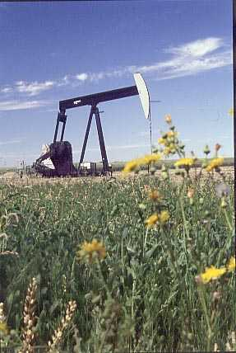
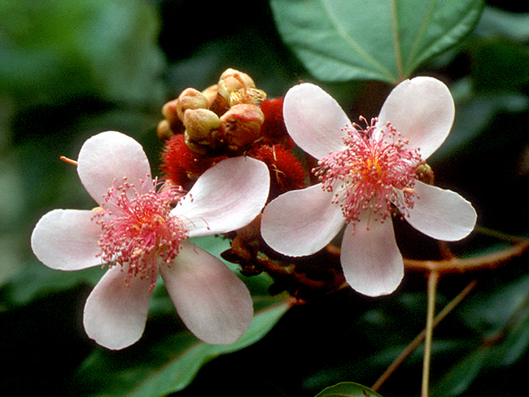
Coal
Oil
JENNY HAGER/ THE IMAGE WORKS
http://www.nationalfuelgas.com
Organic
carbon
http://www.upl.cs.wisc.edu/~stroker/jungle.jpg

Slide 13
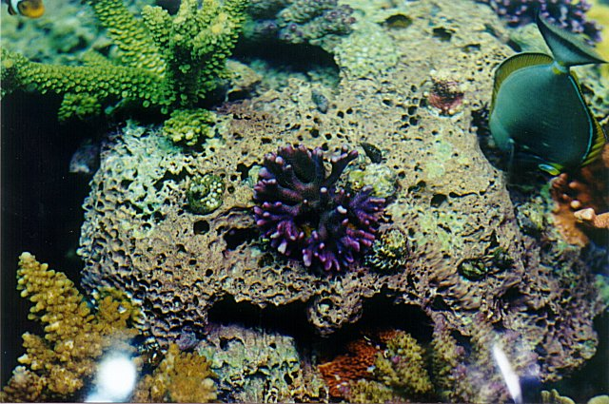
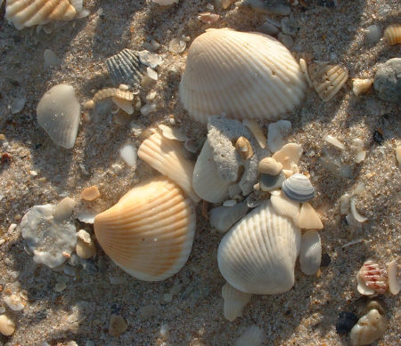
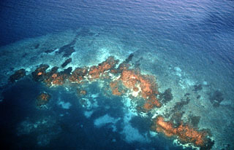
Inorganic
carbon
Seashells
http://www.cmas-md.org/Images/Sanjay/UnivTop4.jpg
Coral
http://www.summerclouds.com/Vero/Sea%20Shells.jpg
http://educate.si.edu/lessons/currkits/ocean/

Slide 14
The Carbon Cycle
Atm
CO₂
Organic
C Cycle
Inorganic
C Cycle

Slide 15
The Organic Carbon Cycle
C is cycled between reduced and oxidized forms by natural processes
Photosynthesis
CO₂ + H₂O → CH₂O + O₂
These processes operate on timescales that are:
short (days, years, centuries)
and
long (thousand, millions of years)

Slide 16
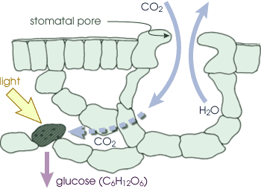
Terrestrial Organic Carbon Cycle
About equal rates of photosynthesis occur on land…
http://earthobservatory.nasa.gov/Library/CarbonCycle/carbon_cycle2.html

Slide 17
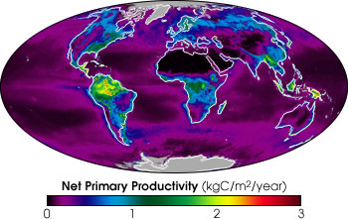
Marine organic carbon cycle
…and in the ocean
http://earthobservatory.nasa.gov/Newsroom/NPP/npp.html

Slide 18
The Terrestrial Organic Carbon Cycle
Photosynthesis
CO₂ + H₂O → CH₂O + O₂
←
Respiration and decay
On land, production of organic carbon by photosynthesis
is largely balanced by respiration and decay
-- Respiration: Used by both plants and animals to
to produce energy for metabolism
-- Decay: Consumption of dead organic matter
by (aerobic or anaerobic) micro-
organisms

Slide 19
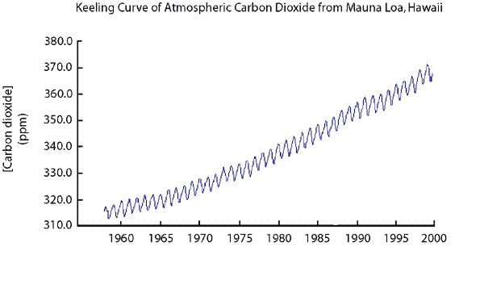
CO2 in the Atmosphere
“the Keeling Curve”

Slide 20
On a global scale, we measure quantities of carbon
in gigatons (Gt)
1 Gt = 1 billion metric tons
1 metric ton = 1,000 kilograms
Typically, we only count the weight of the carbon
itself, i.e., for CH₂O we neglect the weight of the
H₂O. So, we write these units as Gt(C).

Slide 21
Output
Photosynthesis
60 Gt(C)/yr
Atm. CO₂
Input
Respiration & decay
60 Gt(C)/yr
CO₂ reservoir size: 760 Gt carbon

Slide 22
Output
Photosynthesis
60 Gt(C)/yr
Atm. CO₂
Input
Respiration & decay
60 Gt(C)/yr
CO₂ reservoir size: 760 Gt carbon
Residence time: 760 Gt(C) = 12.7 yr
60 Gt(C)/yr

Slide 23
The Terrestrial Organic Carbon Cycle
Atm. CO₂
Photosynthesis
Respiration
Plants
Consumers

Slide 24
The Terrestrial Organic Carbon Cycle
Atm. CO₂
760 Gt
Photosynthesis
Respiration
60
30
Plants
600 Gt
Consumers
∼0 Gt
Red numbers = Gt(C)/year

Slide 25
The Terrestrial Organic Carbon Cycle
Atm. CO₂
760 Gt
Photosynthesis
Respiration
60
30
Plants
600 Gt
Consumers
∼0
decay
death
30
death
30
∼0
Soils
1,600 Gt

Slide 26
Long-term Carbon Cycle:
A small flux of organic carbon (0.05 Gt/yr) is buried in sedimentary rocks, mostly on continental shelves.

Slide 27
Long-term Carbon Cycle:
A small flux of organic carbon (0.05 Gt/yr) is buried in sedimentary rocks, mostly on continental shelves.
Over time, this small flux has accumulated to create a HUGE reservoir: 10,000,000 (or 1 x 10⁷) Gton C.

Slide 28
Long-term Carbon Cycle:
A small flux of organic carbon (0.1 Gt/yr) is buried in sedimentary rocks, mostly on continental shelves.
Over time, this small flux has accumulated to create a HUGE reservoir: 10,000,000 (or 1 x 10⁷) Gton C.
Concentrations of this buried organic carbon include coal, oil and gas--but most carbon is not concentrated.

Slide 29
Long-term Carbon Cycle:
A small flux of organic carbon (0.05 Gt/yr) is buried in sedimentary rocks, mostly on continental shelves.
Over time, this small flux has accumulated to create a HUGE reservoir: 10,000,000 (or 1 x 10⁷) Gton C.
Concentrations of this buried organic carbon include coal, oil and gas--but most carbon is not concentrated.
Organic carbon in sedimentary rocks is ultimately returned as CO₂ resulting from oxidation by exposure to O₂. This process is called weathering.

Slide 30
The Organic Carbon Cycle
Atm. CO₂
760 Gt
Photosynthesis
Respiration
60
30
Plants
600 Gt
Consumers
∼0
decay
death
30
death
30
∼0
weathering
Soils and sediments
1,600 Gt
0.1
0.1
burial
Sedimentary Rocks
10,000,000 Gt

Slide 31
Residence Time for Atmospheric O₂
CO₂ + H₂O → CH₂O + O₂
Burial of organic carbon in sediments (mostly in the oceans) leads to net production of O₂
To calculate the residence time of O₂, one must convert from mass units, Gt(C), to moles
1 mole CO₂ = 44 g CO₂
= 12 g C
Convert:
1 Gt(C) = 10⁹ tons C = 10¹² kg C = 10¹⁵ g C
= 10¹⁵ g C × (1 mole/12 g C)
= 8.33×10¹³ moles

Slide 32
Residence Time for Atmospheric O₂ (cont.)
Burial rate of organic carbon:
0.1 Gt(C)/yr × (8.33×10¹³ moles/Gt(C))
= 8.3×10¹² moles/yr
Atmospheric O₂ reservoir: 3.6×10¹⁹ moles
O₂ residence time:
t_{O2} = 3.6×10¹⁹ moles/ 8.3×10¹² moles/yr
≅ 4×10⁶ yr (4 million years)

Slide 33
Consequences of the long O₂ lifetime
Perturbations made to the carbon cycle by fossil fuel burning or by deforestation will not result in significant depletion of atmospheric O₂
For example, suppose we deforested not just the Amazon basin, but the entire globe
Total amount of carbon in forests:
760 Gt(C) × (8.33×10¹³ moles/Gt(C)
= 6.3×10¹⁶ moles
Atmospheric O₂ reservoir: 3.6×10¹⁹ moles
Percent depletion in O₂ caused by complete deforestation:
6.3×10¹⁶ moles ≅ 0.2%
3.6×10¹⁹ moles

