Slide 1
Chapter 8—Part 2
Basics of ocean structure
The Inorganic Carbon Cycle/
Marine Organic Carbon Cycle

Slide 2
Basics of ocean structure
Surface Ocean
Deep Ocean
~100 m
Well mixed by winds
Mixing occurs as a result
of density differences due
to temperature and salinity
-- the thermohaline circulation
~4 km

Slide 3
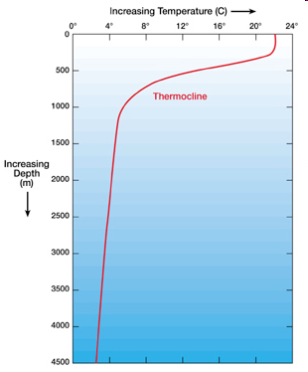
The thermocline
Ocean temperature decreases with depth between ~100 m (the bottom of the mixed layer) and 1 km. This is termed the thermocline
Salinity also increases with depth, also increasing the density of seawater. The increase in density with depth is termed the pycnocline
http://www.windows2universe.org/earth
/Water/temp.html

Slide 4
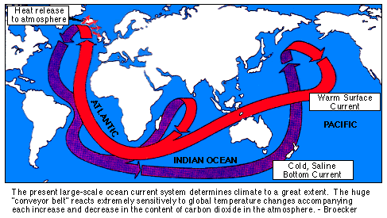
Deep Ocean Circulation

Slide 5
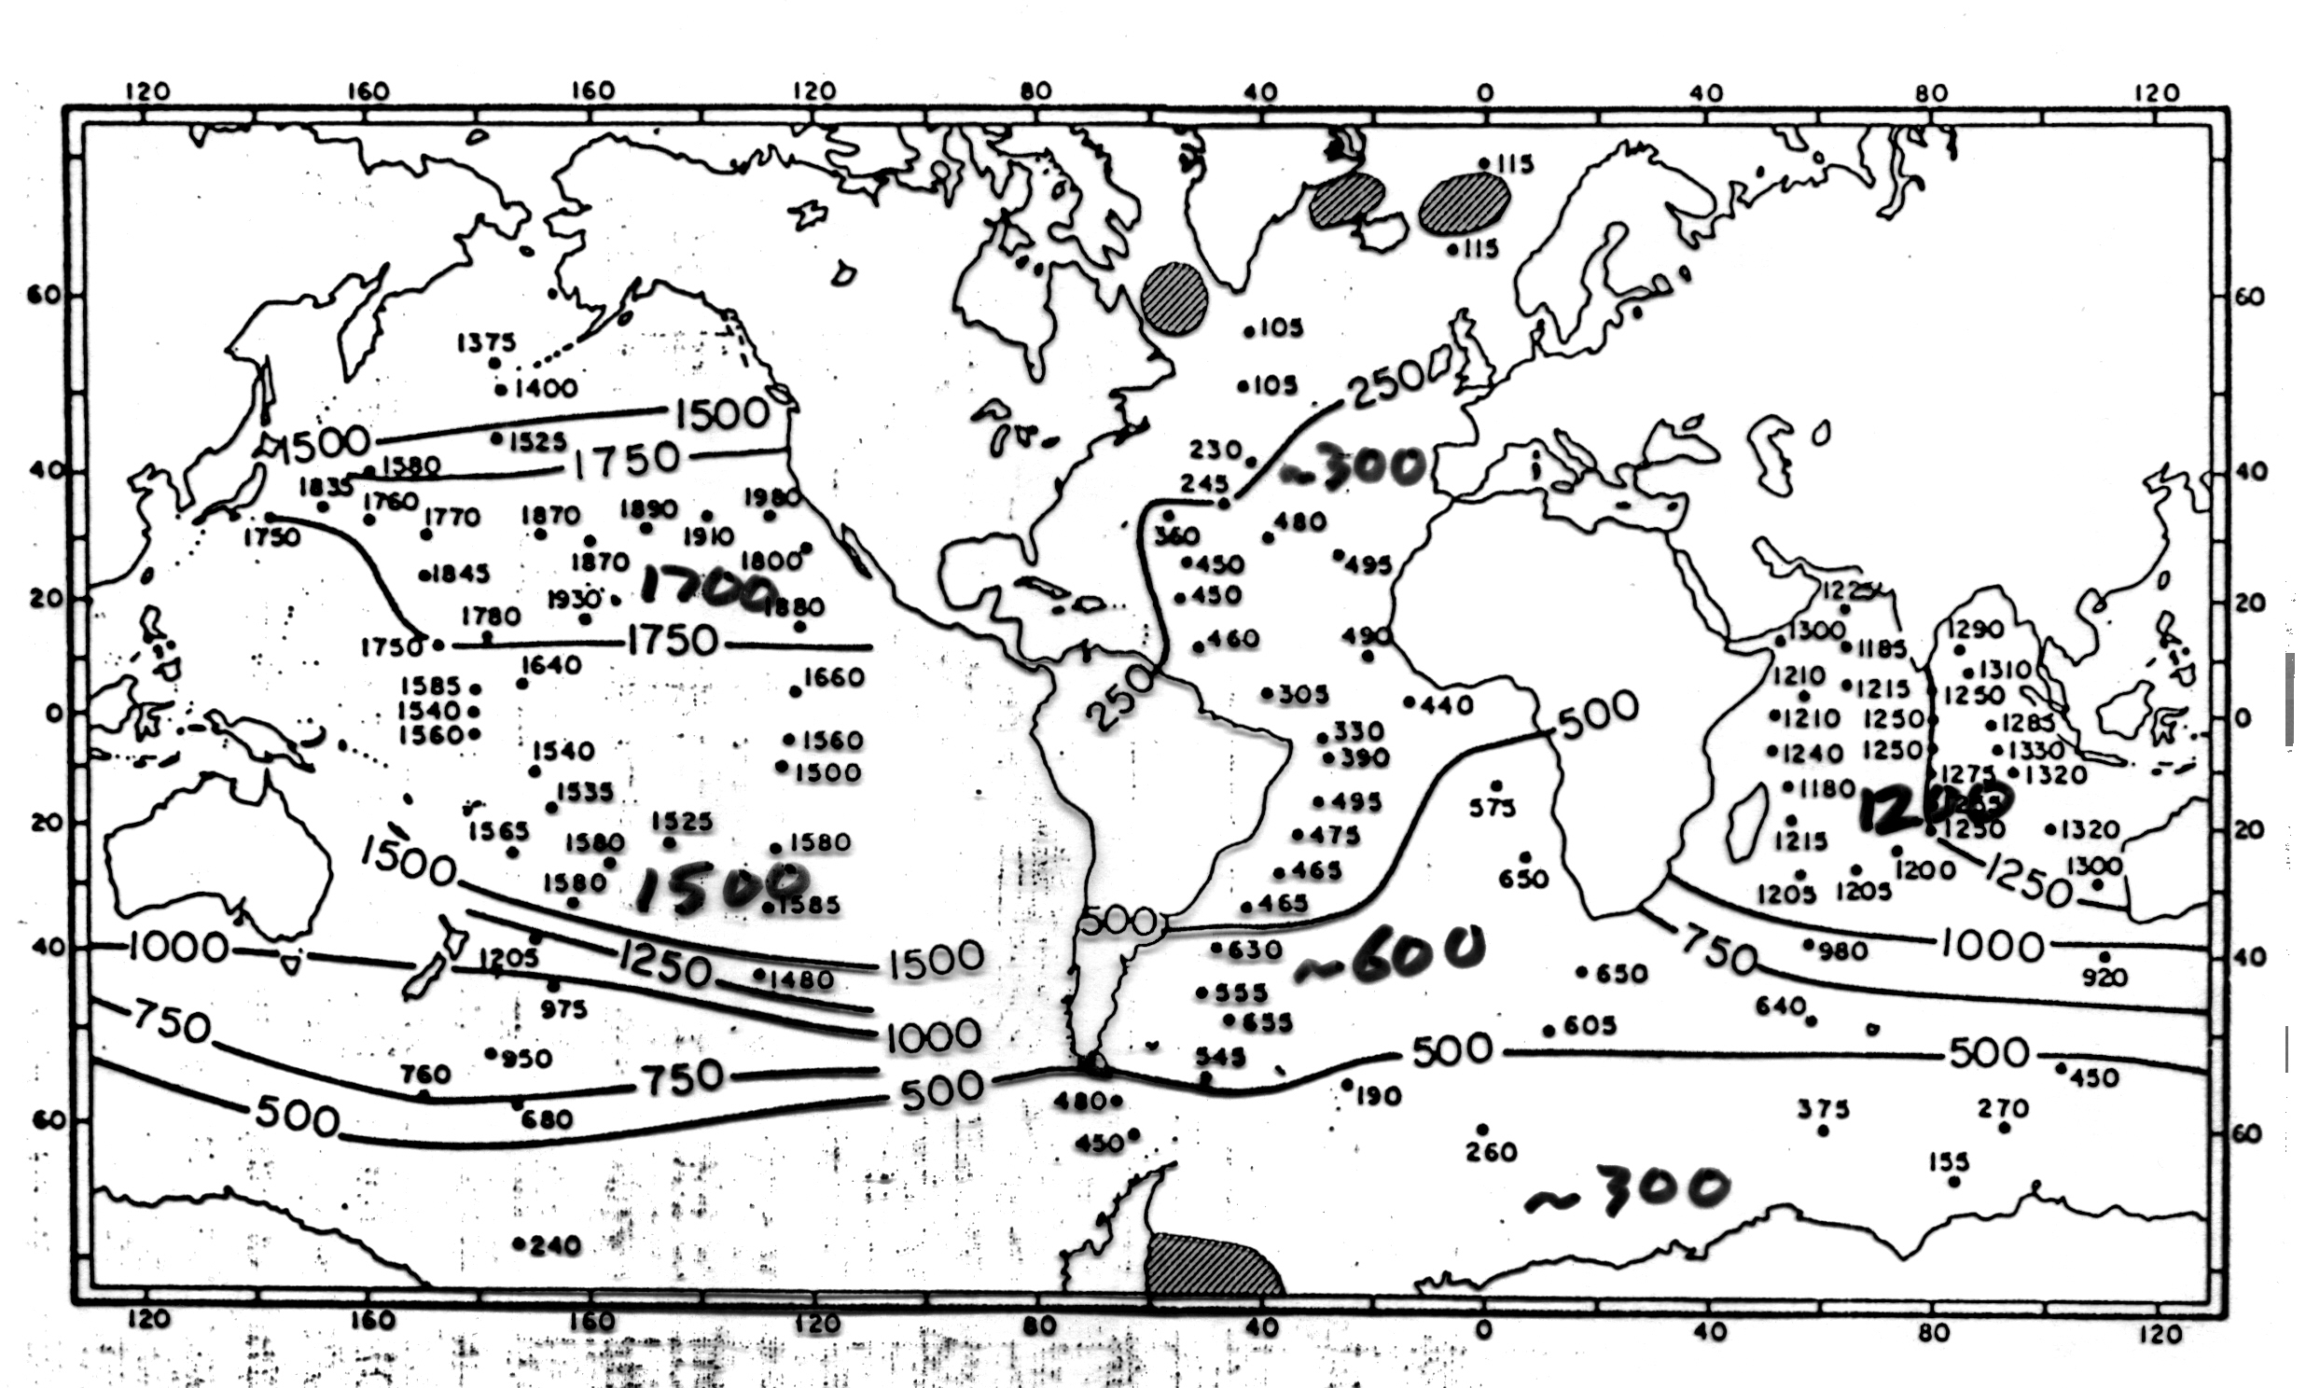
Radiocarbon Age of Deep Water
Ref: Broecker and Peng, Tracers in the Sea (1982), p. 269

Slide 6
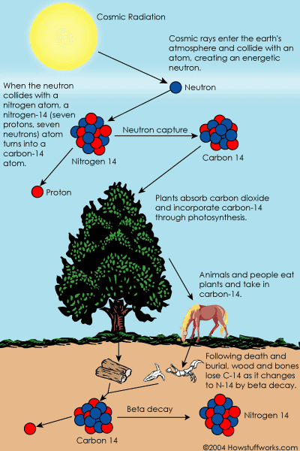
How Carbon-14
is made
¹⁴N: 7 p, 7 n
¹⁴C: 6 p, 8 n
C-14 production:
¹⁴N + n → ¹⁴C + p
C-14 decay:
¹⁴C → ¹⁴N + e⁻
(Beta decay)
http://science.howstuffworks.com/carbon-141.htm

Slide 7
The Inorganic Carbon Cycle
Carbon Uptake by the Oceans:
1. The biological pump
2. Air-sea gas exchange

Slide 8
Atm. CO₂
Air-sea exchange
Surface Ocean
DIC
Deep Ocean
DIC
~100 m
Biological pump
~4 km
DIC = Dissolved
inorganic carbon

Slide 9
The Biological Pump
transfer of CO₂ to the deep ocean:
Photosynthesis creates organic matter; this sinks to the deep ocean, where it decays back to CO₂

Slide 10
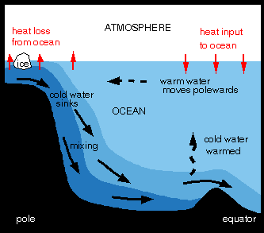
http://www.liv.ac.uk/~ric/

Slide 11
The Biological Pump
transfer of CO₂ to the deep ocean:
Photosynthesis creates organic matter; this sinks to the deep ocean, where it decays back to CO₂
North Atlantic
Pacific Ocean
Deep water

Slide 12
The Biological Pump
transfer of CO₂ to the deep ocean:
Photosynthesis creates organic matter; this sinks to the deep ocean, where it decays back to CO₂
photosynthesis
North Atlantic
Pacific Ocean
Transfer of carbon
Deep water

Slide 13
The Biological Pump
transfer of CO₂ to the deep ocean:
Deep water becomes enriched in CO₂
The carbon is recycled to the surface ca. 1,000 years
photosynthesis
North Atlantic
Pacific Ocean
Transfer of carbon
Deep water

Slide 14
surface
water
Photosynthesis
CO₂ + H₂O → CH₂O + O₂
sinking particles
Respiration
CH₂O + O₂ → CO₂ + H₂O
deep
water

Slide 15
surface
water
Photosynthesis
CO₂ + H₂O → CH₂O + O₂
sinking particles
Respiration
CH₂O + O₂ → CO₂ + H₂O
deep
water
This pumps up the CO₂ partial pressure of deep water…

Slide 16
Atm. CO₂
pCO₂ = 370 ppmv
Surface Ocean
DIC
Deep Ocean
DIC
pCO₂ = 370 ppmv
Biological pump
pCO₂ ≅ 1000 ppmv
Deep water has a
higher CO₂ partial
pressure than does
surface water

Slide 17
Atm. CO₂
Air-sea exchange
60 Gt(C)/yr
Ocean
Dissolved inorganic carbon

Slide 18
How CO₂ is dissolved into sea water:
CO₂
+
H₂O
H₂CO₃
carbon
dioxide
carbonic
acid

Slide 19
How CO₂ is dissolved into sea water:
CO₂
+
H₂O
H₂CO₃
HCO₃⁻
+
H⁺
carbon
dioxide
carbonic
acid
bicarbonate
ion

Slide 20
How CO₂ is dissolved into sea water:
CO₂
+
H₂O
H₂CO₃
HCO₃⁻
+
H⁺
CO₃⁼
+
2H⁺
carbon
dioxide
carbonic
acid
bicarbonate
ion
carbonate
ion

Slide 21
Buffer reaction helps dissolve CO₂ into sea water:
CO₂ + CO₃⁼ + H₂O 2 HCO₃⁻

Slide 22
Buffer reaction helps dissolve CO₂ into sea water:
CO₂ + CO₃⁼ + H₂O 2 HCO₃⁻
This reaction removes CO₂ from the atmosphere, with no change in the amount of H⁺ (i.e., no change in pH)
Definition: pH = − log₁₀[H⁺]
So, low pH = high [H⁺] ⇒ acidic
high ph = low [H⁺] ⇒ basic

Slide 23
Other Common Acids
Hydrochloric acid: HCl ↔ H⁺ + Cl⁻
Nitric acid: HNO₃ ↔ H⁺ + NO₃⁻
Sulfuric acid: H₂SO₄ ↔ 2 H⁺ + SO₄⁼
All of these reactions release H⁺ ions (protons) into solution

Slide 24
How much carbon is dissolved in the ocean?

Slide 25
How much carbon is dissolved in the ocean?
Gt C
Atmospheric CO₂ 760

Slide 26
How much carbon is dissolved in the ocean?
Gt C
Atmospheric CO₂ 760
Carbonic acid 740
(H₂CO₃)
Bicarbonate ion 37,000
(HCO₃-)
Carbonate ion 1,300
(CO₃⁼)

Slide 27
How much carbon is dissolved in the ocean?
Gt C
Atmospheric CO₂ 760
Carbonic acid 740
(H₂CO₃)
Bicarbonate ion 37,000
(HCO₃-)
Carbonate ion 1,300
(CO₃⁼)
39,040 Gton C

Slide 28
Inorganic Carbon in Marine Sediments:
Sea shells
Reefs Carbonate minerals (CaCO₃)
Algae tests

Slide 29
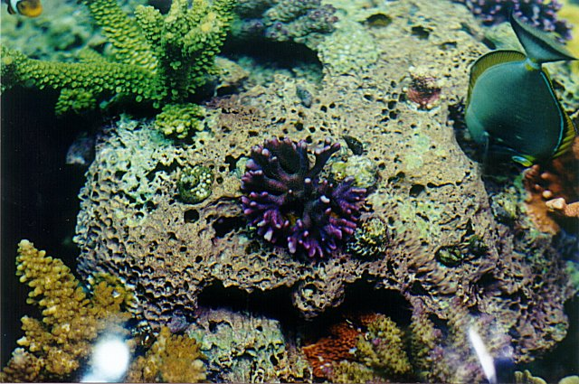
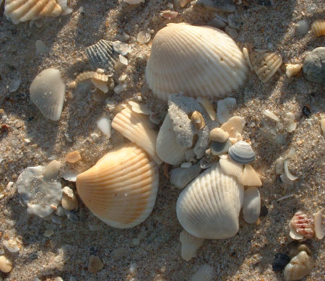
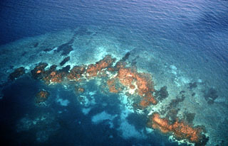
http://www.cmas-md.org/Images/Sanjay/UnivTop4.jpg
http://www.summerclouds.com/Vero/Sea%20Shells.jpg
http://educate.si.edu/lessons/currkits/ocean/

Slide 30
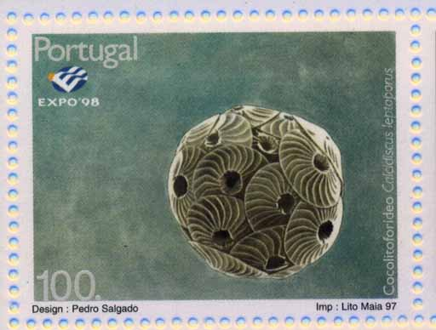

Slide 31
The Inorganic Carbon Cycle (Carbonate-silicate Cycle)
The rest of this lecture will be done slightly differently on the board. I will leave these slides in, though, for the benefit of anyone who missed the lecture.

Slide 32
Silicate Mineral Weathering:
Based on dissolution of calcium silicate minerals (CaSiO₃)
Silicate weathering removes CO₂ from the atmosphere.
Globally, it removes about 0.03 Gton C/year

Slide 33
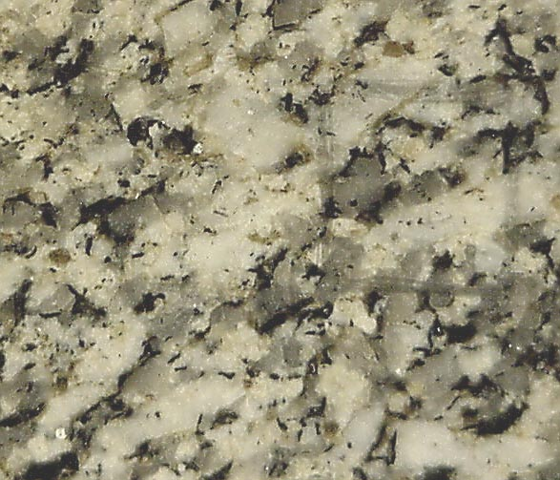
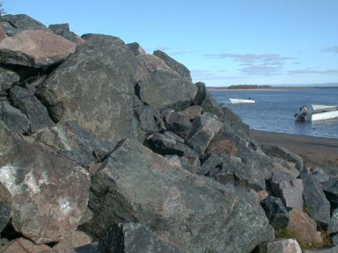
Silicate Mineral Weathering:
Based on dissolution of calcium silicate minerals (CaSiO₃)
Silicate weathering removes CO₂ from the atmosphere.
Globally, it removes about 0.03 Gton C/year
http://144.173.212.218/Granite.jpg
http://www.explorelabrador.nf.ca/Granite.jpg

Slide 34
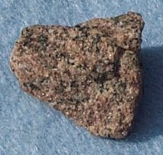
Silicate weathering:
CaSiO₃ + 2 H₂O + 2 CO₂ → Ca²⁺ + 2 HCO₃⁻ + SiO₂ + H₂O
http://www.gwydir.demon.co.uk/

Slide 35
Silicate weathering:
CaSiO₃ + 2 H₂O + 2 CO₂ → Ca²⁺ + 2 HCO₃⁻ + SiO₂ + H₂O
Carbonate precipitation:
Ca²⁺ + 2 HCO₃⁻ → CaCO₃ + H₂O + CO₂
http://www.gwydir.demon.co.uk/

Slide 36
Silicate weathering:
CaSiO₃ + 2 H₂O + 2 CO₂ → Ca²⁺ + 2 HCO₃⁻ + SiO₂ + H₂O
Carbonate precipitation:
Ca²⁺ + 2 HCO₃⁻ → CaCO₃ + H₂O + CO₂
Net Reaction
http://www.gwydir.demon.co.uk/

Slide 37
Silicate weathering:
CaSiO₃ + 2 H₂O + 2 CO₂ → Ca²⁺ + 2 HCO₃⁻ + SiO₂ + H₂O
Carbonate precipitation:
Ca²⁺ + 2 HCO₃⁻ → CaCO₃ + H₂O + CO₂
Net Reaction
http://www.gwydir.demon.co.uk/

Slide 38
Silicate weathering:
CaSiO₃ + 2 H₂O + 2 CO₂ → Ca²⁺ + 2 HCO₃⁻ + SiO₂ + H₂O
Carbonate precipitation:
Ca²⁺ + 2 HCO₃⁻ → CaCO₃ + H₂O + CO₂
Net Reaction
http://www.gwydir.demon.co.uk/

Slide 39
Silicate weathering:
CaSiO₃ + 2 H₂O + 2 CO₂ → Ca²⁺ + 2 HCO₃⁻ + SiO₂ + H₂O
Carbonate precipitation:
Ca²⁺ + 2 HCO₃⁻ → CaCO₃ + H₂O + CO₂
Net Reaction
http://www.gwydir.demon.co.uk/

Slide 40
Silicate weathering:
CaSiO₃ + 2 H₂O + 2 CO₂ → Ca²⁺ + 2 HCO₃⁻ + SiO₂ + H₂O
Carbonate precipitation:
Ca²⁺ + 2 HCO₃⁻ → CaCO₃ + H₂O + CO₂
Net Reaction
CaSiO₃ + CO₂ → CaCO₃ + SiO₂
http://www.gwydir.demon.co.uk/

Slide 41
Silicate weathering:
CaSiO₃ + 2 H₂O + 2 CO₂ → Ca²⁺ + 2 HCO₃⁻ + SiO₂ + H₂O
Carbonate precipitation:
Ca²⁺ + 2 HCO₃⁻ → CaCO₃ + H₂O + CO₂
Net Reaction
CaSiO₃ + CO₂ → CaCO₃ + SiO₂
http://www.gwydir.demon.co.uk/

Slide 42
Silicate weathering results in a net loss of CO₂
This contrasts with carbonate weathering, which does not remove atmospheric CO₂

Slide 43
Silicate
Weathering
0.03
Atm. CO₂
Carbonate
Weathering
0.17
Air-sea exchange
Volcanism
0.03
60 Gt/yr
Ocean
Dissolved inorganic carbon
39,040 Gton
Deposition
0.5
Dissolution
0.3
Marine Sediments
2,500 Gton
Carbonate
Weathering
0.17
Burial
0.2
Sedimentary Rocks
40,000,000 Gton C

Slide 44
The Long-term Inorganic Carbon Cycle:
Weathering
CaSiO₃ + CO₂
CaCO₃ + SiO₂
Volcanism

Slide 45
The Long-term Inorganic Carbon Cycle:
Weathering
CaSiO₃ + CO₂
CaCO₃ + SiO₂
Volcanism

Slide 46
The Long-term Inorganic Carbon Cycle:
Weathering
0.03
GtonC/yr
CaSiO₃ + CO₂
CaCO₃ + SiO₂
0.03
GtonC/yr
Volcanism

Slide 47
What controls silicate weathering rates?
Time
Temperature
Rainfall
Exposure of fresh rock surfaces
Vegetation (roots provide acid)

Slide 48
Weathering Feedback Loop:
Atm. CO₂
Silicate
weathering
Rates
Surface
Temperature
Weathering rates increase with increased temperature

Slide 49
Weathering Feedback Loop:
Atm. CO₂
Silicate
weathering
Rates
Surface
Temperature
Weathering reactions remove CO₂, and as CO₂ declines, planet temperatures go down

Slide 50
Weathering Feedback Loop:
Atm. CO₂
Silicate
weathering
Rates
Surface
Temperature
This is a negative feedback loop, or a stable system. This loop is a key control on climate over long time scales (i.e., millions of years).

Slide 51
The Inorganic
Carbon Cycle
Atm. CO₂
Fast
Air-sea
exchange
Med.
Slow
Marine
sediments
Sedimentary
rocks

