Slide 1
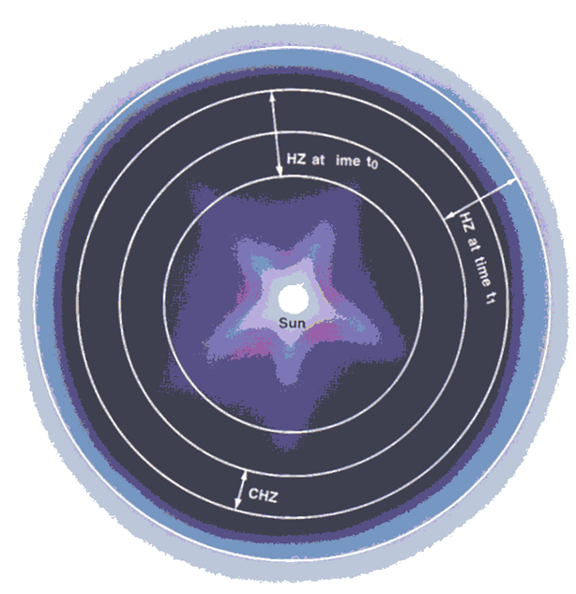
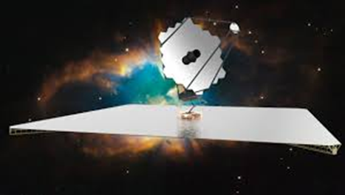
The Search for Life on Planets Around Other Stars
Jim Kasting
Department of Geosciences
Penn State

Slide 2
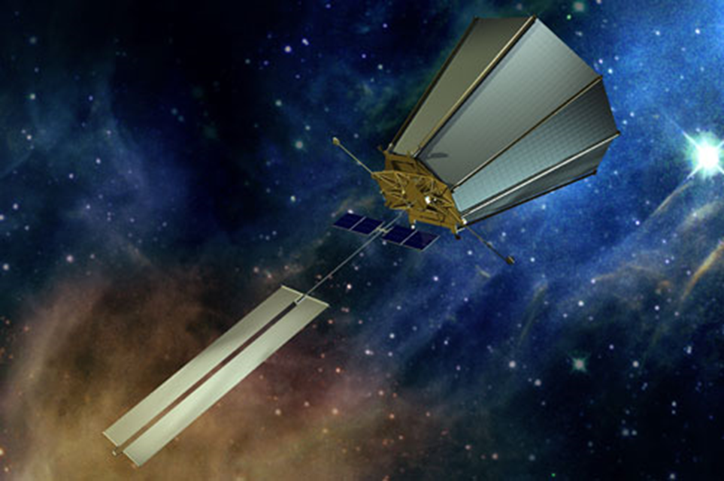
The search for life on planets around other stars
NASA (and ESA) is interested in searching for life on planets around other stars
An early effort was TPF-C (Terrestrial Planet Finder—Coronagraph)
Unlike JWST, which will only be able to observe transiting planets, TPF-C would have done direct imaging, i.e., looking for reflected light from non-transiting planets
Terrestrial Planet Finder—
Coronagraph (cancelled in 2006)

Slide 3
Requirements for life
A planet with a liquid or solid surface
-- No gas giants allowed
A thermodynamic free energy gradient to drive metabolism and growth
-- Stellar radiation provides most of the free energy
on Earth today
Availability of carbon and other bioessential elements (CHNOPS)
-- This assumes life ‘as we know it’

Slide 4
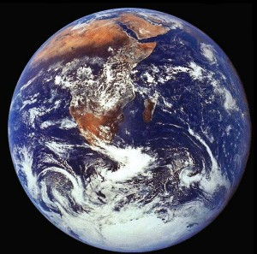
Fourth requirement for life (as we know it) : Liquid water
Life on Earth requires liquid water during at least part of its life cycle
So, our first choice is to look for other planets like Earth
Subsurface water is not relevant for remote life detection because it is unlikely that a subsurface biota could modify a planetary atmosphere in a way that could be observed (at modest spectral resolution)

Slide 5
Definition of η_{Earth}
η_{Earth}—the fraction of stars that have at least one rocky planet in their habitable zone
This is what we need to know in order to design a space telescope to look for such planets around nearby stars
We should be conservative when calculating η_{Earth} for this purpose, because we don’t want to undersize the telescope

Slide 6
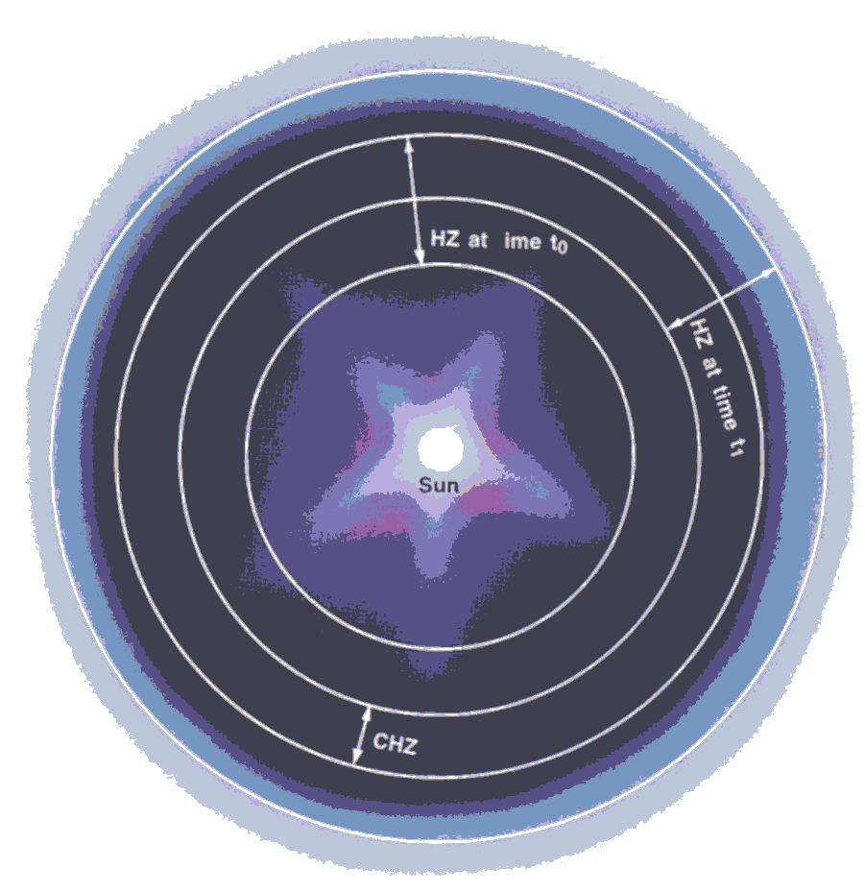
Definitions (from Michael Hart, Icarus, 1978)
Habitable zone (HZ) -- the region around a star in which an Earth-like planet could maintain liquid water on its surface at some instant in time
Continuously habitable zone (CHZ) -- the region in which a planet could remain habitable for some specified period of time (e.g., 4.6 billion years)

Slide 7
Michael Hart’s calculations (Icarus, 1978, 1979)
4.6-Gyr CHZ around our own Sun is quite narrow
0.95 AU: Runaway greenhouse
1.01 AU: Runaway glaciation
CHZ’s around other spectral types are even narrower
Corollary: Earth may be the only habitable planet in our galaxy

Slide 8
Problems with Hart’s model
He concluded, incorrectly, that a fully glaciated planet could never deglaciate by building up CO₂
There is strong evidence that this actually happened on Earth several times in the aftermath of Snowball Earth glaciations
Furthermore, there is a well-known negative feedback that causes CO₂ to accumulate on frozen planets…

Slide 9
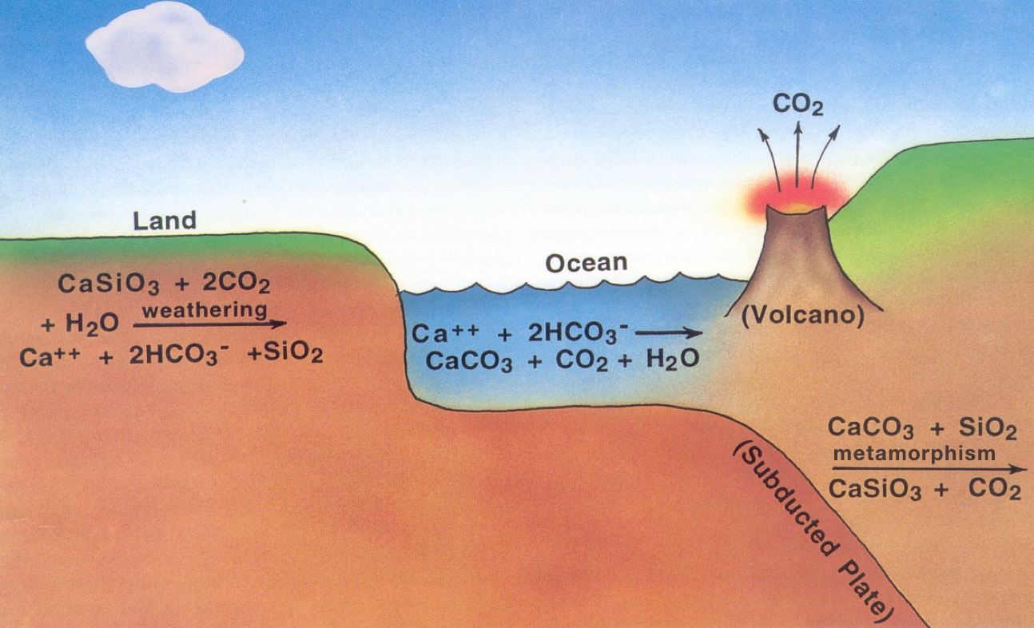
The carbonate-silicate cycle
The habitable zone is relatively wide because of negative feedbacks
in the carbonate-silicate cycle: Atmospheric CO₂ should build up as
the planet cools
Higher CO₂ is also at least part of the solution to the faint young Sun
problem on Earth

Slide 10
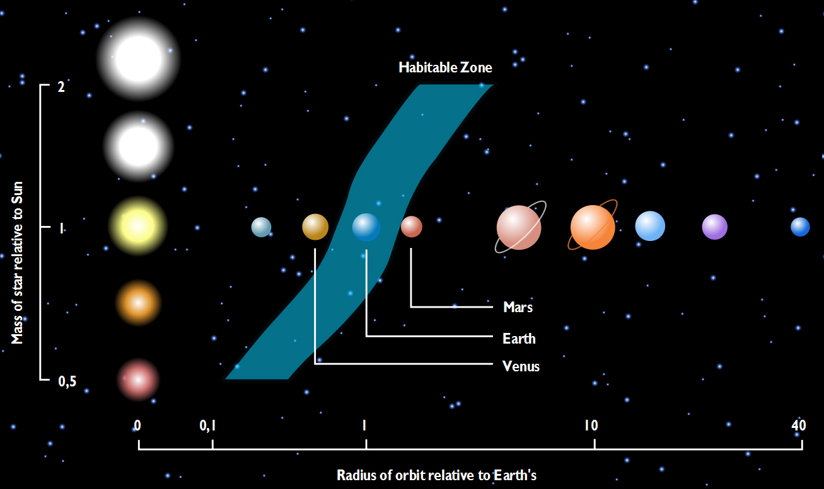
The ZAMS habitable zone
With this in mind, one gets a habitable zone that is fairly wide compared
to the mean planetary spacing
Figure applies to zero-age-main-sequence stars; the HZ moves outward
with time because all main sequence stars brighten as they age
http://www.dlr.de/en/desktopdefault.aspx/tabid-5170/8702_read-15322/8702_page-2/

Slide 11
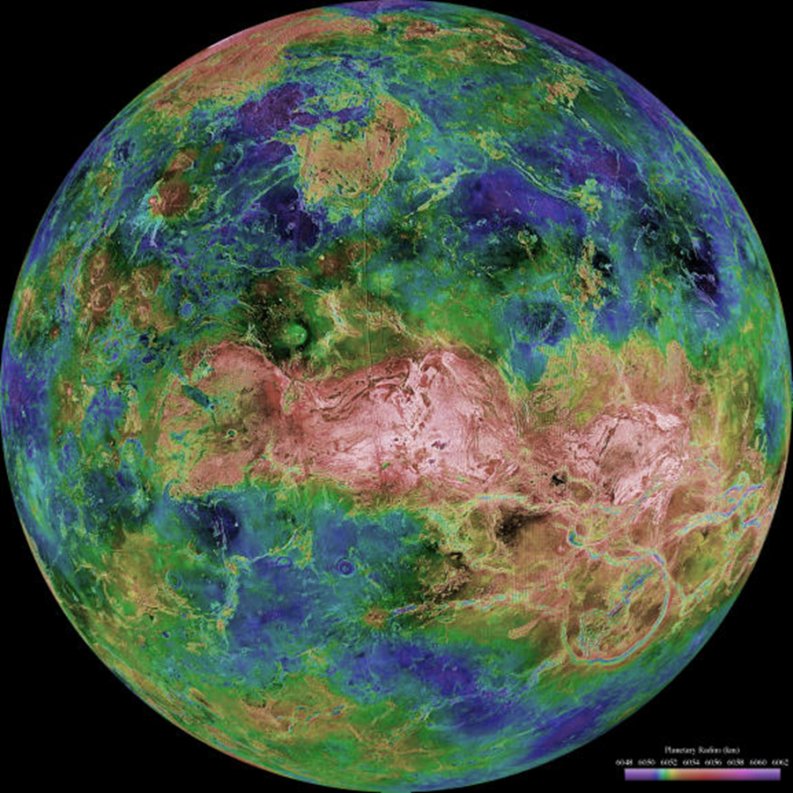
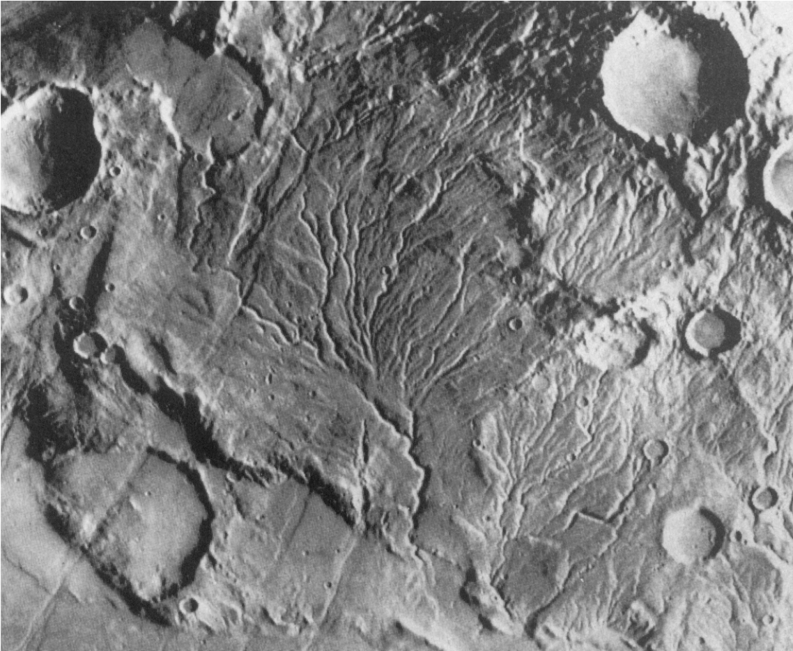
Empirical HZ limits
Some researchers don’t trust theorists
We can also define empirical limits on the HZ
From looking at its surface, we can discern that Venus has not had liquid water for at least the last 1 b.y.
Mars, on the other hand, looks as if it was habitable at about 3.8 Ga

Slide 12
In the last 10 years, there have been many new exoplanet discoveries…

Slide 13
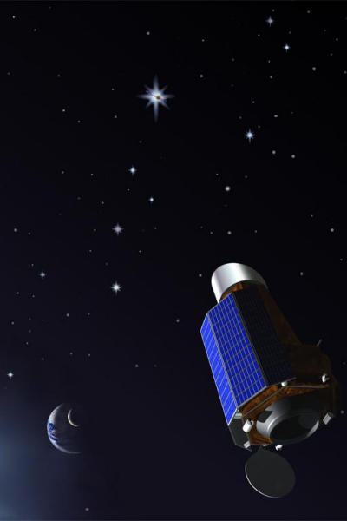
Kepler Mission
This space-based telescope
pointed at a patch of the
Milky Way and monitored the
brightness of ~160,000 stars,
looking for transits of Earth-
sized (and other) planets
10⁻⁵ precision photometry
0.95-m aperture ⇒ capable
of detecting Earths
Launched: March 5, 2009
Died (mostly): April, 2013
http://www.nmm.ac.uk/uploads/jpg/kepler.jpg

Slide 14
What is the value of η_{Earth}?
η_{Earth}—the fraction of stars that have at least one rocky planet in their habitable zone
Kepler taught us some of what we want to know
η_{Earth} ≅ 0.2 for M stars (Dressing and Charbonneau, ApJ, 2015)
η_{Earth} = 0.24 +0.46/-0.16 for FGK dwarfs (Chris Stark et al., JATIS, in press*)
*The ExoEarth Yield Landscape for Future
Direct Imaging Space Telescopes (from SAG
13 report)

Slide 15
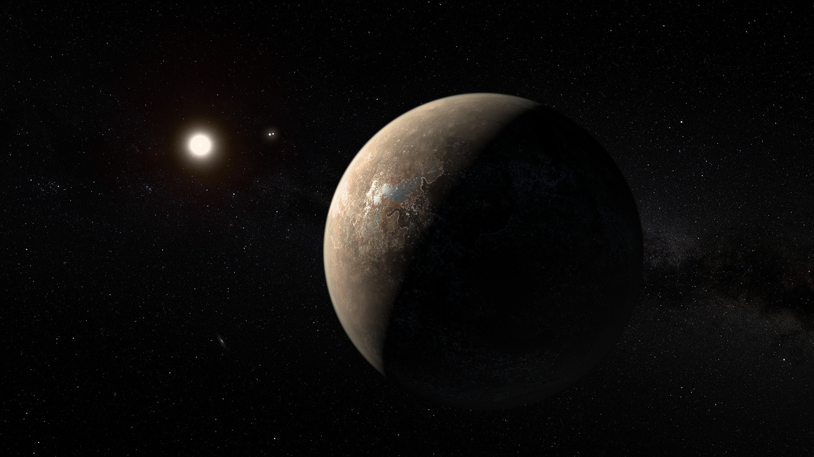
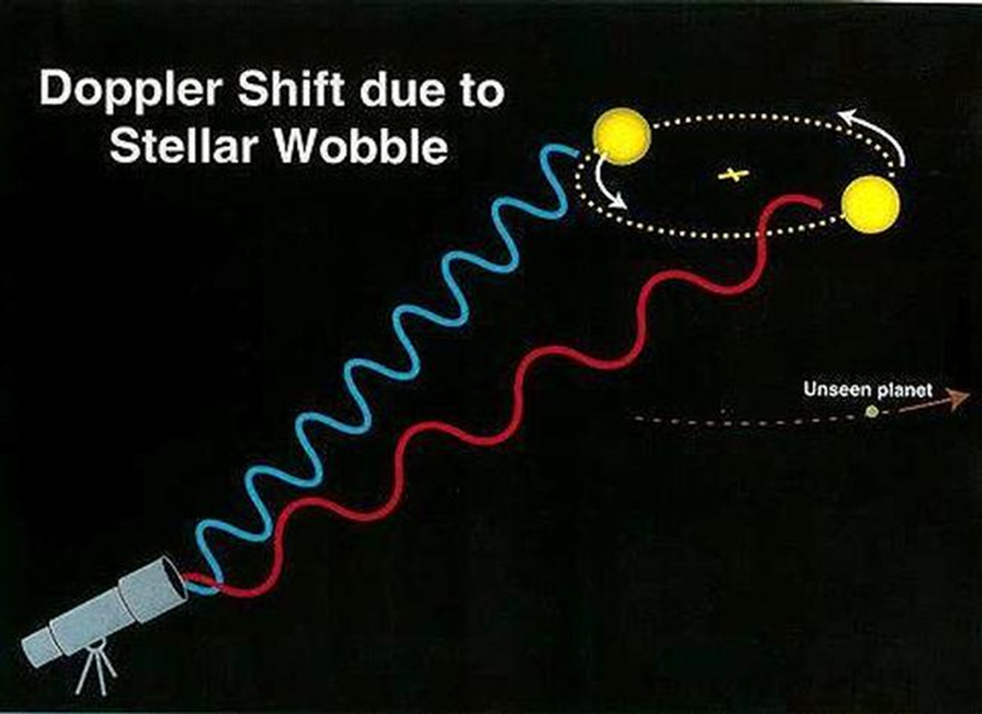
Proxima Centauri b
There is a planet in the habitable zone around Proxima Centauri!
This planet was found from the ground (HARPS) using the radial velocity method
Star: Red dwarf, 0.12 M_{Sun}, 4 light years distant
Planet: M sini = 1.27±0.2 M⊕, stellar flux = 0.65 S⊕
Anglada-Escudé et al., Nature (2016)

Slide 16
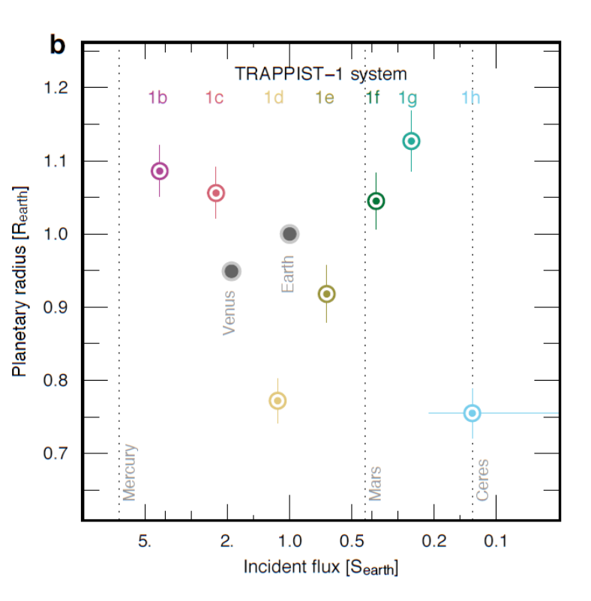
TRAPPIST-1 System
These planets were found by the transit method with an automated 60-cm telescope in Chile
Stellar characteristics
Very late M star
Distance: 12.1 pc (~40 light years)
Mass: ~0.08 M_{Sun}
T_{e}: ~2560 K
Luminosity: 0.00052 L_{Sun}
Radius: 0.12 R_{sun}
Metallicity: [Fe/H] = +0.04±0.08
Gillon et al., Nature (2017)

Slide 17
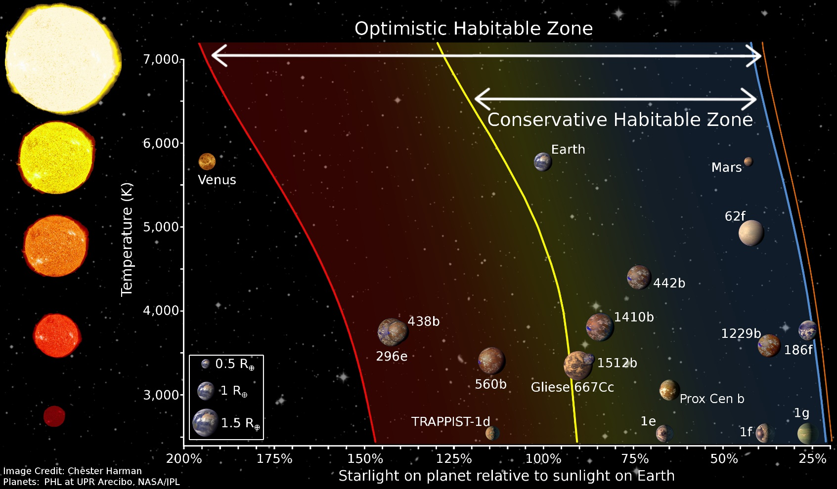
Updated habitable zone
Three of the seven Trappist-1 planets fall within the conservative
HZ, as does Proxima Centauri b

Slide 18
Future observation/spectral characterization of exoplanets ⇒

Slide 19
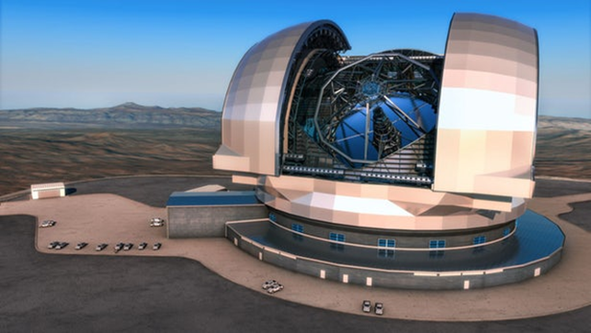
From the ground
Proxima Centauri b can hopefully be observed from the ground using future 30- and 40-m telescopes (and maybe existing 8-m ones)
Need a good coronagraph to separate the light from the planet from that of the star
The general name for this technique is direct imaging
High-resolution spectroscopy could detect O₂ in a planet’s atmosphere by using the Doppler shift of the individual rotation-vibration lines (Snellen et al., A&A, 2015)
ESO’s planned Extremely
Large Telescope (ELT)—39 m
aperture

Slide 20
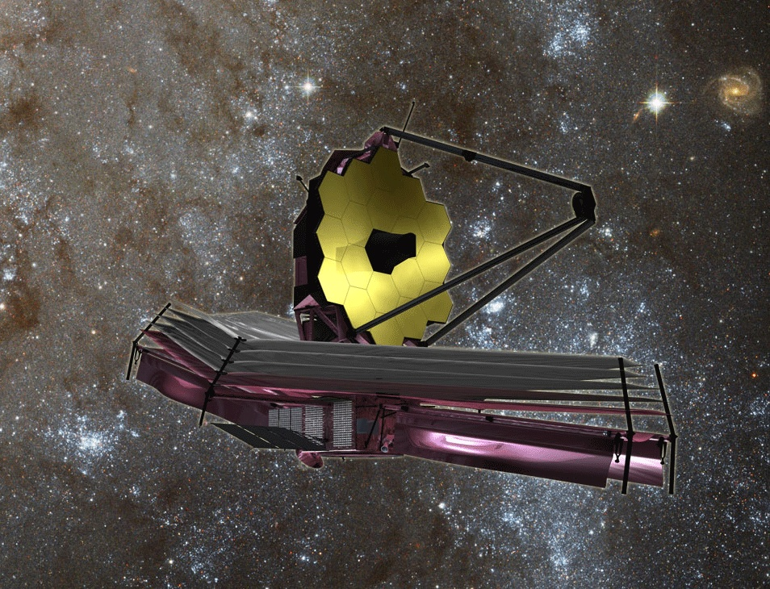
From JWST and TESS
NASA’s James Webb Space Telescope, now scheduled for launch in 2020, could in principle characterize Earth-size planets using transit spectroscopy
NASA’s TESS mission, which launches in early 2018, will look for transiting HZ planets around nearby K and M stars
TRAPPIST-1 is already a target
In practice, however, getting good spectra of rocky planets is a scientific long-shot
We want instead to look for non-transiting planets using space-based direct imaging..
6.5 m
NASA’s James Webb Space Telescope

Slide 21
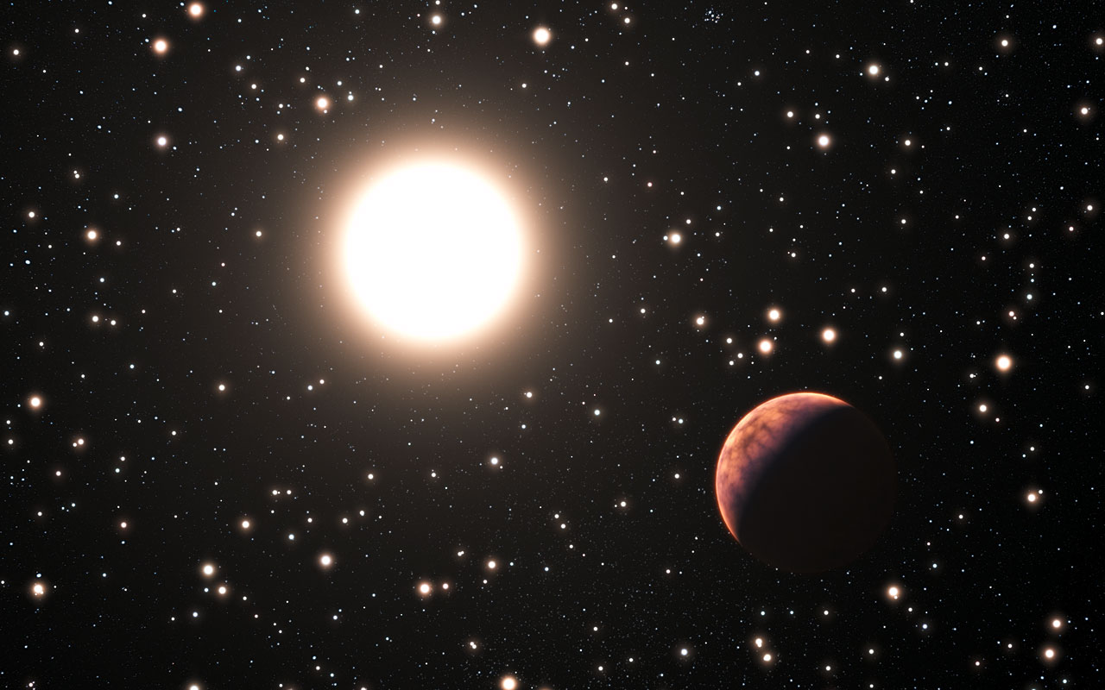
From direct imaging
In direct imaging, one tries to block out the light from the star and look for the reflected light (or emitted IR radiation) from the planets around it
The thermal-IR is attractive because the planet-star contrast ratio is smaller
But the visible/near-IR is better because the diffraction limit is much smaller (θ ~ λ/D) and you don’t need to cool the telescope

Slide 22
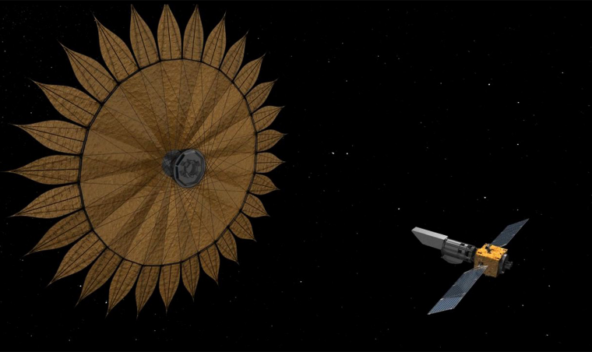
Modern direct imaging concepts
LUVOIR: the Large UV-Optical-IR Space Telescope
HabEx: the Habitable Planets Explorer
LUVOIR is bigger (9-15 m)
HabEx is smaller, but still not tiny (4-6 m)
Both telescopes are being studied as potential flagship missions for the 2030’s
These missions can also look for signs of life
LUVOIR?
HabEx? (May or may not include a
starshade)

Slide 23


Looking for life via the by-products of metabolism
Green plants and algae (and cyanobacteria) produce oxgyen from photosynthesis:
CO₂ + H₂O → CH₂O + O₂
Methanogenic bacteria produce methane
CO₂ + 4 H₂ → CH₄ + 2 H₂O
CH₄ and O₂ are out of thermodynamic equilibrium by 20 orders of magnitude* Hence, their simultaneous presence is strong evidence for life
O₂
CH₄
*As first pointed out by James Lovelock (Nature, 1965)

Slide 24
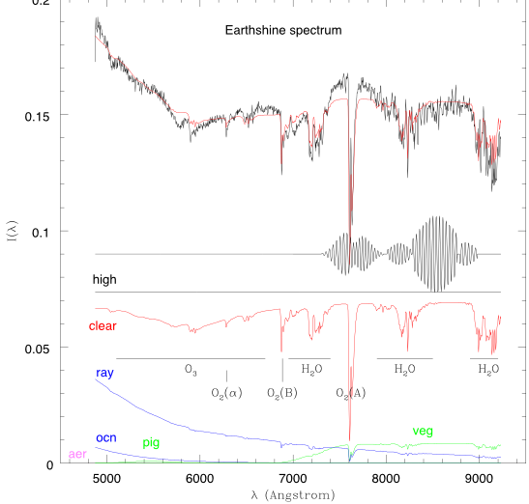
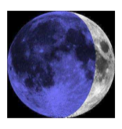
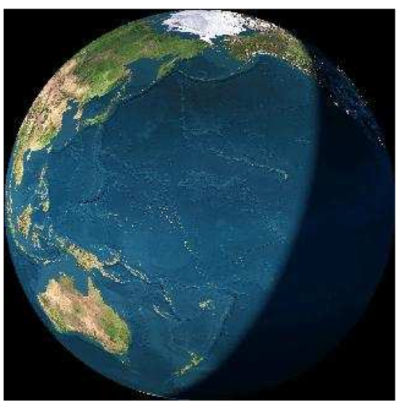
Visible spectrum of Earth
Integrated light of Earth, reflected from dark side of moon: Rayleigh
scattering, chlorophyll, O₂, O₃, H₂O
Ref.: Woolf, Smith, Traub, & Jucks, ApJ 2002; also Arnold et al. 2002

Slide 25
Conclusions
Detectable life requires, at a minimum, a planet with a solid (or liquid) surface, a source of free energy, sufficient availability of carbon, and surface liquid water
Habitable zones should be defined conservatively if they are being used to generate design parameters for future space-based telescopes
3-D climate models are needed to further refine the boundaries of the HZ
30-40 m ground-based telescopes may be able to characterize some nearby M-star planets (like Proxima b)
JWST may be able to get transit spectra of an Earth-like planet around an M star (like TRAPPIST-1)
In the long run, both NASA and ESA want to do space-based direct imaging of exoplanets. This is our best chance for finding Earth-like planets and for looking for signs of life

Slide 26
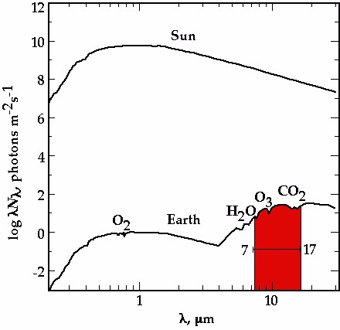
Terrestrial Planet Finder (TPF)
Visible or thermal-IR?
• Contrast ratio:
10¹⁰ in the visible
10⁷ in the thermal-IR
Resolution: θ = λ/D
-- Real telescopes
operate at some multiple
of this value
• Required aperture:
~8 m in the visible
80 m in the IR
TPF-C
TPF-I
≈ 10¹⁰
≈ 10⁷
Courtesy: Chas Beichman, JPL

Slide 27
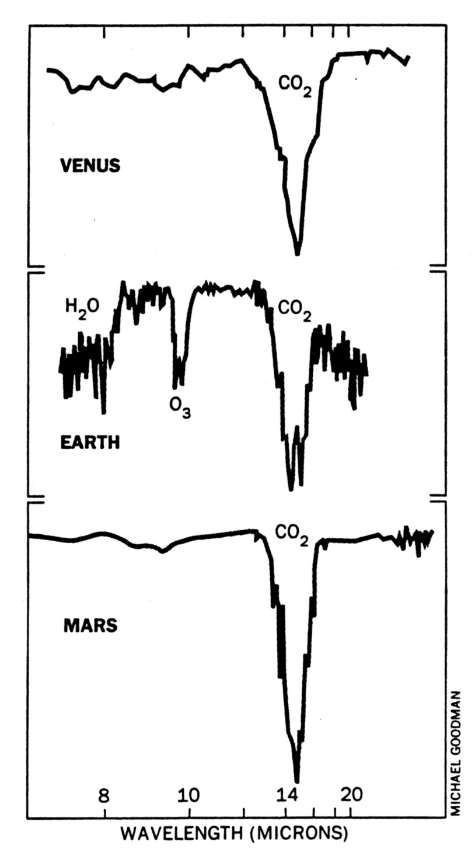
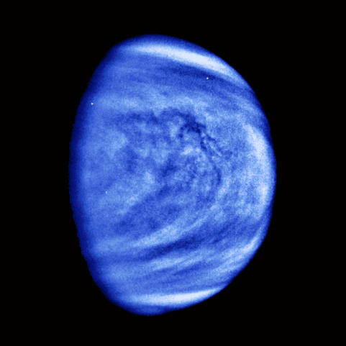
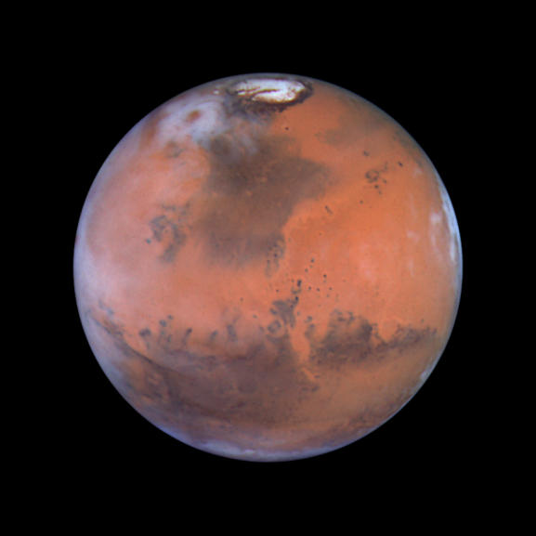
Thermal-IR
spectra
Source:
R. Hanel, Goddard
Space Flight Center

