Slide 1
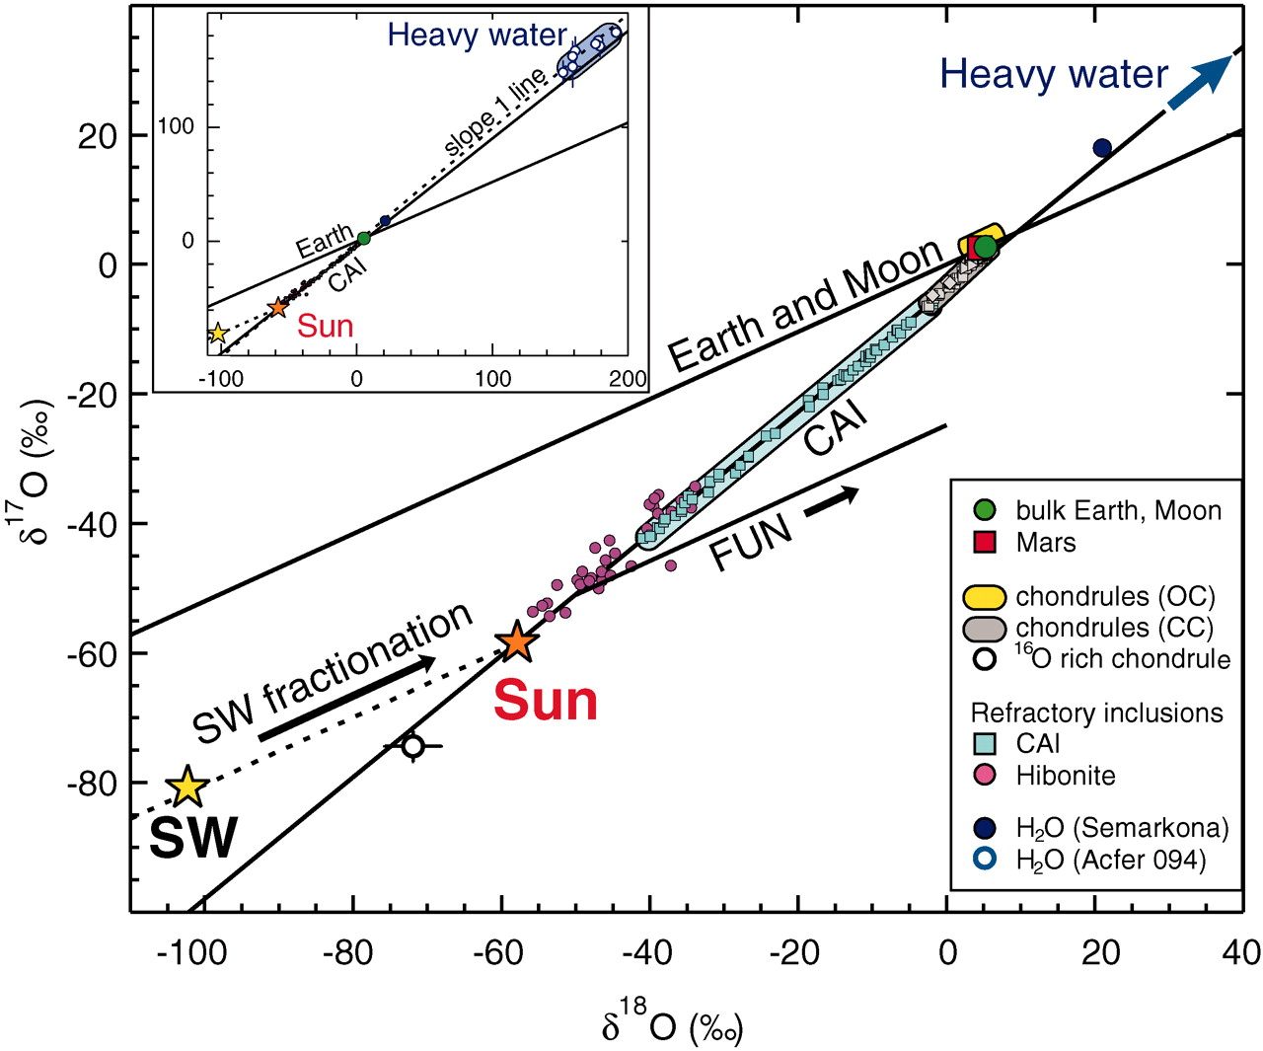
O isotopes in the early Solar System
Oxygen has three stable isotopes: ¹⁶O, ¹⁷O, and ¹⁸O
Normally, they plot along the mass fractionation line
δ¹⁷O ≅ 0.52 δ¹⁸O
where δ^{x}O is the deviation in
parts permil (‰) from the
standard (typically, SMOW)
The Earth and the Moon plot along the same line. Meteorites and meteorite inclusions, e.g. CAIs, plot elsewhere
K. D. McKeegan et al., Science (2011)
The solar wind measurements come from
NASA’s Genesis spacecraft, which crashed
into the Utah desert in 2004.

Slide 2
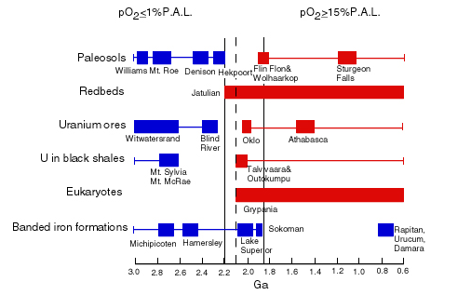
Geologic O₂ Indicators
(Detrital)
H. D. Holland (1994)
Blue boxes indicate low O₂
Red boxes indicate high O₂
Dates have been revised; the initial rise of O₂ is now placed at
2.45 Ga

Slide 3
MIF data as of 2011
The pattern in Δ³³S continues to hold as new data are added
Note the significant asymmetry between positive and negative Δ³³S values, especially from 2.5-2.7 Ga
Need a larger sulfur exit channel for the negative values so that the isotopic signal is diluted
D. T. Johnston, Earth Sci. Rev (2011)

Slide 4
Causes of sulfur MIF
All of this has led to great interest in the causes of sulfur MIF
Ever since 2000, the leading candidate has been photolysis of SO₂ in the 190-220 nm band
SO₂ + hν → SO + O
The SO₂ molecule predissociates (i.e., goes to an excited bound state before breaking apart), creating lots of opportunities for unusual isotope effects

Slide 5
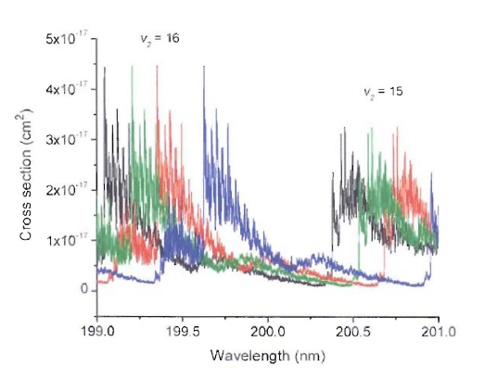
Production of sulfur “MIF” by SO₂ photolysis
Photolysis
Photo-
excitation
UV absorption coefficients
Blowup of different forms of SO₂
The different isotopologues of SO₂ (e.g. ³²SO₂ and ³³SO₂)
absorb UV radiation at slightly different wavelengths
J.R. Lyons, GRL (2007)

Slide 6
Production of sulfur “MIF” by SO₂ photolysis
Photolysis
Photo-
excitation
UV absorption coefficients
Blowup of different forms of SO₂
This wavelength region is shielded by ozone today, and so
Farquhar et al. inferred that the Archean atmosphere must
have been low in O₂ and O₃
J.R. Lyons, GRL (2007)

Slide 7
PNAS, in press
In a new paper, Babikov has shown that while assumptions 2 and 3 are correct, assumption 1 is valid only some of the time
In particular, isotopic reaction rates should be doubled for S₂ formation, but not for formation of S₄ or S₈

Slide 8
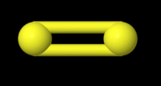
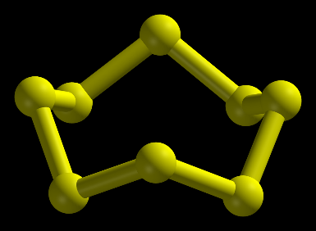
Sulfur chain formation
The main formation sequence is thought to be
S + S + M → S₂ + M
S₂ + S₂ + M → S₄ + M
S₄ + S₄ + M → S₈ + M
At each of the latter two steps, the chance of incorporating any minor isotope, ^{x}S, goes down by a factor of 2 ⇒ big MIF signal that affects each isotope equally
S₂
S₄
S₈

Slide 9
Sulfur chain formation
S₂ formation does not create MIF because S₂ acts as rigid rotator
The ‘normal’ (³²S³²S) molecule is symmetric, so it lacks even rotational states
The isotopically substituted molecule (^{x}SS) is asymmetric and has both even and odd rotational states
This creates twice as many pathways for formation of ^{x}SS compared to S₂, thereby doubling the rate constant
S₂
S₄
S₈

Slide 10
Sulfur chain formation
S₄ and S₈ are also symmetric molecules, but they are ‘floppy’ and should not behave like rigid rotators; hence, they do not obey the same selection rules on rotational states, and so the rates of the isotopically substituted reactions should not be doubled
S₂
S₄
S₈

Slide 11
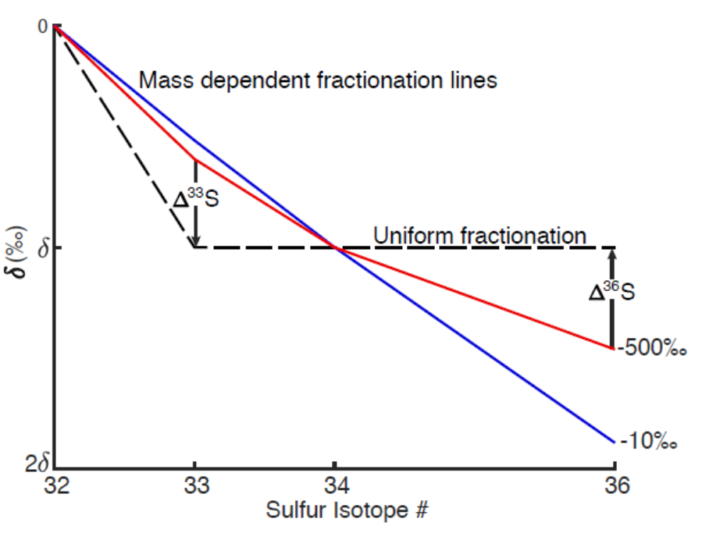
MIF generation during formation of S₄ and S₈
If the rates of the S₄ and S₈ formation reactions behave as Babikov predicts, then each reaction should generate 500‰ fractionation (i.e., a factor of 2)
Δ³³S should be negative for elemental sulfur
Δ³⁶S should be positive and approximately twice as large
Harman et al., Science (submitted)

Slide 12
MIF generation during formation of S₄ and S₈
In the linear regime, the predicted slope of Δ³³S vs. δ³⁴S is 0.5, in agreement with the data
In the linear regime, the slope of Δ³⁶S vs. Δ³³S is −2
Harman et al., Science (submitted)

