Slide 1
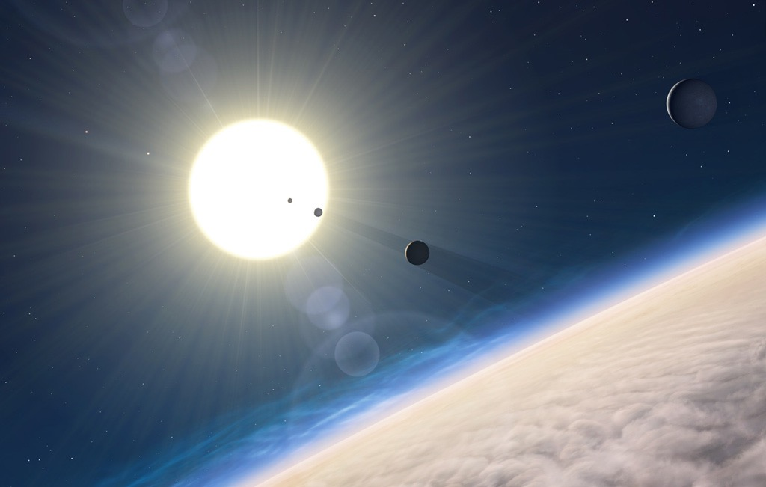
Potential habitable worlds
The search for
Ravi Kopparapu
(NASA Goddard)

Slide 2
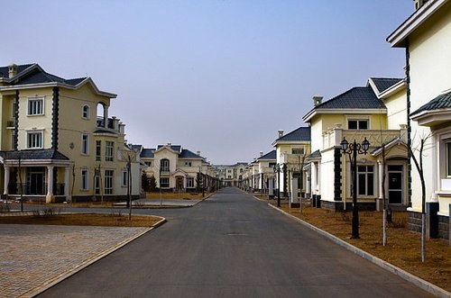
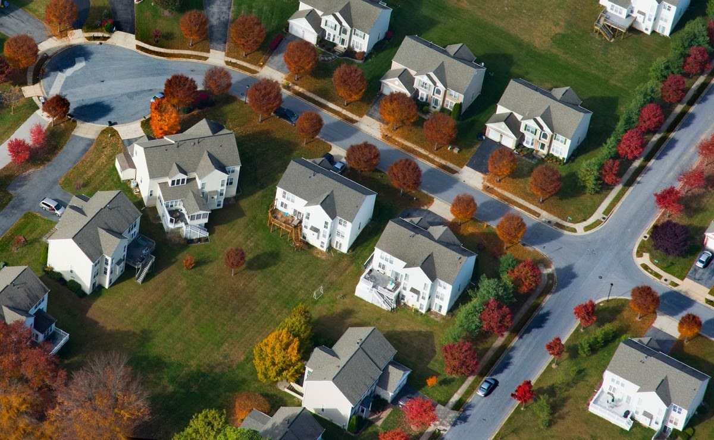
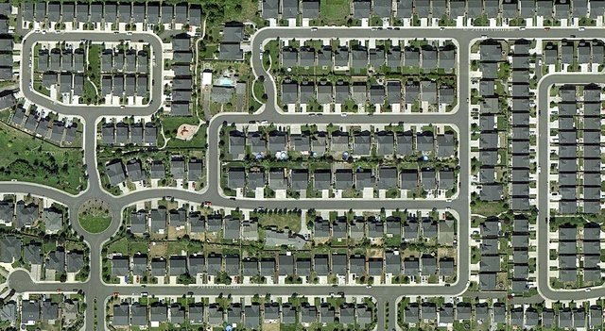

where is everybody?

Slide 3
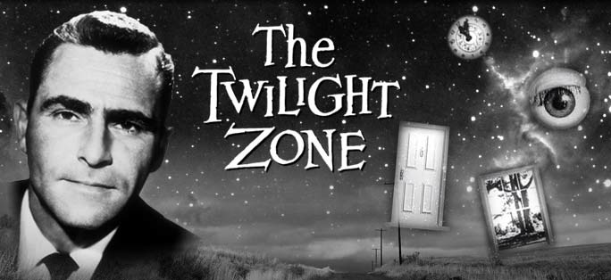
Where is everybody?
Is there anyone out there?

Slide 4

ARE THERE PLANETS AROUND OTHER STARS?
IF YES, HOW COMMON ARE THEY?
WHAT KIND OF PLANETS ARE OUT THERE?
DO THEY HAVE LIFE ON THEM?
DOES LIFE REQUIRE SPECIAL CONDITIONS?
IS EARTH THE ONLY HABITABLE PLANET?
HOW DO WE FIND A HABITABLE PLANET?
ROD SERLING

Slide 5
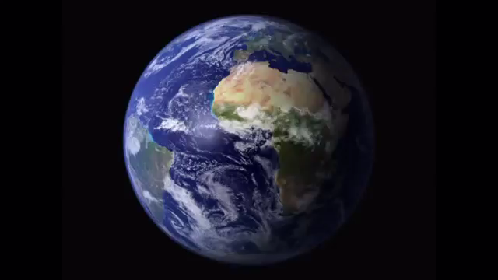
our habitable planet
NASA-GSFC,Robert Simmon

Slide 6
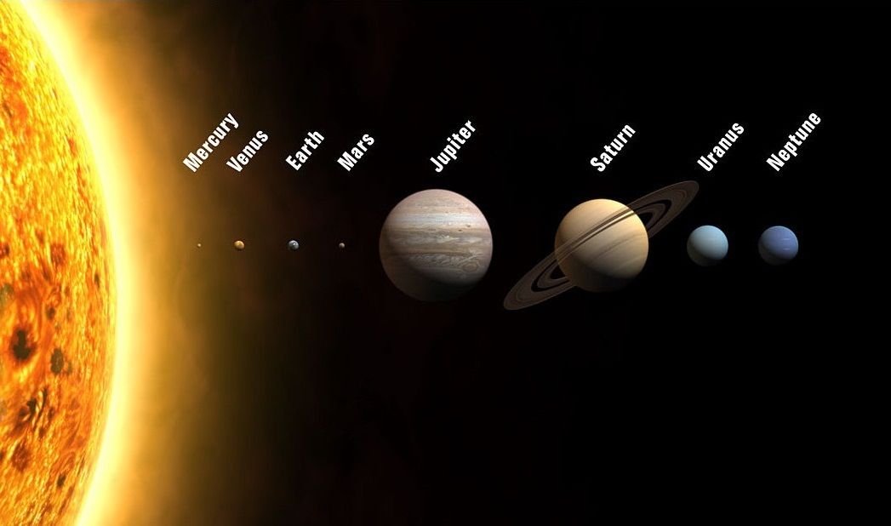
our solar system
IAU.org

Slide 7
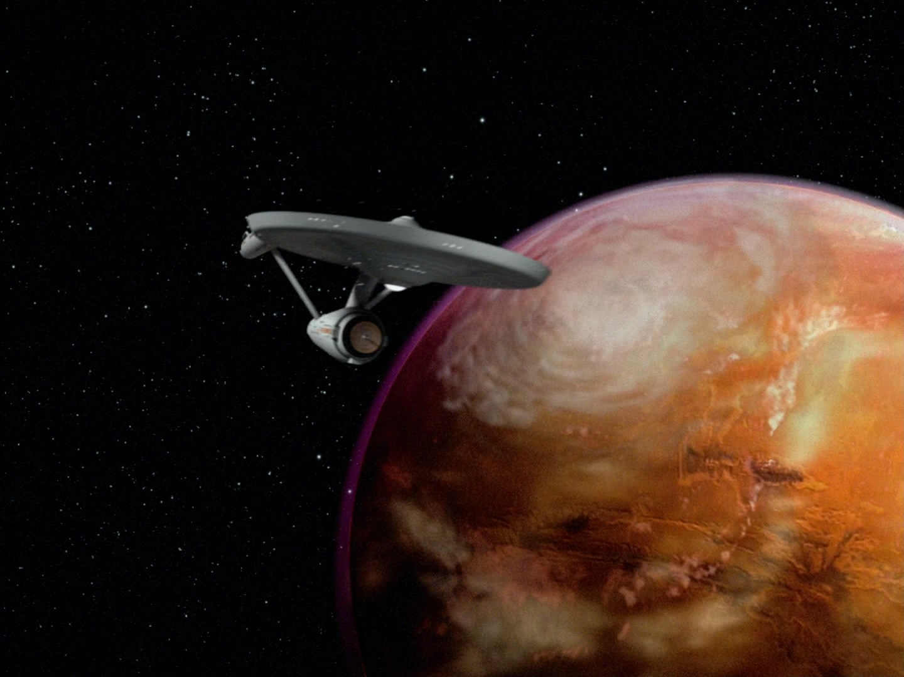
science and science fiction
DO WE KNOW IF THERE ARE PLANETS AROUND OTHER STARS?

Slide 8

Extrasolar planet
Michael Lentz (USRA)
MORE THAN 1700 PLANETS FOUND. THOUSANDS MORE WAITING TO BE CONFIRMED

Slide 9
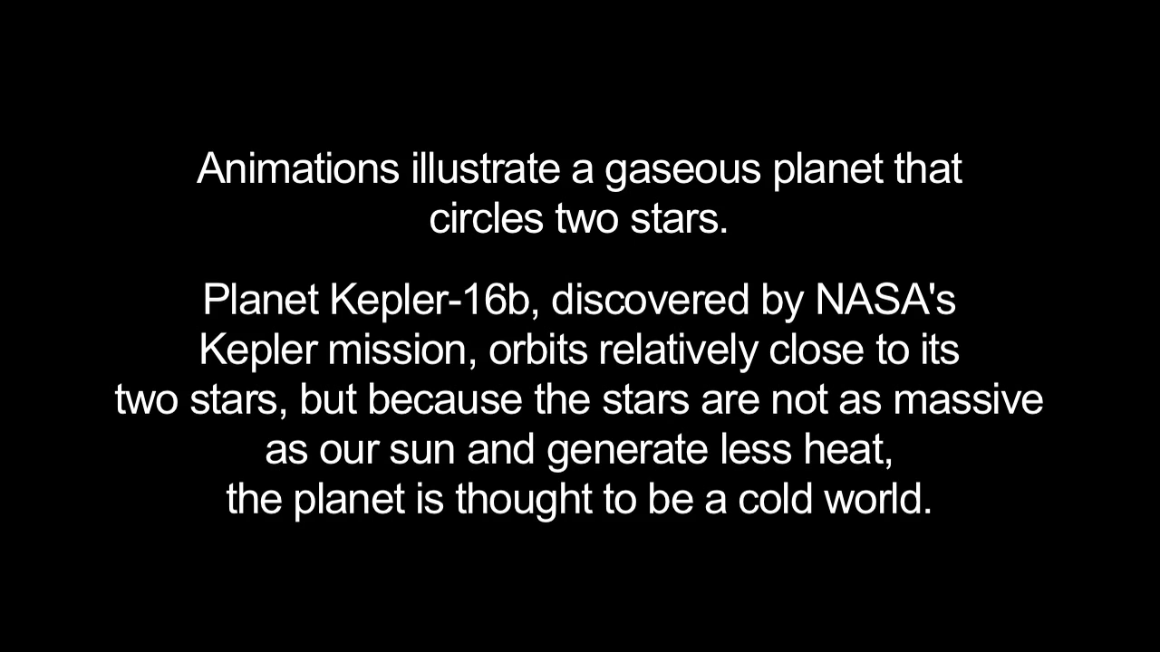
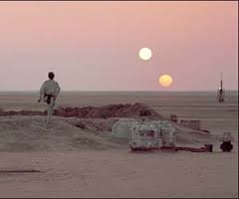
double star planets
Kepler-16b
(Animation: JPL/Caltech)

Slide 10
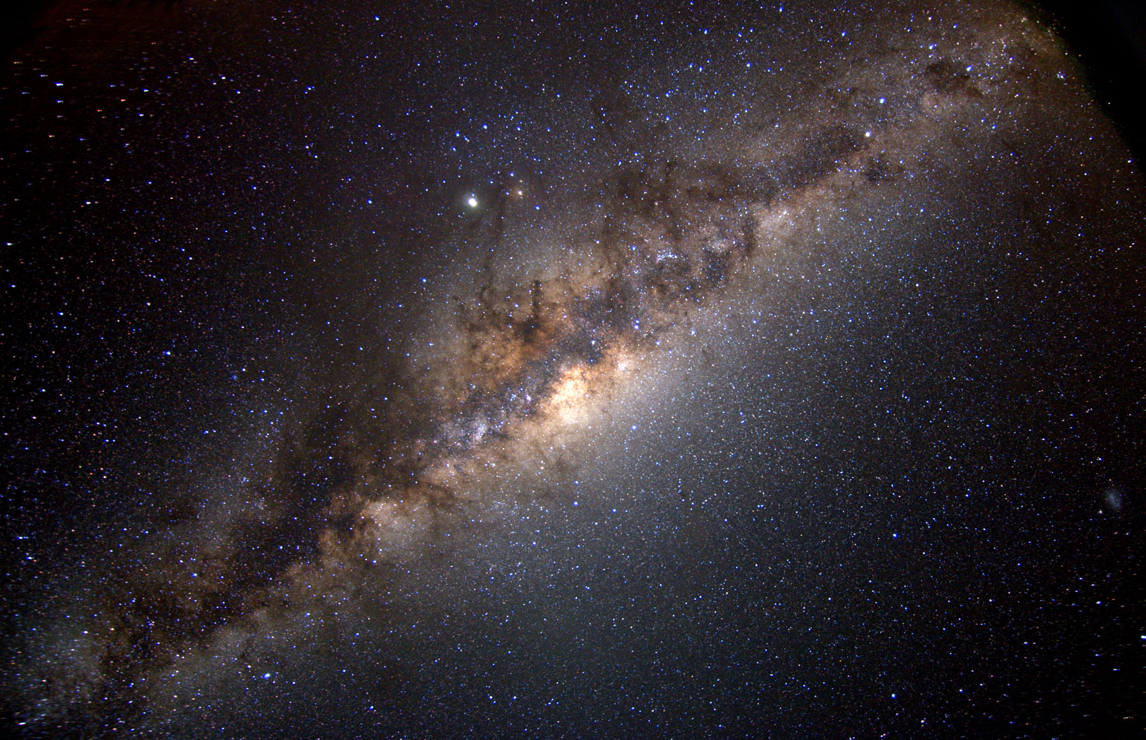
Almost every star in our Galaxy has a planet around it.

Slide 11
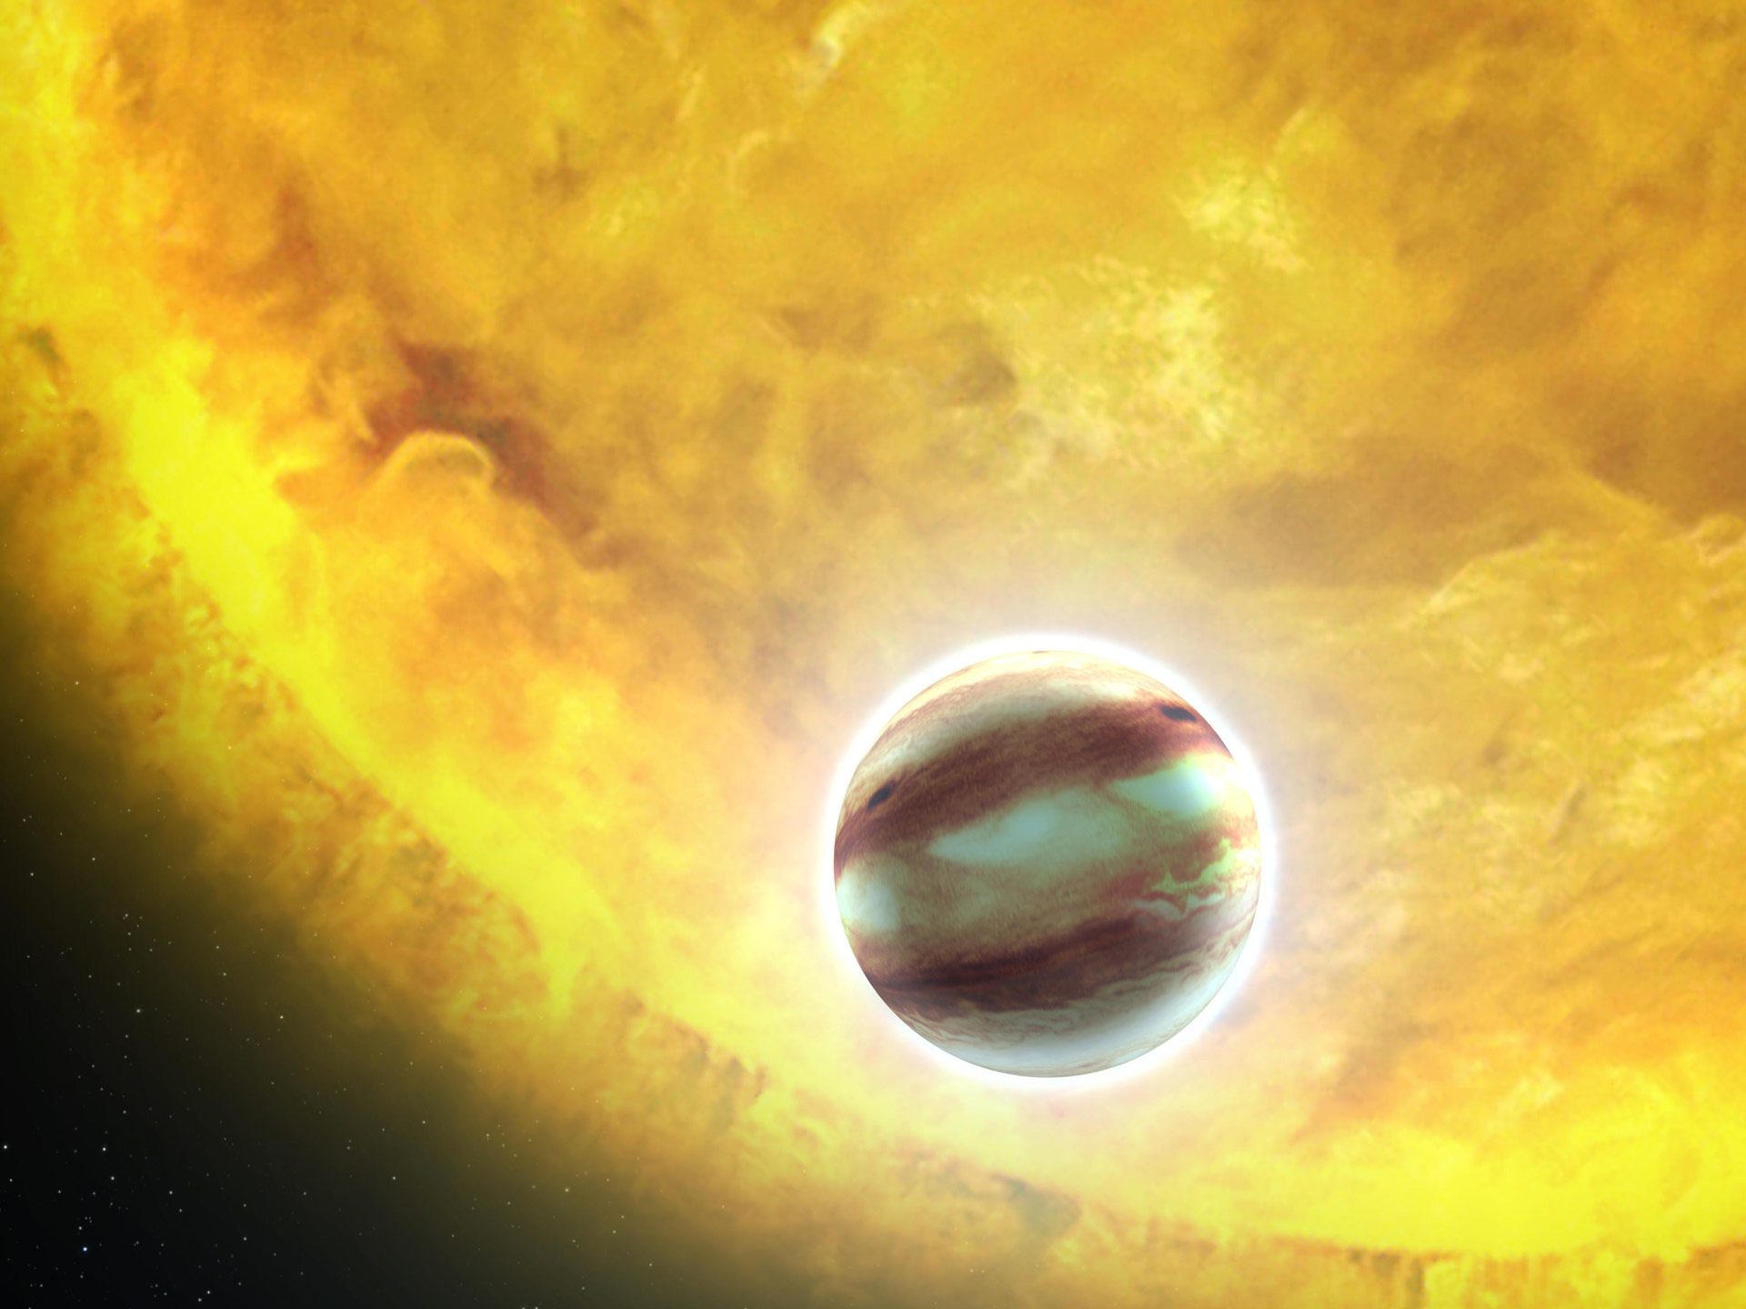
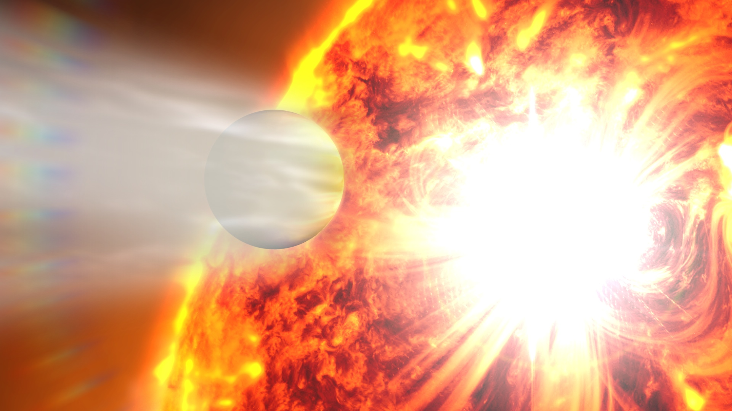
what kind of planets are out there?
hot-jupiters!
NASA, ESA, and G. Bacon (STScI)
NASA-GSFC

Slide 12
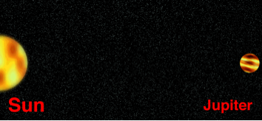

FIRST EXTRASOLAR PLANETARY SYSTEM AROUND A SUN-LIKE STAR
51 PEGASI b

Slide 13
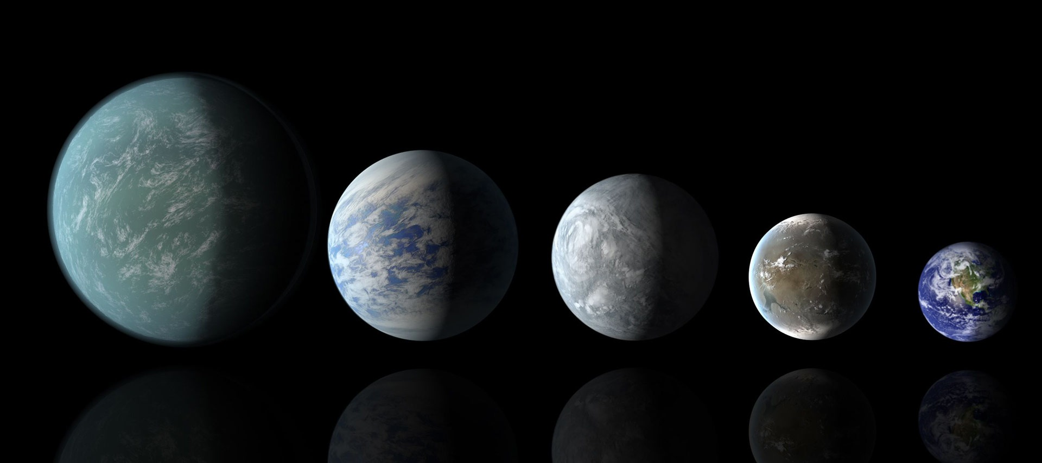
what kind of planets are out there?
super-earths and mini-neptunes!
NASA Ames/JPL-Caltech

Slide 14
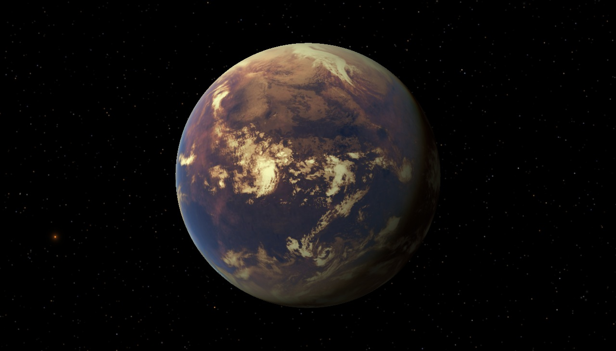
our solar system
IAU.org

Slide 15
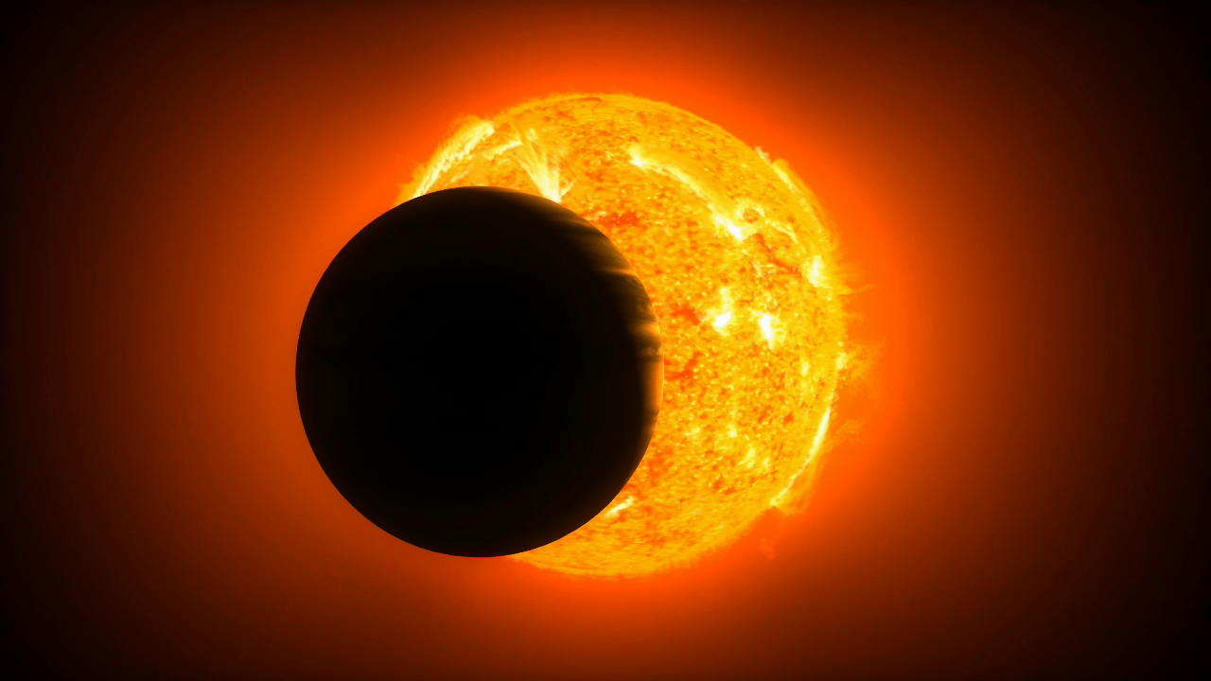
why didn’t we find any before?
A Sun-like star is about a billion times brighter than the light reflected from its planets.
This is like being in San Francisco and trying to see a pinhead 15 meters from a grapefruit in Washington, D.C.

Slide 16
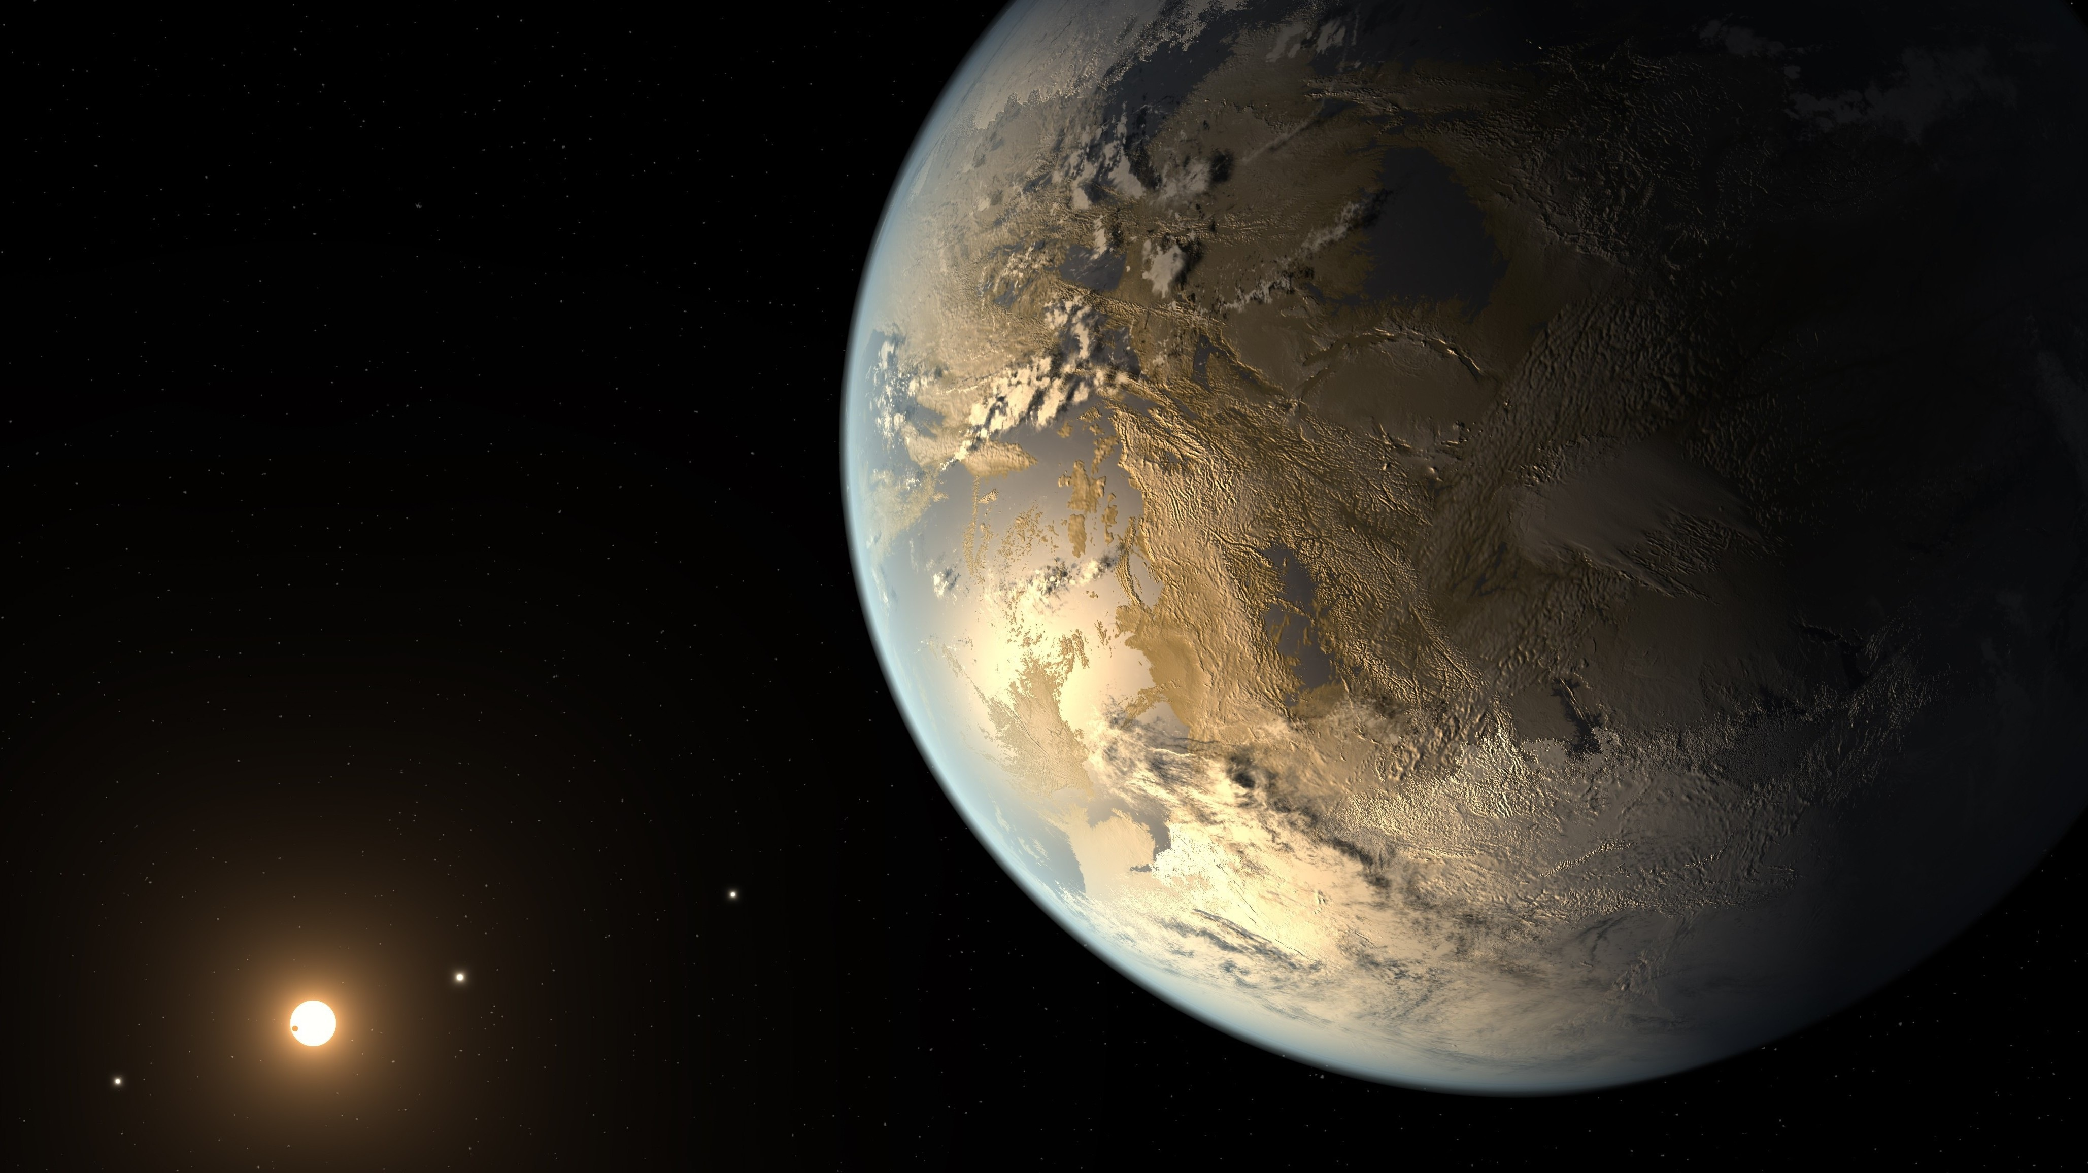
any interesting candidates?
Do you mean the planets that are Earth-size that can have alien life?
NASA Ames/SETI Institute/JPL-Caltech

Slide 17
why is the earth habitable?
Right size, atmosphere, temperature, abundant water.
But the most important…right distance from the Sun.

Slide 18
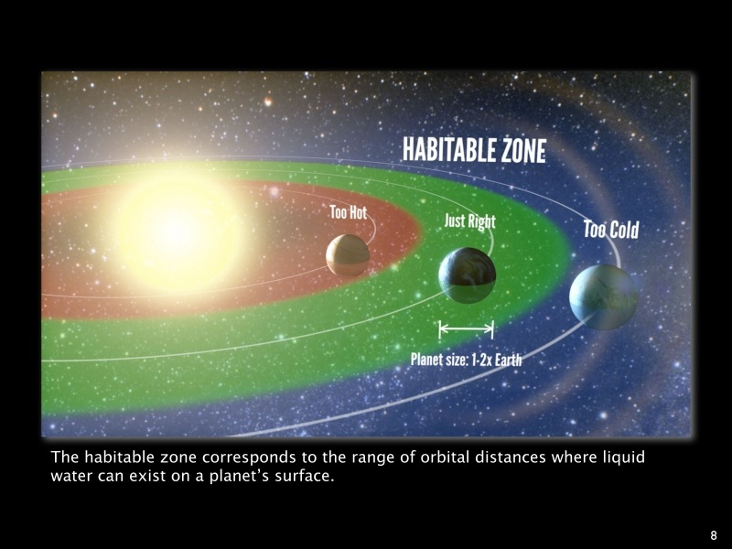
habitable zone
(“Goldilocks Zone”)
Credit: Petigura/UC Berkeley, Howard/UH-Manoa, Marcy/UC Berkeley

Slide 19
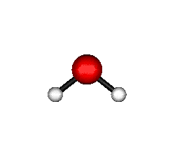

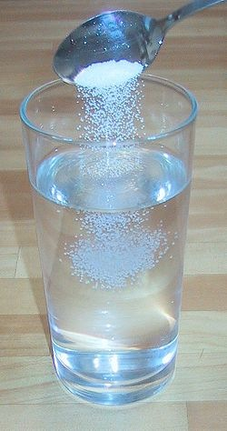
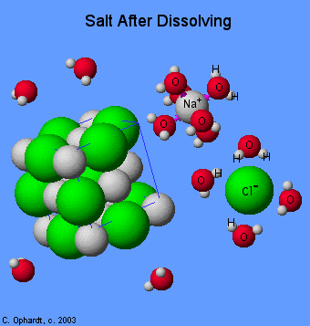
why “Liquid Water”?
Oxygen
Hydrogen
Hydrogen
Water is a “polar” molecule.
And a universal solvent!
Can form bonds allowing
chemical reactions.

Slide 20
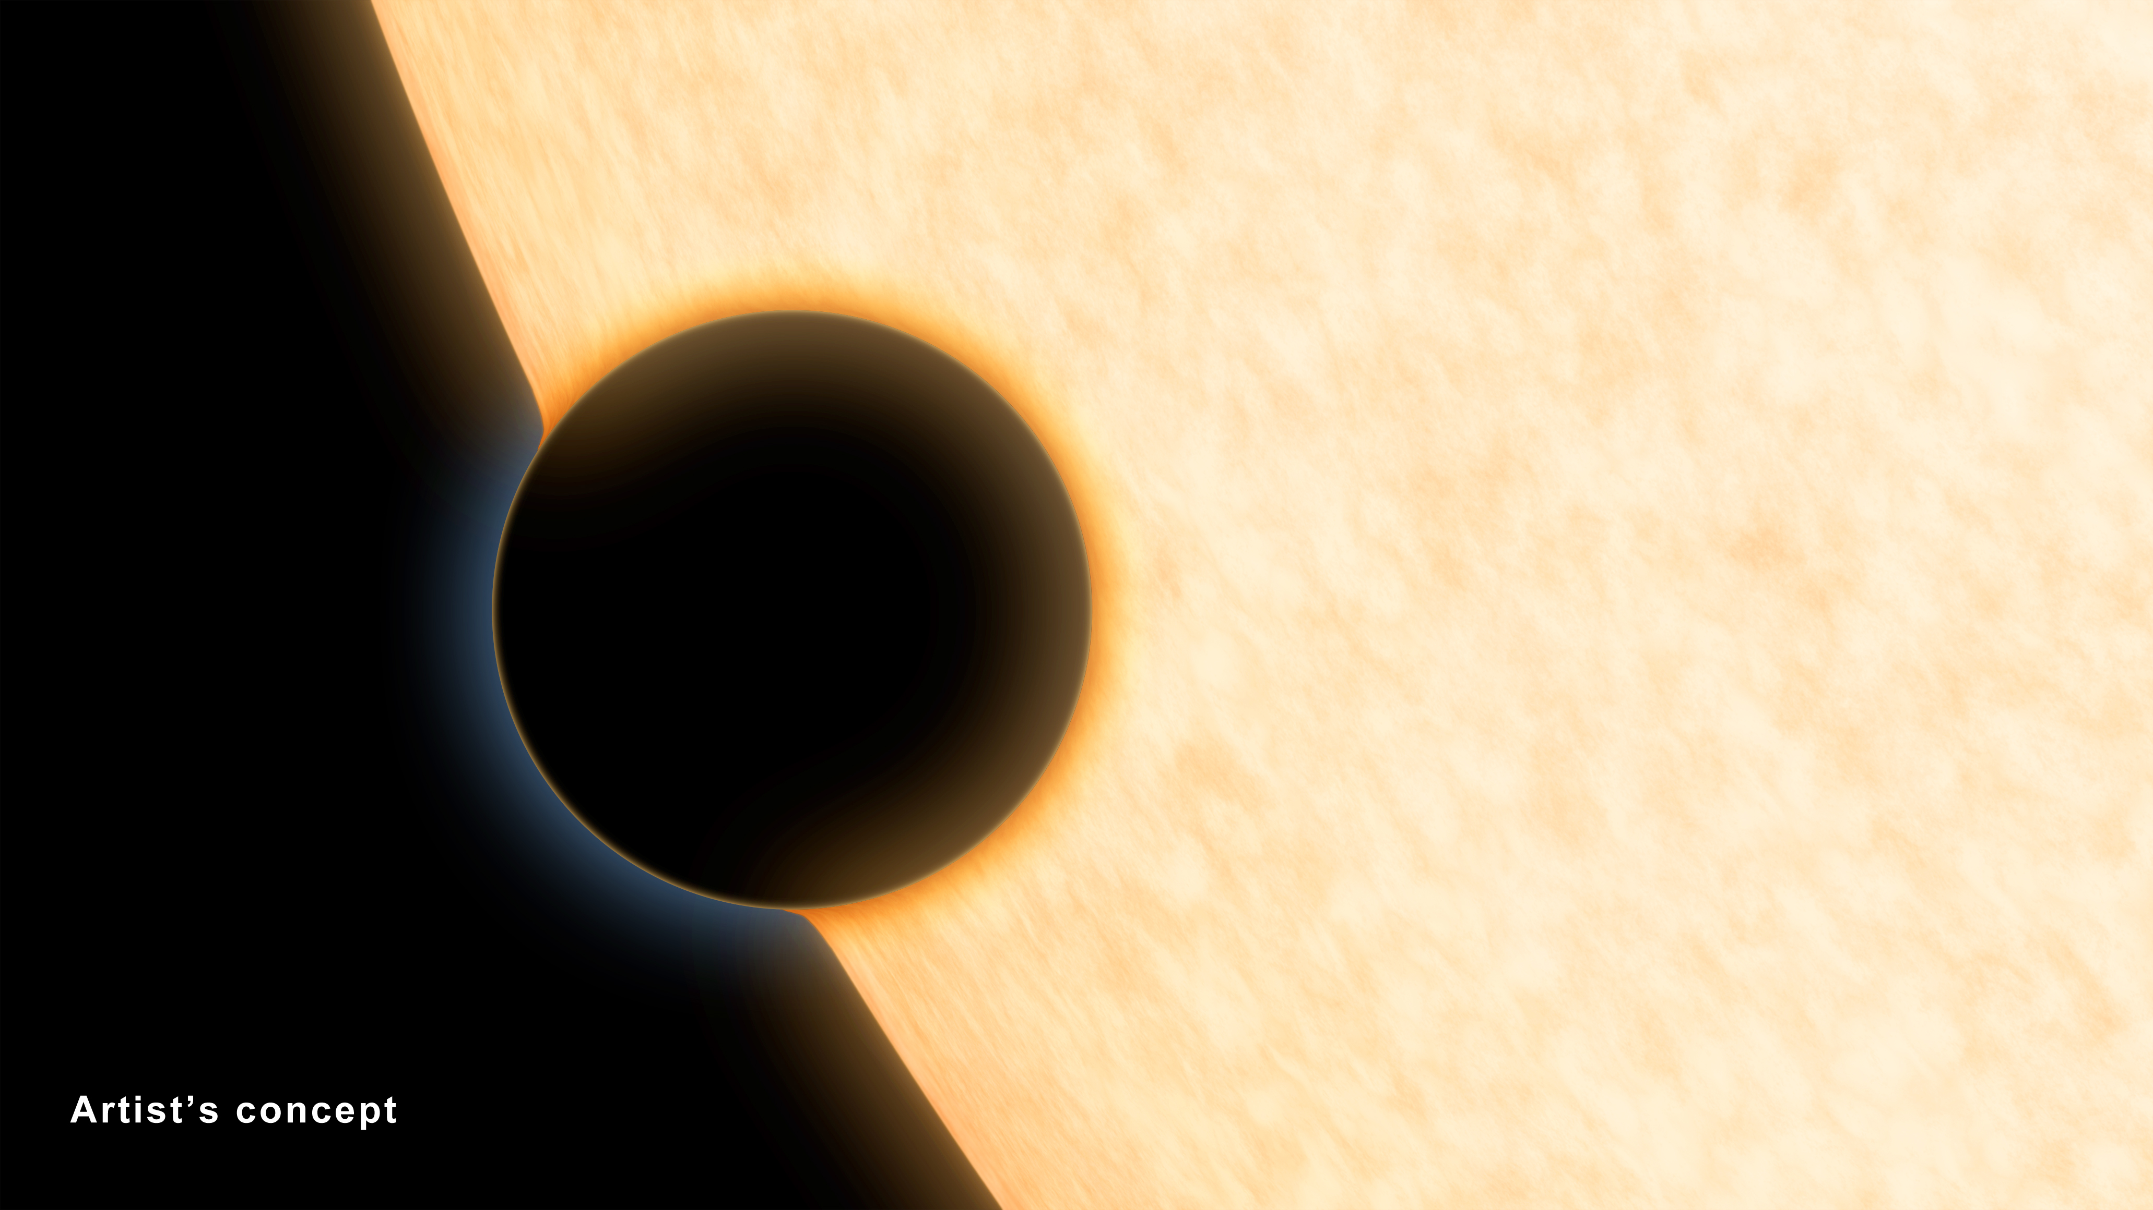
Currently, we can only see the outer atmospheres of planets remotely, using telescopes.

Slide 21

how do we find signatures of life on other planets?
NASA/JPL/Caltech

Slide 22
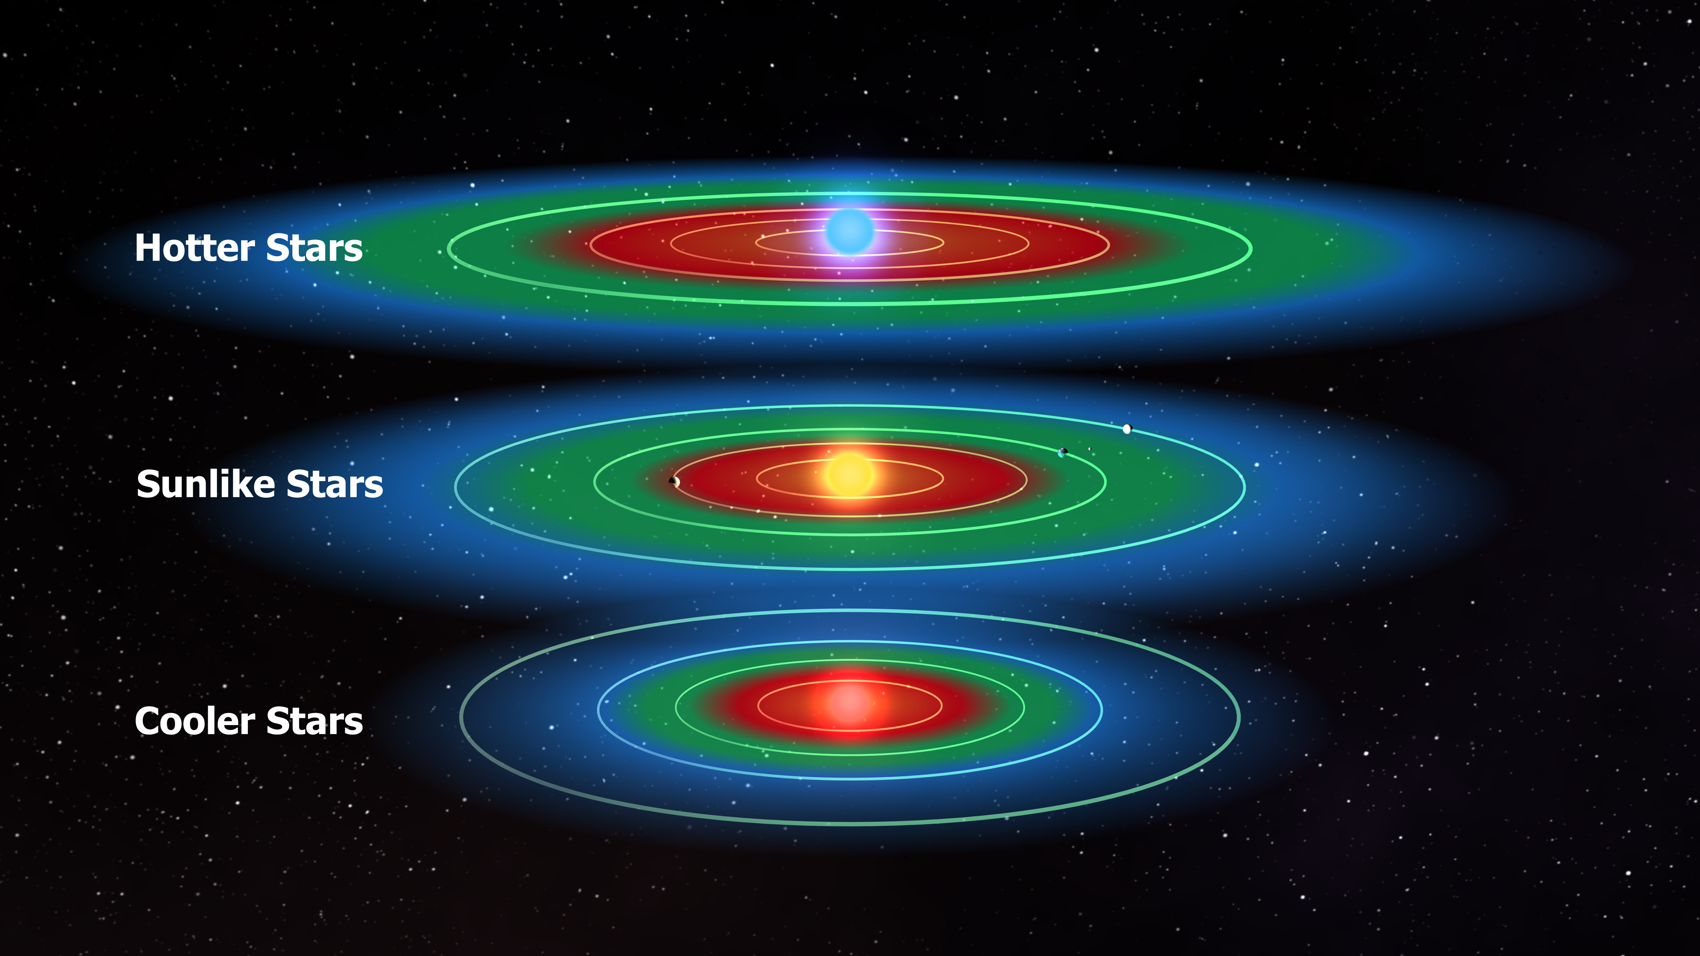
habitable zone
`
NASA/Kepler Mission/Dana Berry

Slide 23
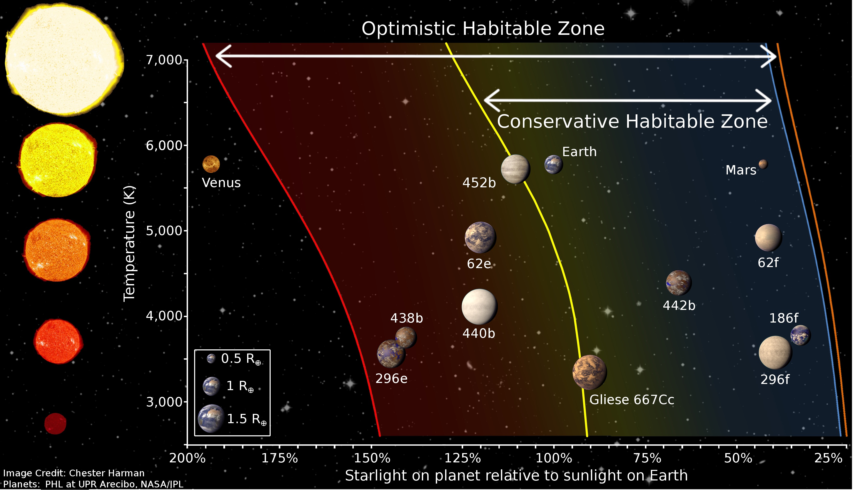

Slide 24
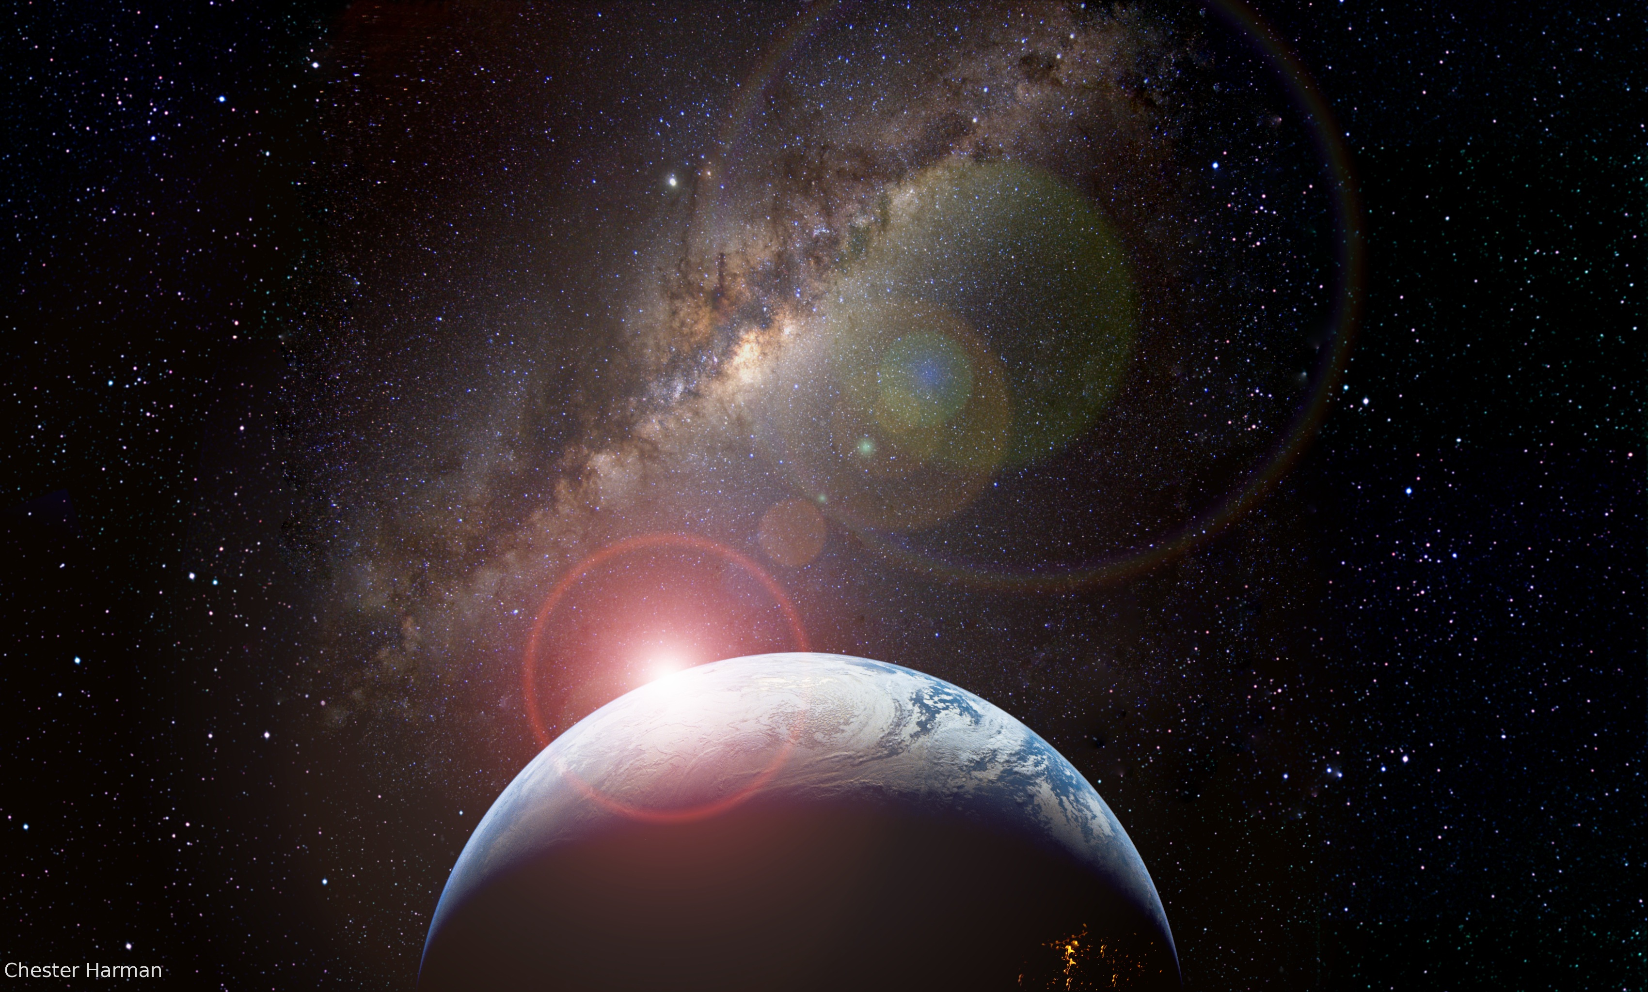
how common are potential habitable planets?

Slide 25

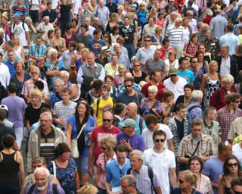
how common are potential habitable planets?
Survey:
Gather information from a small population that is uniformly mixed.
Apply the result to a larger population

Slide 26
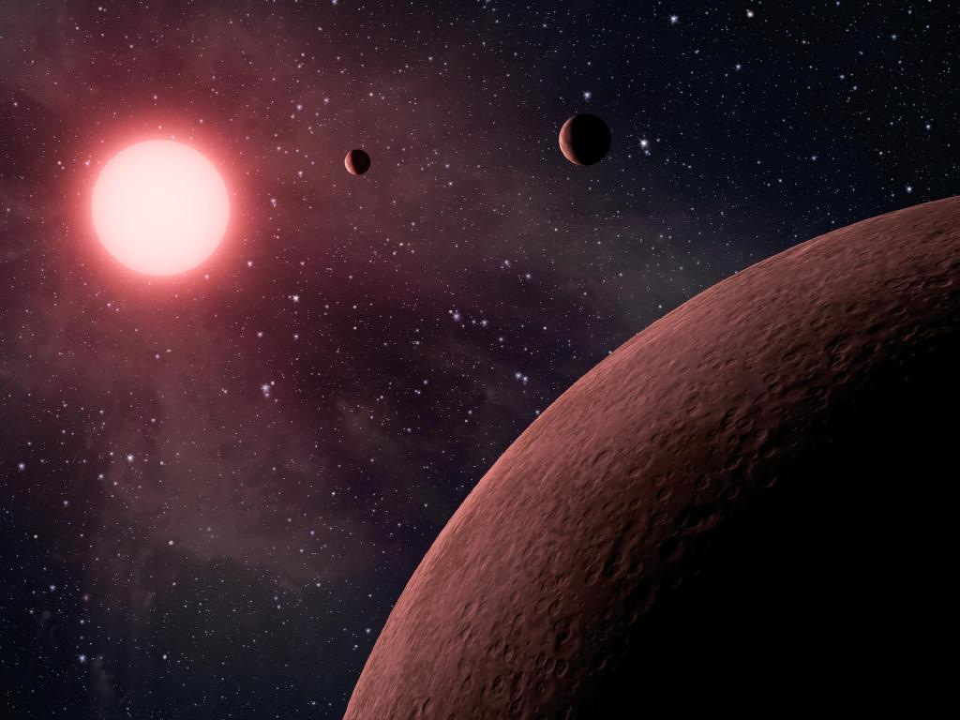
how common are potential habitable planets?
For small, cool stars ~ 50% (conservative estimate!)
About 40 billion in our Galaxy!

Slide 27
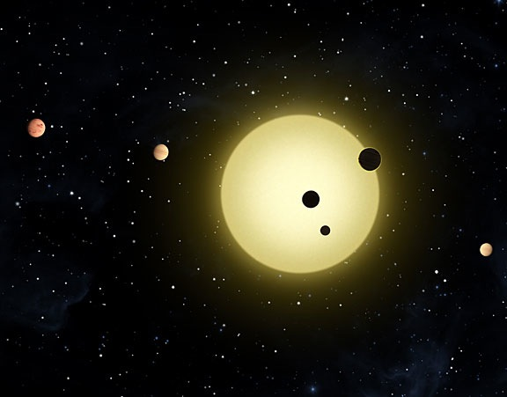
how common are potential habitable planets?
For Sun-like stars ~ 22%
About 2 billion in our Galaxy!

Slide 28
Why are we around a sun-like star?
22%
50%

Slide 29
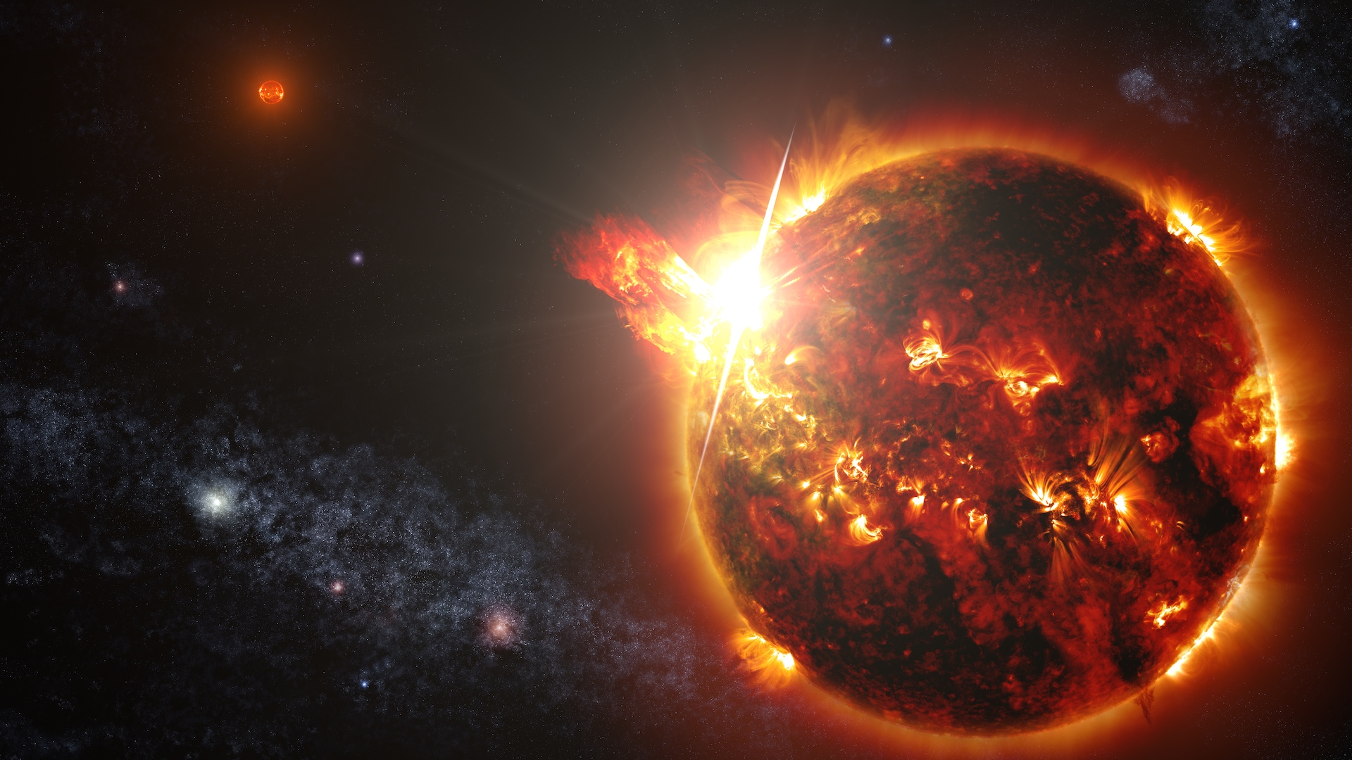
Cool, red stars have flares.
Planets are tidally locked.
Estimates are preliminary.
Credit: NASA-GSFC

Slide 30
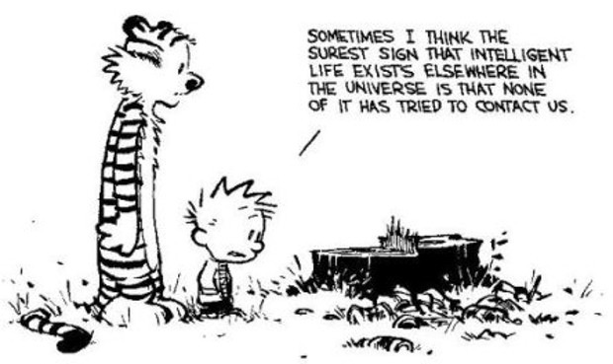
where is everybody?
Calvin and Hobbes: Bill Watterson

Slide 31
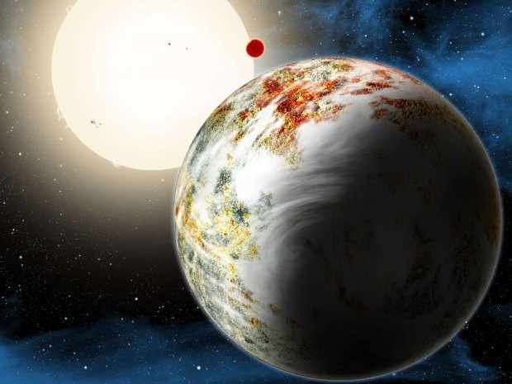
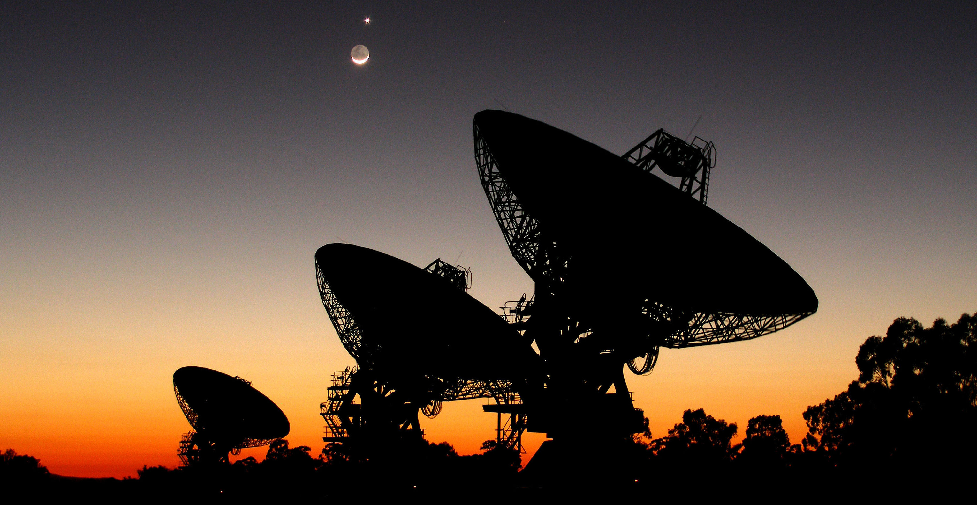
where is everybody?
Life is hard to arise ?
Intelligent life is uncommon ?
They want to be anonymous
Hard to travel/communicate expensive
Prime Directive ?
Did not search long enough?
They are us !
Great Filter ?
We are not listening properly.

Slide 32
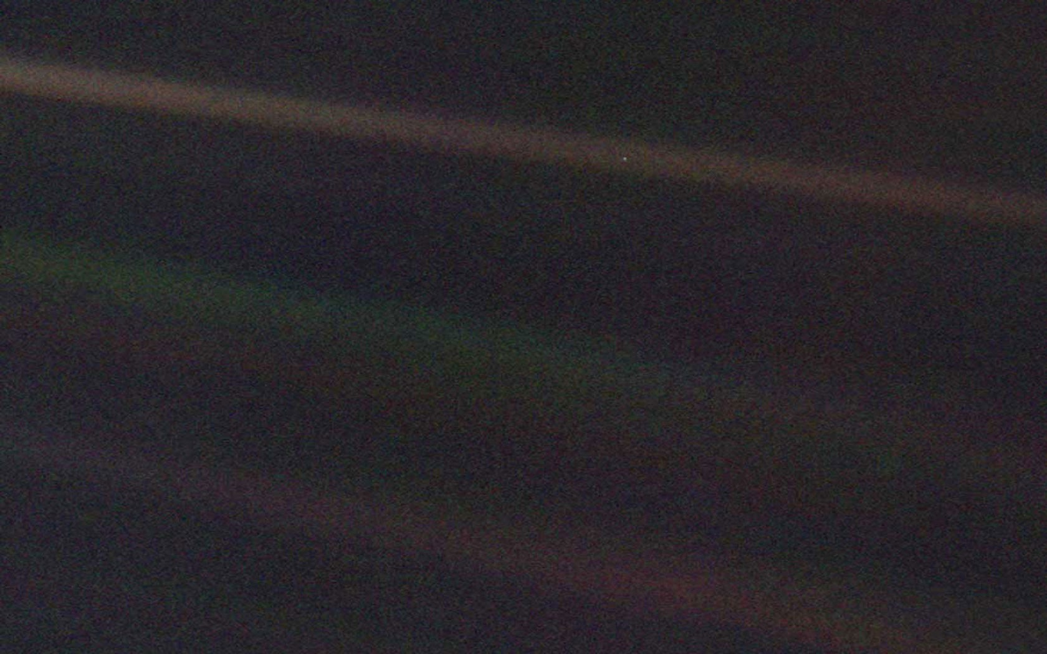
earth from voyager 1

Slide 33
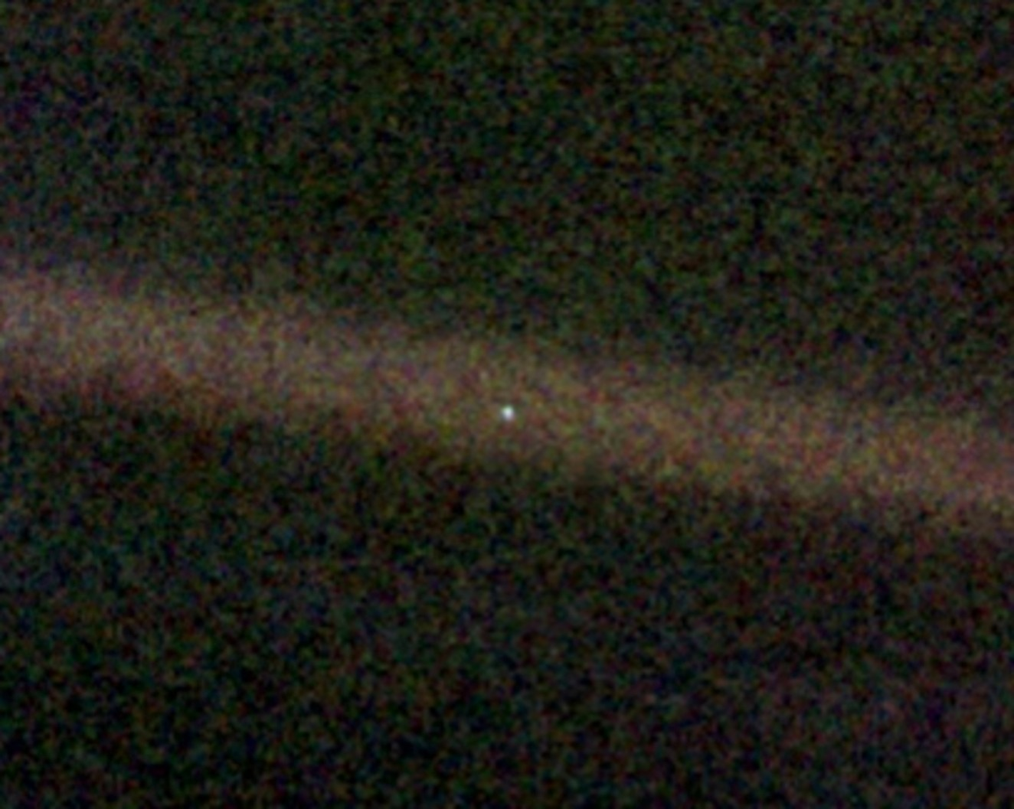
earth from voyager 1

Slide 34
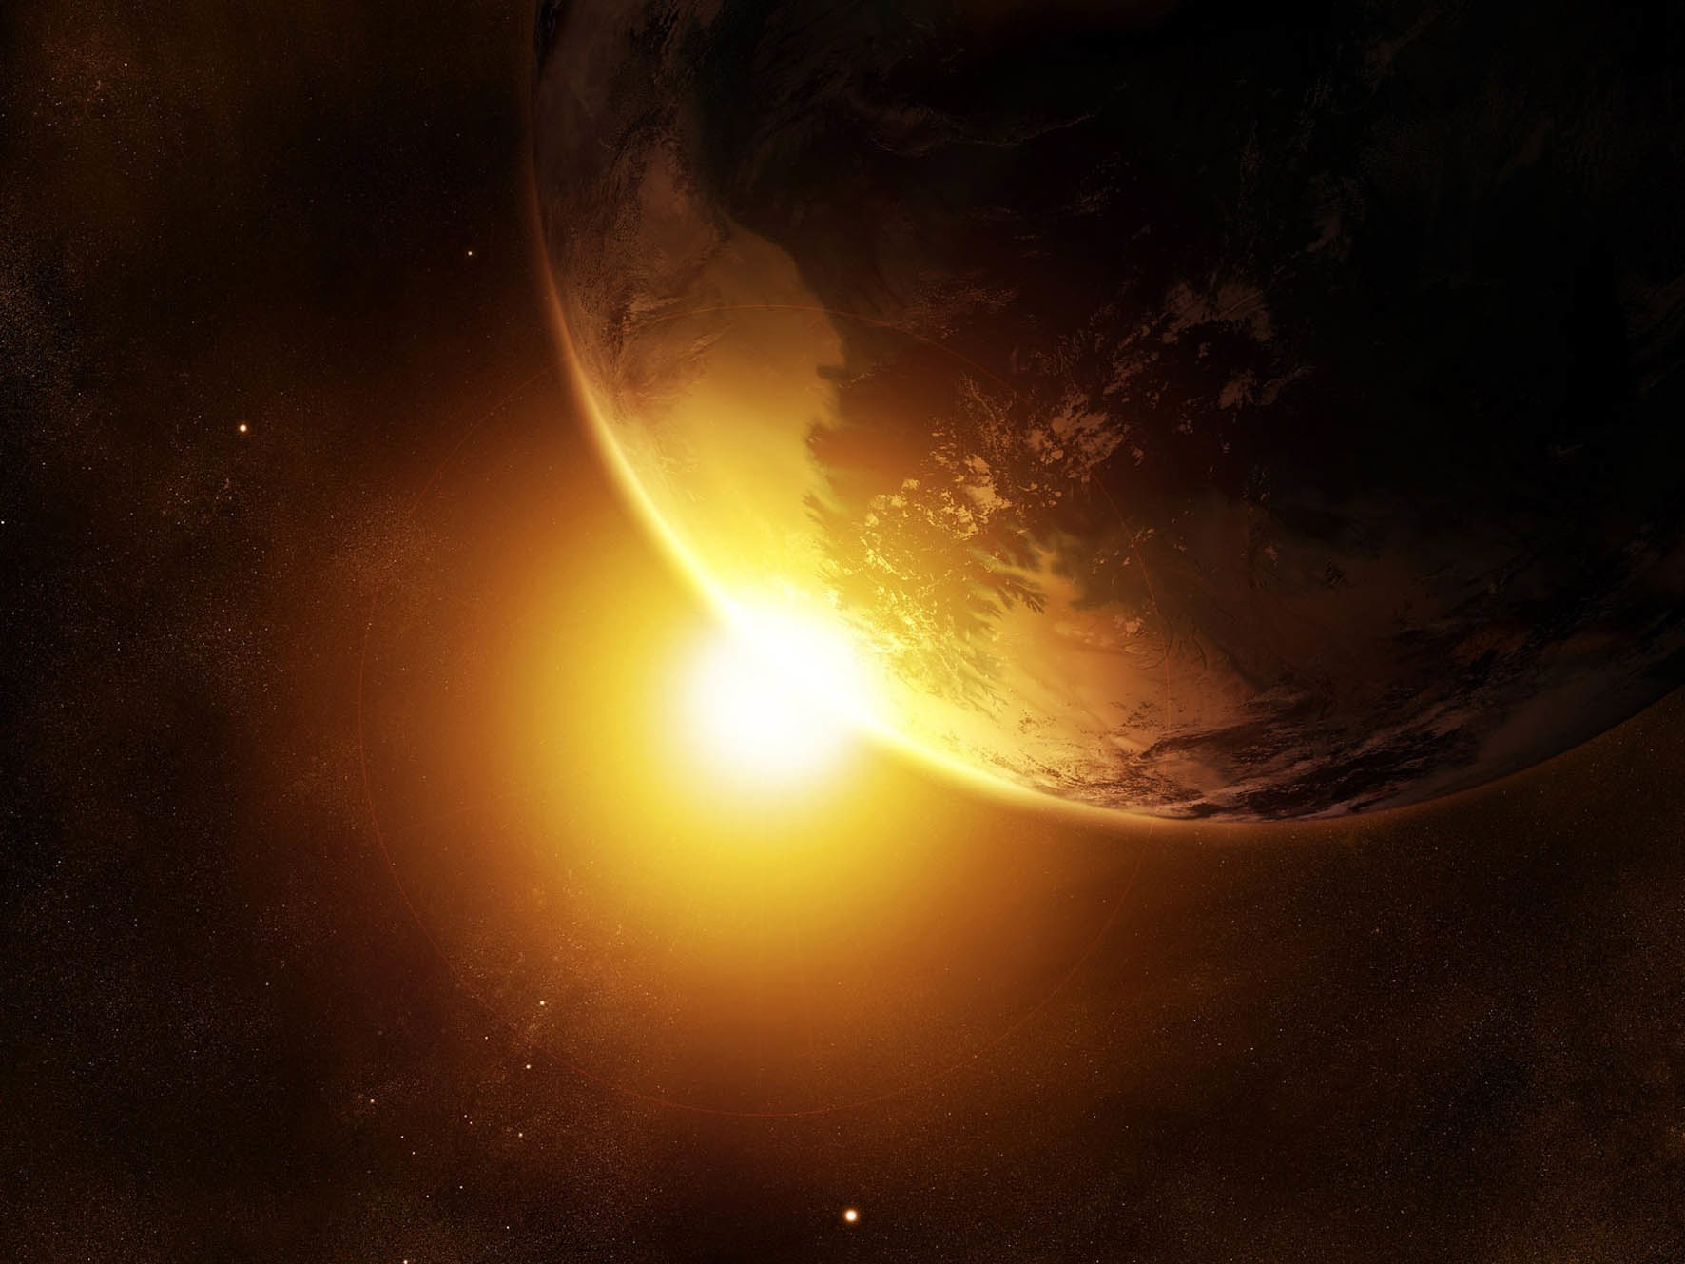
contact
Ravi Kopparapu
Ph: 225-678-0058
email: ravikumar.kopparapu@nasa.gov
webpage: http://www3.geosc.psu.edu/~ruk15/

Slide 36


earth from voyager 1
Carl Sagan

Slide 37
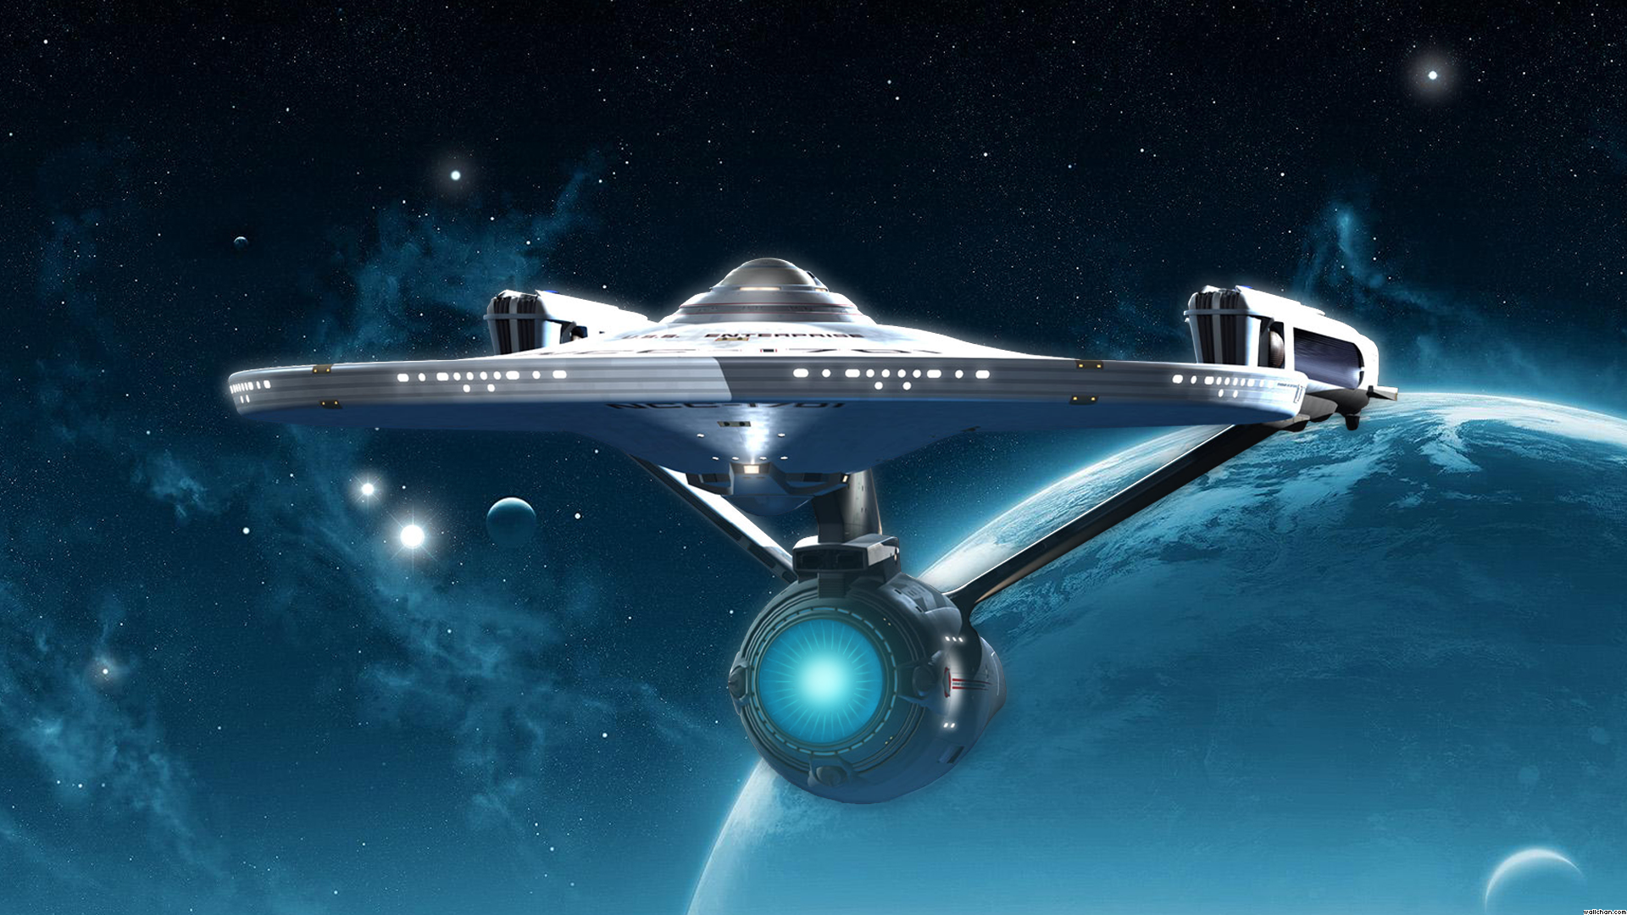
Because, Star trek!
why should i care?

Slide 38
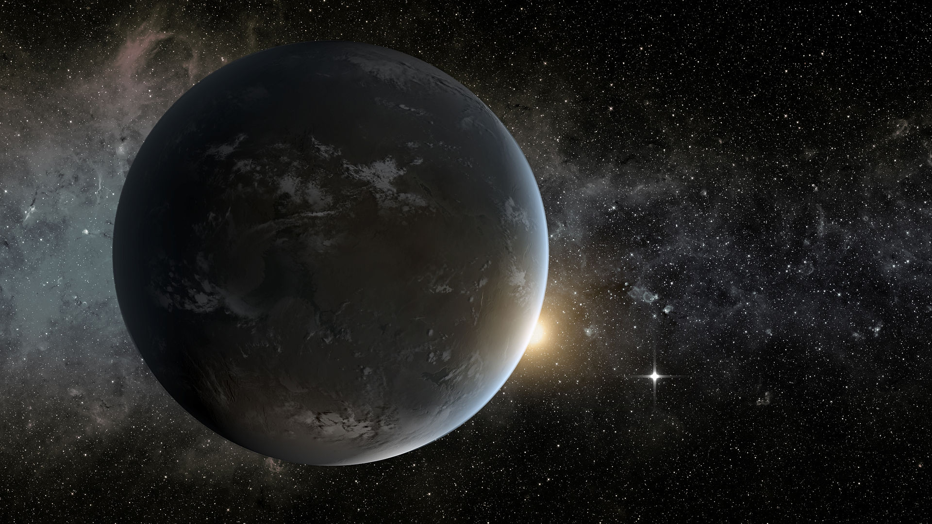
candidates
Kepler-62f
Kepler-186f
We do not know if there is any life on any of these planets

Slide 39
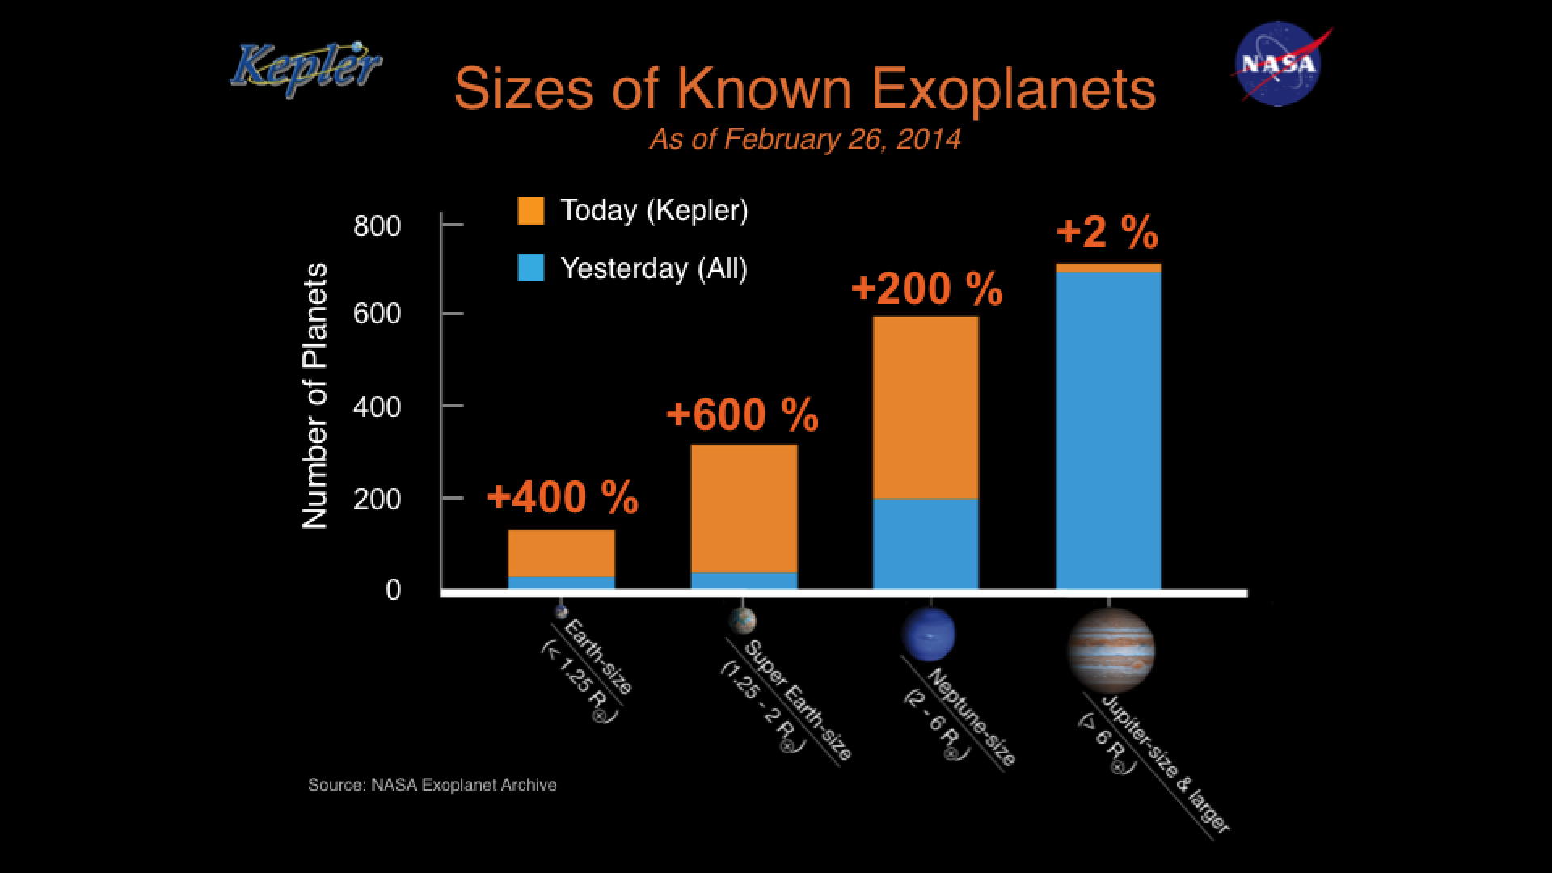

Slide 40
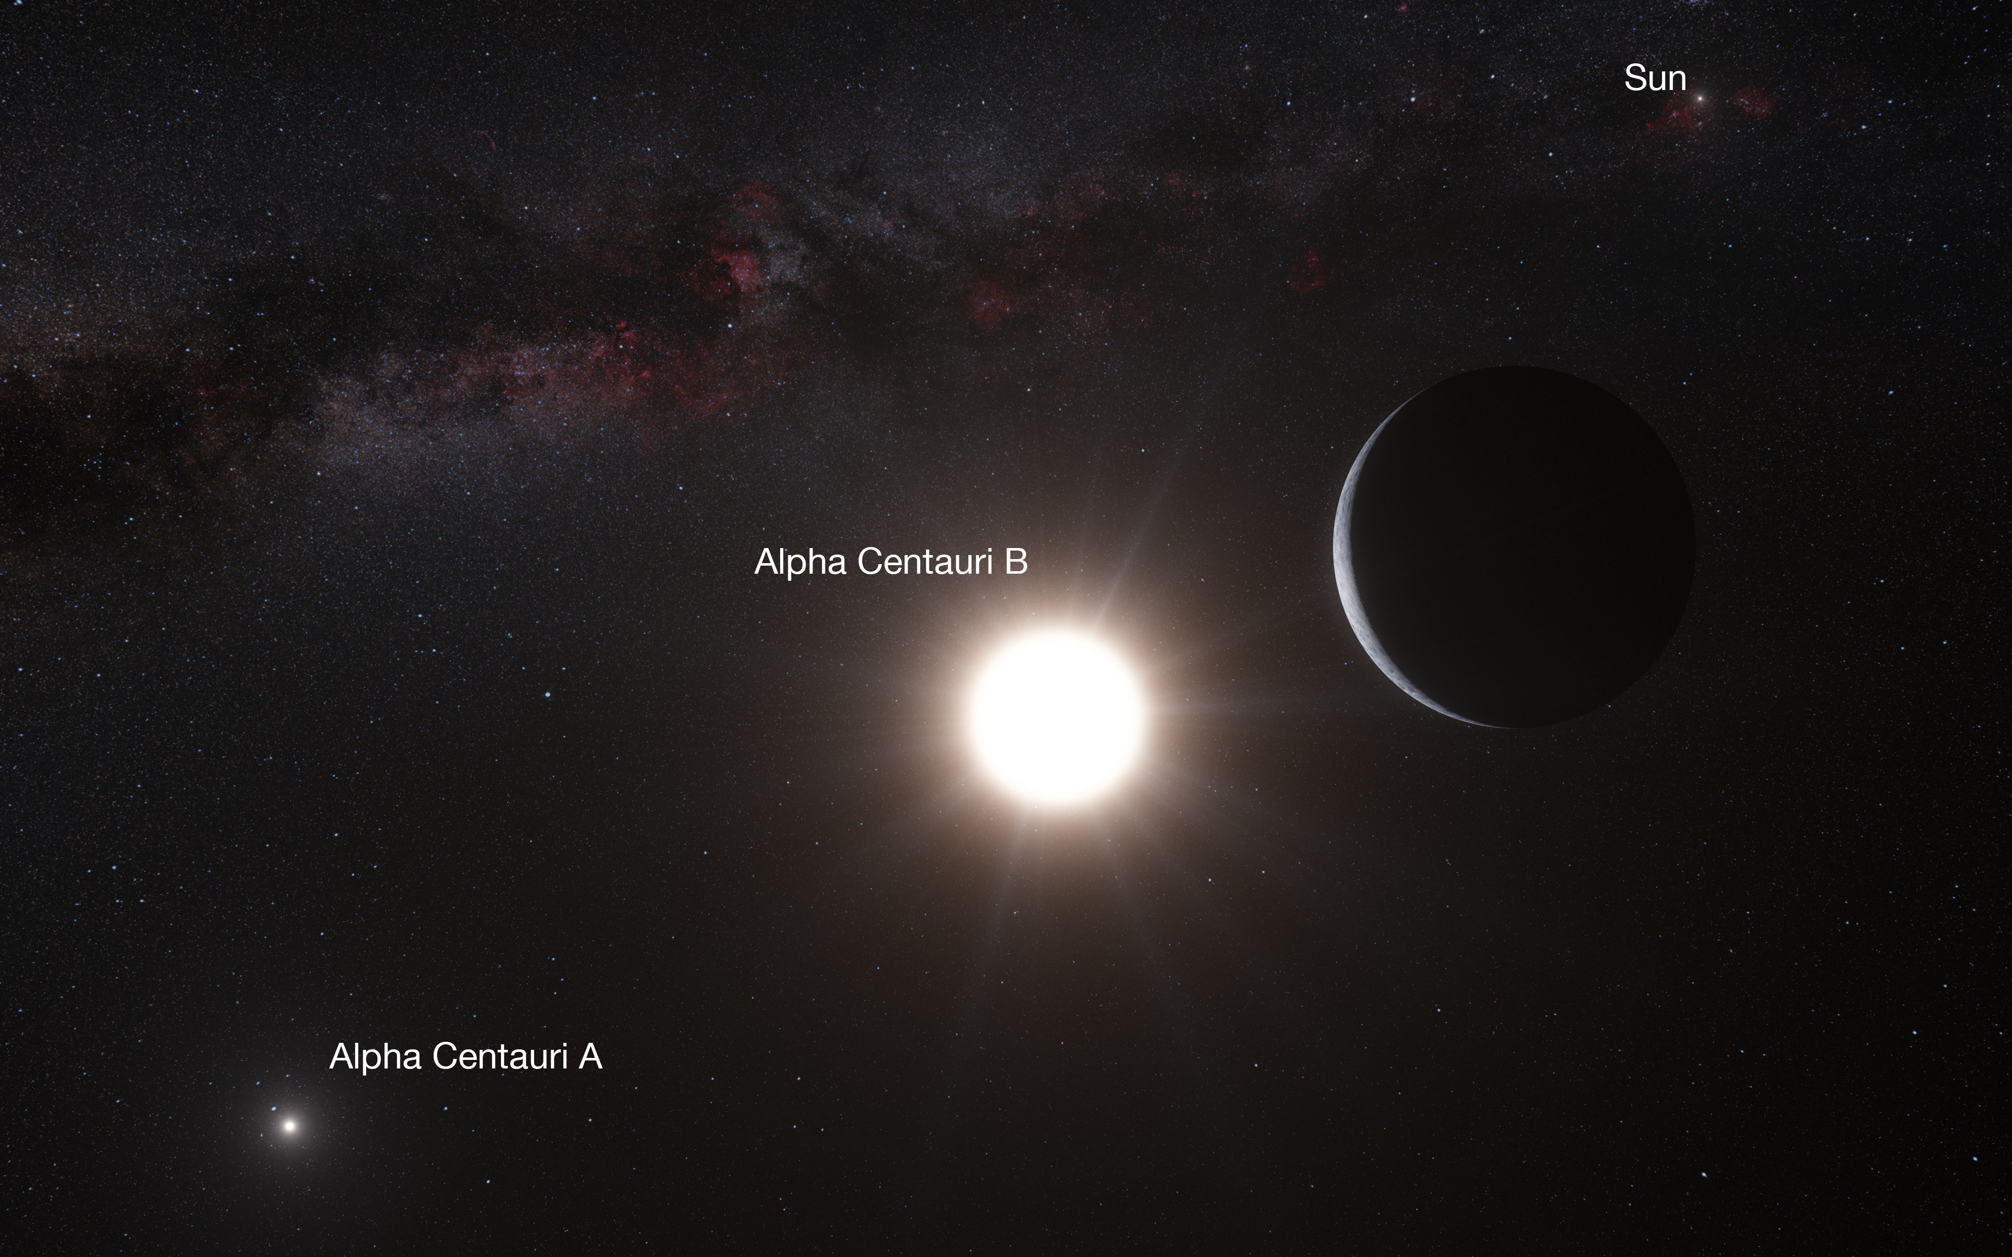
How long does it take to travel to the nearest star system?

Slide 41
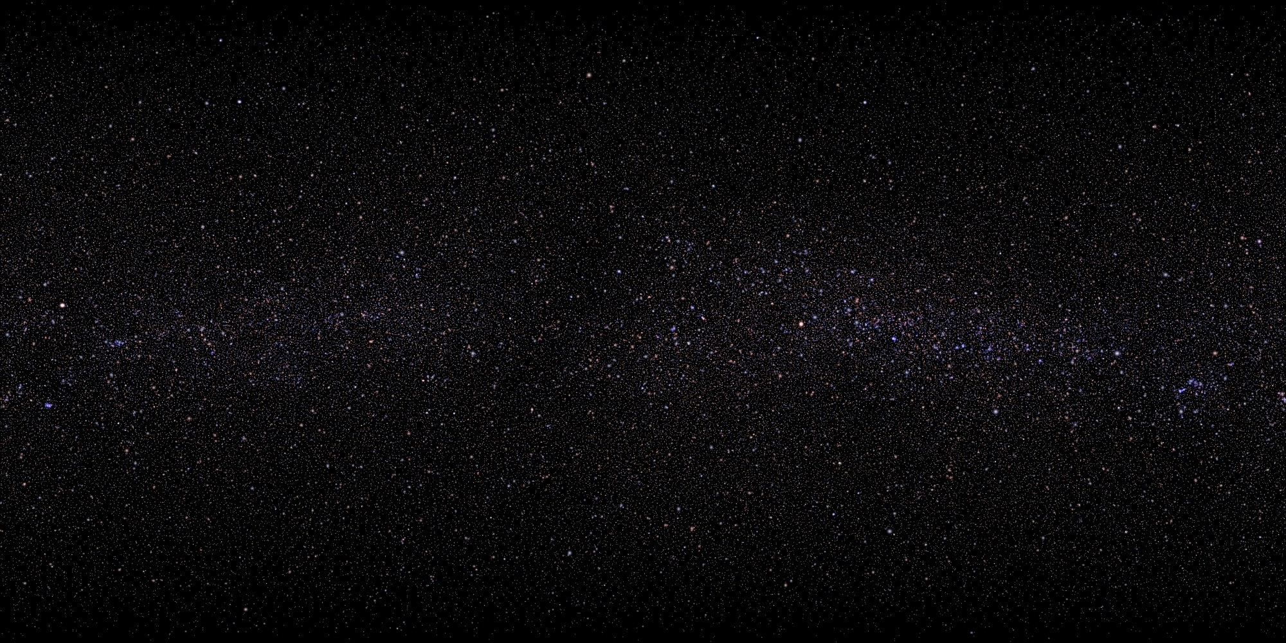
distances in space
If the Earth-Sun distance = 1 foot
Pluto is at 40 feet away
Voyager 1 is at 120 feet away
The nearest star is 42 miles (D.C to Baltimore) !
The nearest planetary system is 120 miles away.
In the year 40,000 AD, Voyager will pass near a star that is approaching us

Slide 42
With the fastest spacecraft we have now, it would take…

Slide 43
75,000 years !

Slide 44
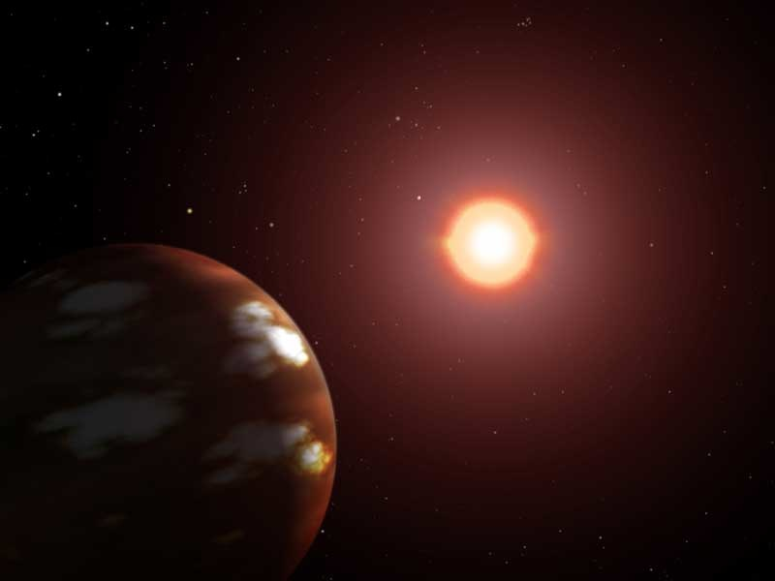
Extrasolar planet
A planet that orbits another star (dead or alive)
NASA

Slide 45
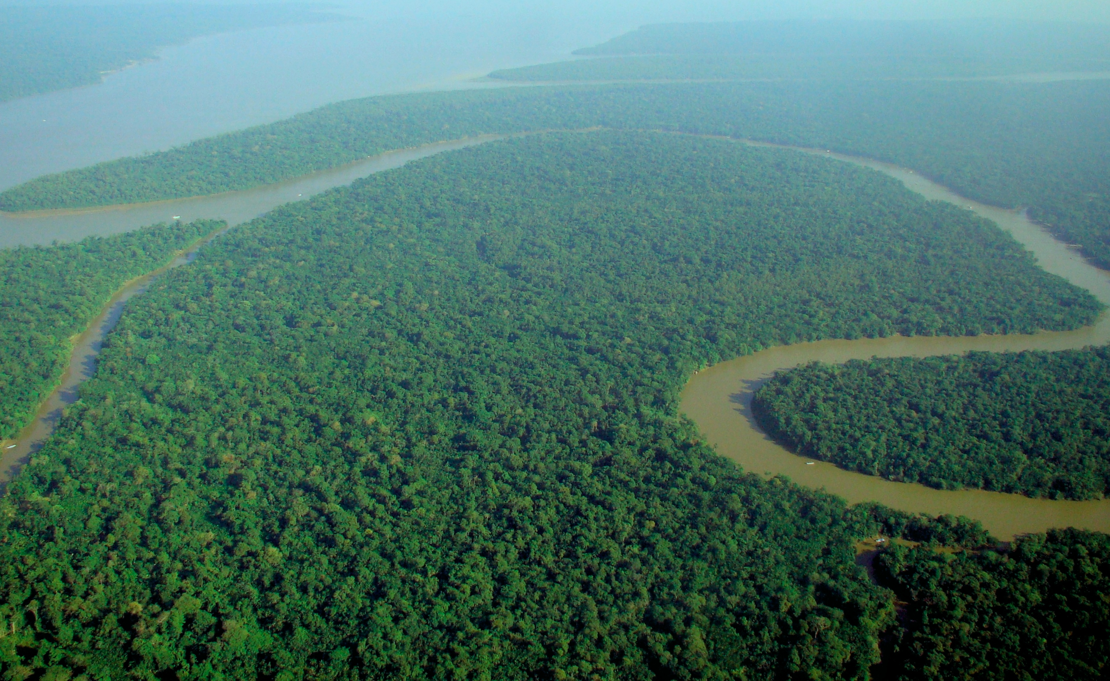
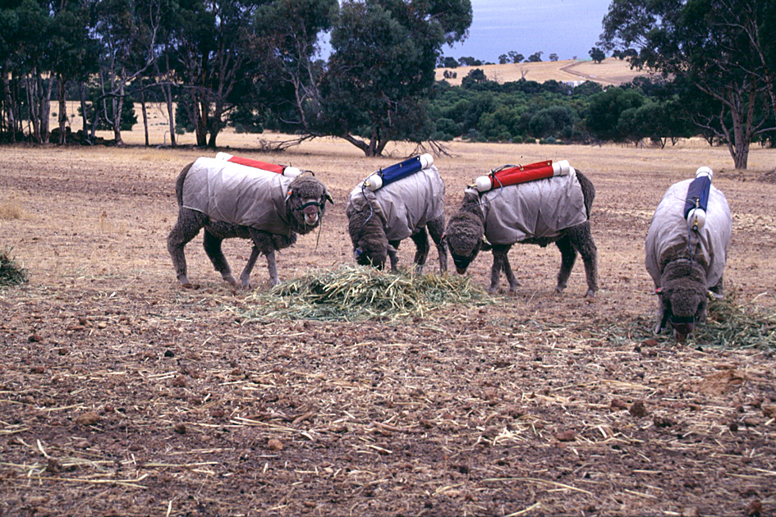
“water on the surface of a planet”?
Oxygen
Methane
Green plants and algae (and cyanobacteria) produce oxgyen from photosynthesis.
Bacteria produce methane.
A combination of these two gases could be a potential life signature.

Slide 46
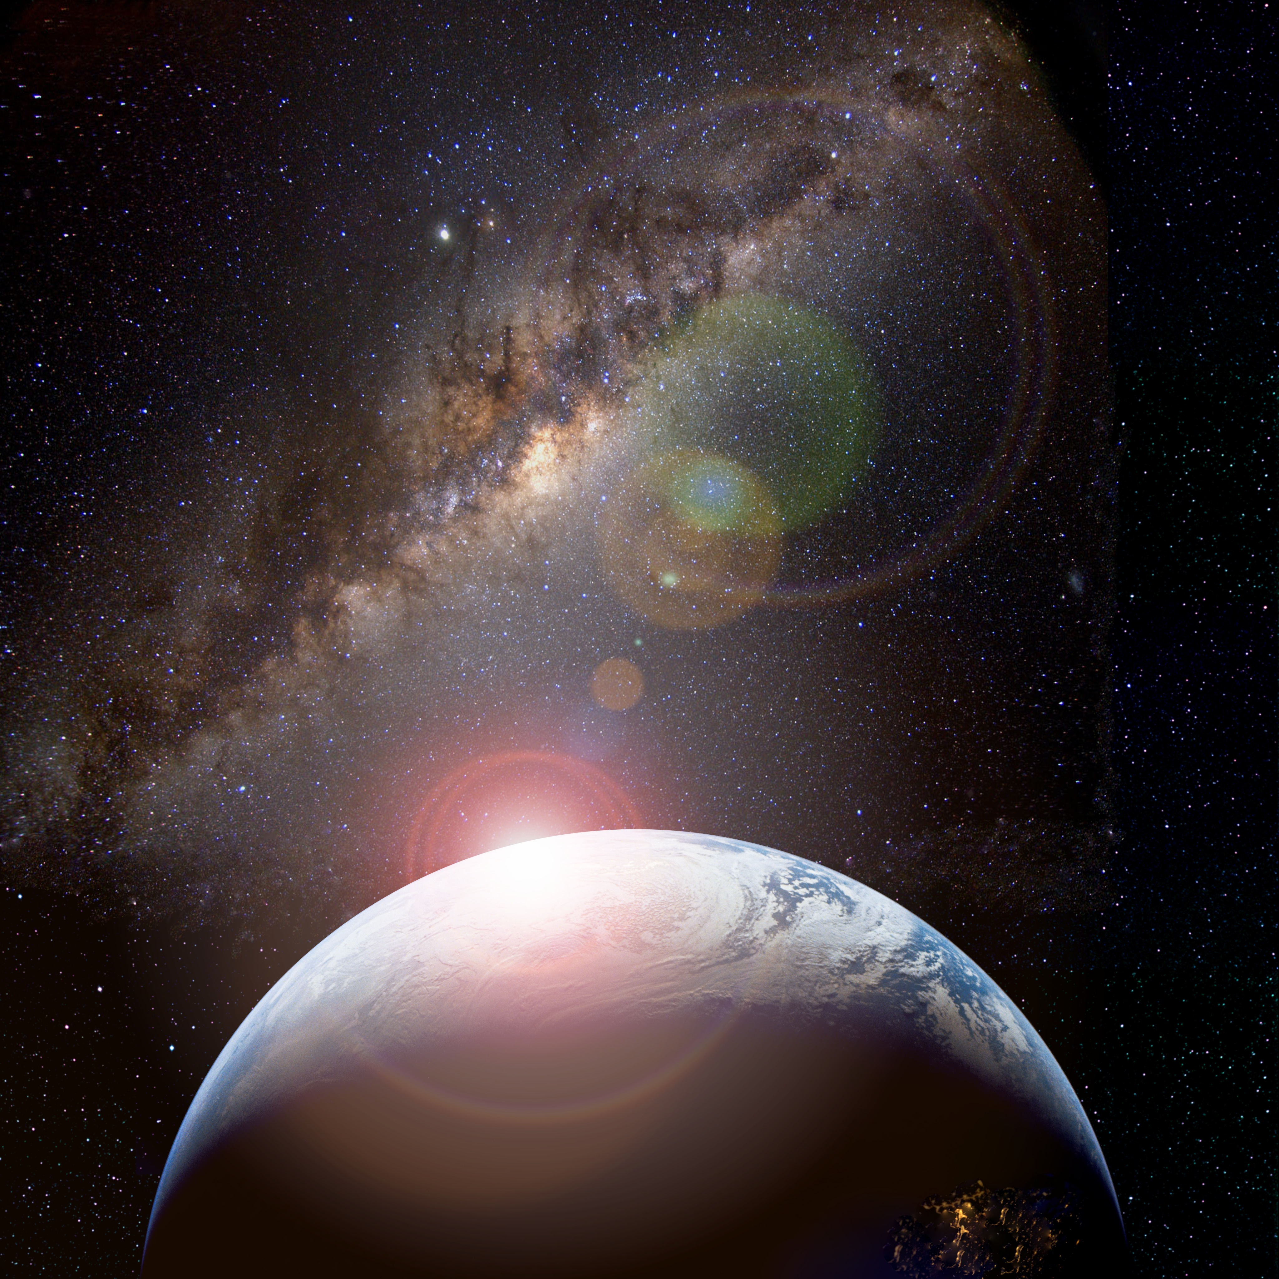
Potential habitable worlds
The search for
Ravi Kopparapu

