Slide 1
Gravitational-waves: Sources and detection
Ravi kumar Kopparapu
Center for Gravitational-Wave Physics (CGWP)

Slide 2
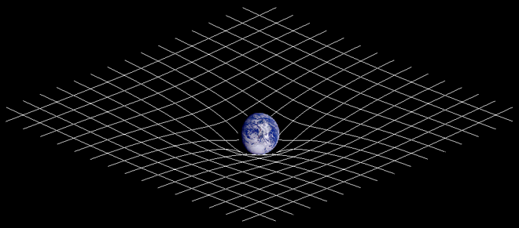
Gravity
Einstein’s General theory of relativity :
Gravity is a manifestation of curvature of 4- dimensional (3 space + 1 time) space-time produced by matter (metric equation ? g_{μν} = η_{μν} )
If the curvature is weak, it produces the familiar Newtonian gravity:
F = G M1 M2/r²

Slide 3
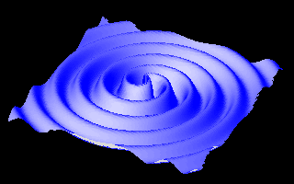
Gravitational-waves
When the curvature varies rapidly due to motion of the object(s), curvature ripples are produced. These ripples of the space-time are Gravitational-waves.
Gravitational-waves propagate at the speed of light.
Animation by William Folkner, LISA project, JPL

Slide 4
Electromagnetic (versus) Gravitational- waves
EM waves are produced by accelerated charges, whereas GWs are produced by accelerated “masses”.
EM waves propogate through space-time, GWs are oscillations of space-time itself.
Typical frequencies of EM waves range from (10⁷ Hz – 10²⁰ Hz) whereas GW frequencies range from ~ (10⁻⁹ Hz – 10⁴ Hz). They are more like sound waves.

Slide 5
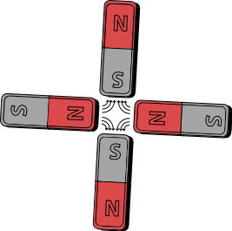
Quadrupole Field
An oscillating dipole produces EM waves.
A time varying mass-quadrupole produces GWs

Slide 6
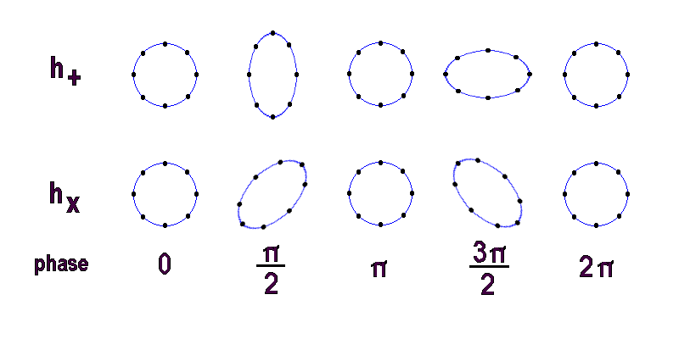
Gravitational-waves
GWs stretch and compress the space-time in two directions (polarizations): ‘+’ and ‘x’.
h₊ & h_{x} are time-varying and their amplitude depend on the source that is emitting GWs.

Slide 7
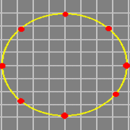
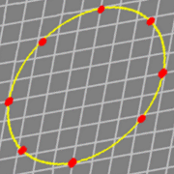
Gravitational-waves
h₊
h_{x}

Slide 8
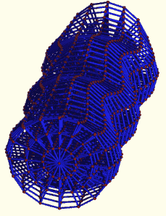
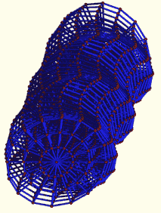
Propagation
h₊ h_{x}

Slide 9
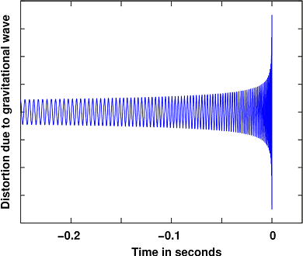
Sources of GWs
Inspiral sources: Binary black holes, Binary Neutron stars (pulsars), Binary white-dwarfs or combination of these.
As two stars orbit around each other, they steadily lose
energy and angular momentum in the form of GWs.
This makes the orbital separation to shrink slowly and they merge after some time (this time depends on their masses and orbital separation that we observe)

Slide 10
Inspiraling binary stars

Slide 11
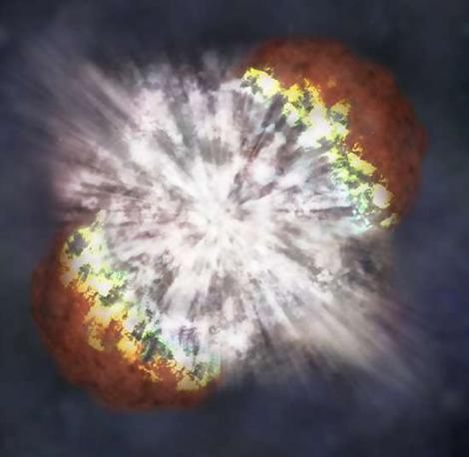
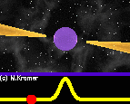
Sources of GWs
Exploding stars: Core collapse
Supernovae
Pulsars (rotating Neutron stars)
Stochastic sources: Jumble of signals from lot of sources

Slide 12
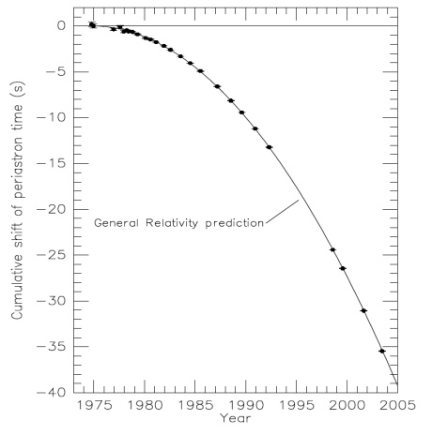
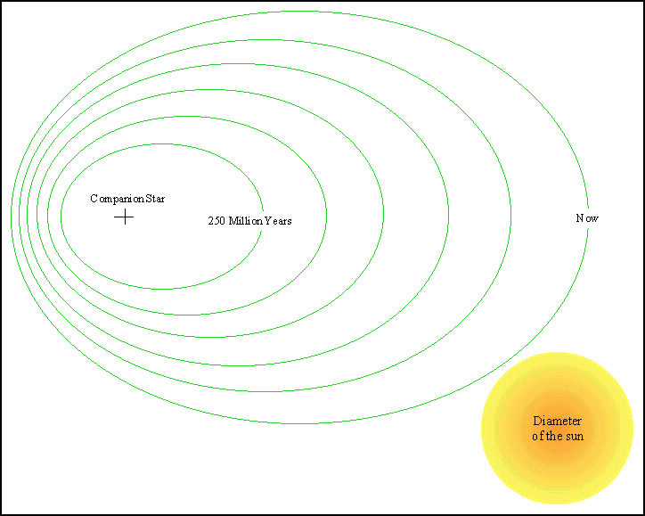
How do we know GWs exist ? Indirect proof.
Hulse-Taylor binary pulsar (Nobel prize 1993)
Steady decrease in orbital
separation due to loss of energy
through GWs.

Slide 13
Detection of Gravitational-waves
Ground based detectors:
LIGO (U.S.A), VIRGO (Italy), GEO (Germany), TAMA (Japan), AURIGA (Australia)
(Proposed) Space-based detectors:
LISA (NASA-ESA)

Slide 14
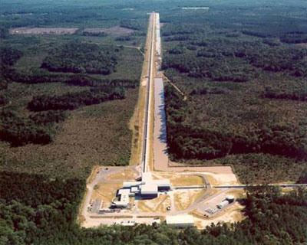
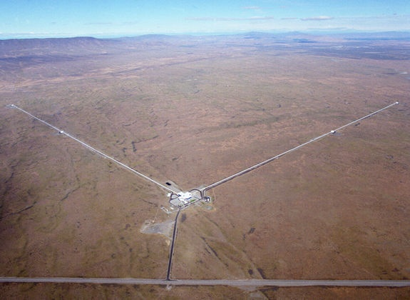
Livingston, Louisiana Hanford, Washington
Livi

Slide 15
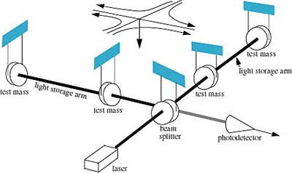
Laser Interferometer Gravitaional wave Observatory
LIGO
Length of each arm, L = 4 km,
frequency range , f = 10 Hz – 10⁴ Hz
ΔL ~ 10⁻¹⁸ meters, size of proton ~ 10⁻¹⁵ meters

Slide 16
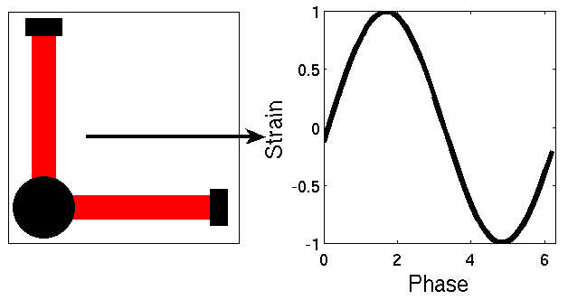
LIGO
Measuring GWs

Slide 17
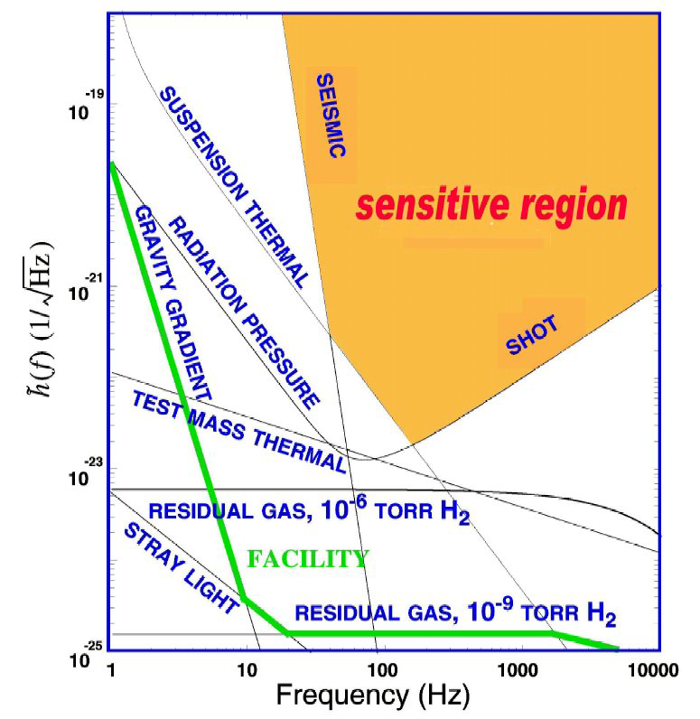
LIGO
Current range for an inspiralling binary NS
averaged over all orientations and locations
is ~ 15 Mpc ( near Virgo cluster of galaxies)

Slide 18
Signal and Noise
No noise
With Noise

Slide 19
What type of sources can LIGO detect ?
Last stages of inspiral of Binary NS
Mergers of stellar and supermassive black holes
Core-collapse supernovae
Pulsars

Slide 20
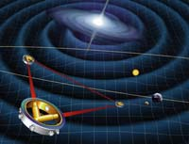
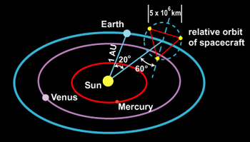
Space-based GW detection
LISA (Laser Interferometer Space Antenna)

Slide 21
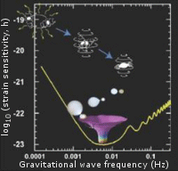
Sources for LISA
Double White Dwarfs
White-dwarf black hole
Supermassive and Intermediate mass black holes

Slide 22
What’s the big deal ?
GWs bring info about objects that can not be seen with EM observations and vice-versa.
This is a radically different field than EM observations.
Measuring a length smaller than proton size is no longer a science fiction !! Observations have already been taken with the first version of LIGO (and VIRGO, GEO).
We talked about signals and sources that we *know* about. Any new field has it’s own surprises (radio, gamma-ray).
“….there are known knowns, there are known unknowns, But there are also unknown unknowns….”
---- Don Rumsfeld

Slide 23
The future
Enhanced LIGO ~ 2010,
Advanced LIGO ~ 2013 , Can see black hole binaries upto 4 Gpc (12 billion light years, z ~ 1)
Advanced LIGO can detect hundreds of merger events in one year of observations because it can observe to larger distances !!
Join us….if you are interested…

Slide 24
What are Gravitaitonal-waves ?
Einstein’s General theory of relativity :
Gravity →Curvature of 4-dimensional (3 space + 1
time) space-time fabric produced by matter
Gravitational-waves →Ripples on space-time produced
by accelerated matter

